Slide 1
Patient Selection for Combined Left Atrial Appendage Closure & AF Ablation in The Era of PFA and OPTION
Walid Saliba, MD
Director, EP lab
Director, Atrial Fibrillation Center
Heart and Vascular Institute
Cleveland Clinic

Slide 2
Disclosures
Boston Scientific
Biosense Webster
Siemens Medical
Medtronic

Slide 3
Patient Selection for Combined LAAC & AF Ablation
Current practice
What Changed
Intraprocedural consideration
Impact of new technology /Clinical Trials

Slide 4
John
75 yo male with HTN, HLD, OSA, GCA and mild CAD
Echo: Normal LVEF, Mod LA enlargement, mild MR
h/o Rectal Bleeding and spontaneous Rt subdural Hematoma 2021
Recurrent AF diagnosed 2022, s/p DCC x 2 + started on flecainide
CHADS2VASc 4 → LAAC with Watchman implantation
Now with Increasing AF burden: Referred for further evaluation
AF ablation not performed at the time of LAAC 1 year ago

Slide 5
Indication for LAAC
Patient Selection
1. Current Candidates
Indication for AF ablation
+
Symptomatic AF +/- AAD’s
CHADsVASc>2
unable to take long term OAC
Benefits
Avoid Bleeding risk duplication
Avoid procedure risk duplication
More efficient HC utilization
Better accepted by patient

Slide 6
Indication for LAAC
Patient Selection
What Changed…
Indication for AF ablation
+
Symptomatic AF +/- AAD’s
CHADsVASc>2
unable to take long term OAC
Early Ablation
PFA
OPTION Trial
Expanded Indication for LAAC
New CPT code
Newer devices

Slide 7
LAAC in patients “contraindicated” to OAC
Indication for LAAC
CHADsVASc>2
unable to take long term OAC
2b
2a
Expanded Indication for LAAC

Slide 8
LAAC in patients contraindicated to OAC
LAAC as an alternative to OAC reduce the risk of stroke without the bleeding risk
OPTION
CHAMPION AF (enrollment complete)
CATALYST (enrolling)
Expanding Indications

Slide 9
LAAC in patients contraindicated to OAC
LAAC as an alternative to OAC reduce the risk of stroke without the bleeding risk
LAAC in addition to OAC
Further stroke reduction
LAAOS III: Benefit of Combination therapy
Belt and Suspenders:
The need for “Safety”
(LAAOS IV)

Slide 10
LAAOS IV
LAAC in patients contraindicated to OAC
LAAC as an alternative to OAC reduce the risk of stroke without the bleeding risk
LAAC in addition to OAC
Further stroke reduction
LAAOS III: Benefit of Combination therapy
Belt and Suspenders:
The need for “Safety”
(LAAOS IV)

Slide 11
Early Ablation
Expanded Indication for LAAC

Slide 12
AFFIRM
2002
CASTLE-AF 2018
CABANA 2018
EAST AFNET 4 2020
STOP AF - 2021
EARLY AF - 2021
EARLY AF 3 y f/u - 2023 (Progressive AF)
2014 AHA/ACC/HRS Guidelines
2019 AHA/ACC/HRS Focused Update of the 2014 Guidelines
EARLY Rhythm Control
Ablation for Early Rhythm Control
Rate control vs. Rhythm control
Rhythm Control : AAD’s vs Ablation
Early Ablation for Rhythm control

Slide 13
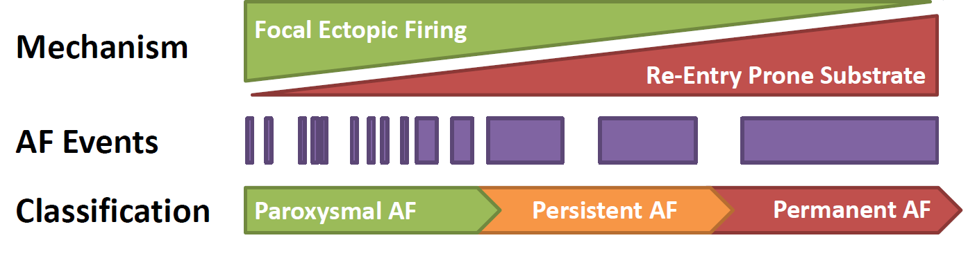
Natural History of AF
1. AF is a Chronic Progressive Disease
7% Progression per year
Inflammation / Fibrosis / Atrial myopthy
Decreased ability to maintain SR
Decreased quality of Life
Mortality, Stroke, CHF, HF hospitalization
Progression is associated with worse outcome

Slide 14
Natural History of AF
1. AF is a Chronic Progressive Disease
“Early Rhythm Control” may alter the Progression of Atrial Myopathy
Early Ablation

Slide 15
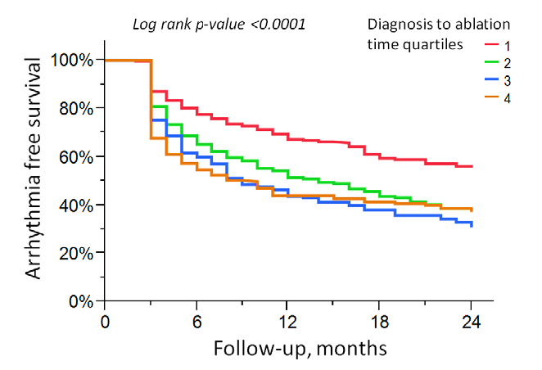
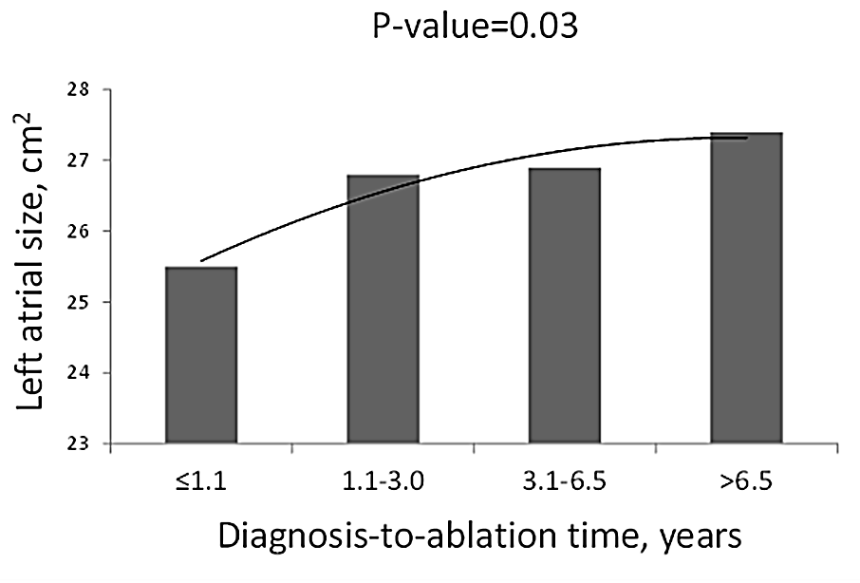
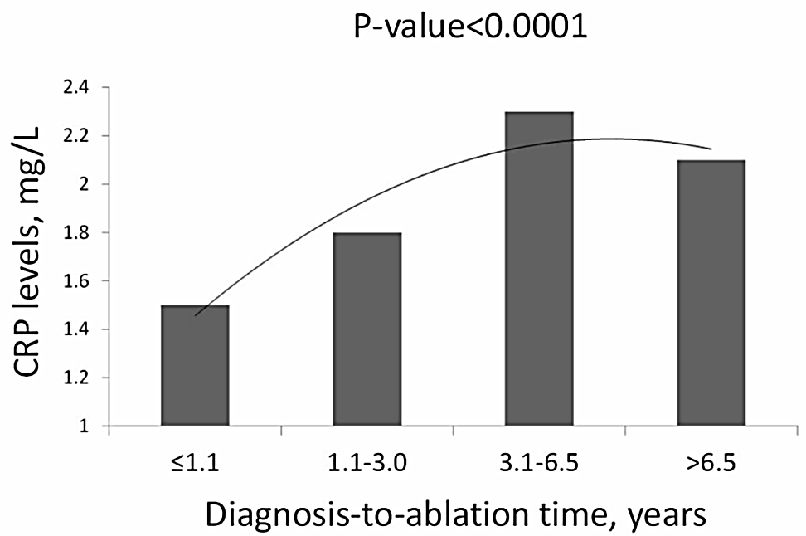
Shorter diagnosis-to-ablation times→ better outcomes.
Longer diagnosis to ablation time → increased markers of atrial remodeling: LA size, CRP, BNP.
33.6%,
57.1%
Hussein et al. Circ Arrhythm Electrophysiol. 2016
Notes:
15

Slide 16
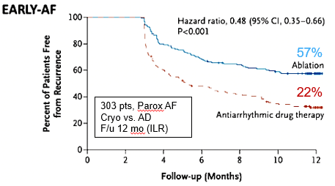
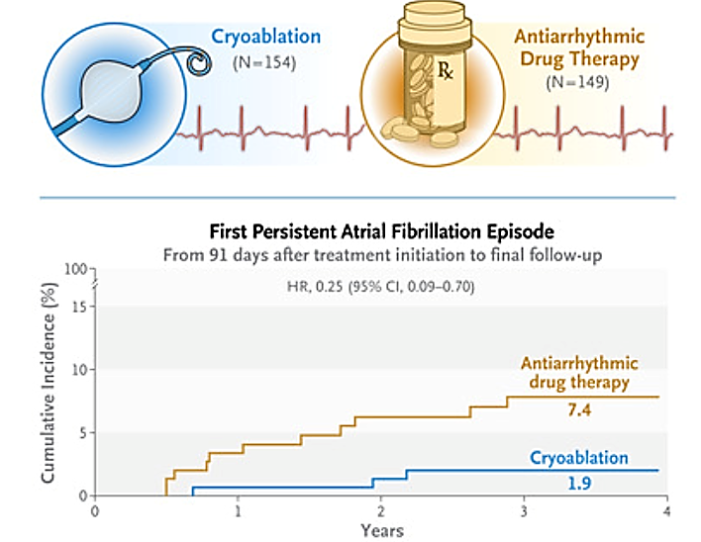
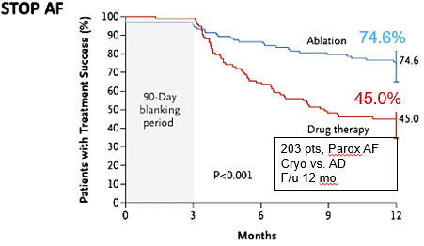
Early AF Ablation
Cryoablation or Drug Therapy for Initial Treatment of AF
EARLY AF
Better outcome with Ablation vs AAD→ More patients free from AF recurrence
Lower incidence of progression to persistent AF
First Persistent AF Episode
From 91 days after treatment initiation to final f/u
STOP AF
HR:0.25 (95% CI, 0.09-0.7)
Cumulative Incidence (%)
Years

Slide 17
Early Ablation
PFA
Expanded Indication for LAAC

Slide 18
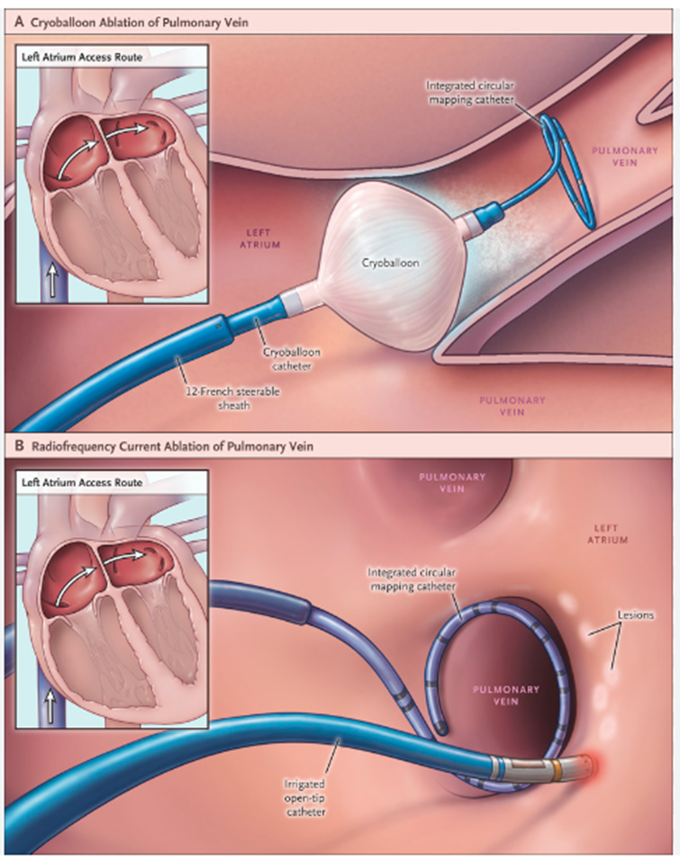
Current Ablation Technology
Cryo
Cryo
RF
Thermal ablation
RF

Slide 19
Current Ablation Technology
Thermal ablation: Limitations
Efficacy: Limited success rate (~70% @ 1 year)
Durable lesion / Gaps → Reconnection (15-50%)
Efficiency: Time consuming; point by point

Slide 20
Current Ablation Technology
Thermal ablation: Limitations
Efficacy: Limited success rate (~70% @ 1 year)
Durable lesion / Gaps → Reconnection (15-50%)
Efficiency: Time consuming: point by point
Safety
Phrenic nerve palsy (up to 6%)
Esophageal injury (up to 0.5%)
PV stenosis / Vascular injury
Pericardial effusion (Thermal pop)

Slide 21
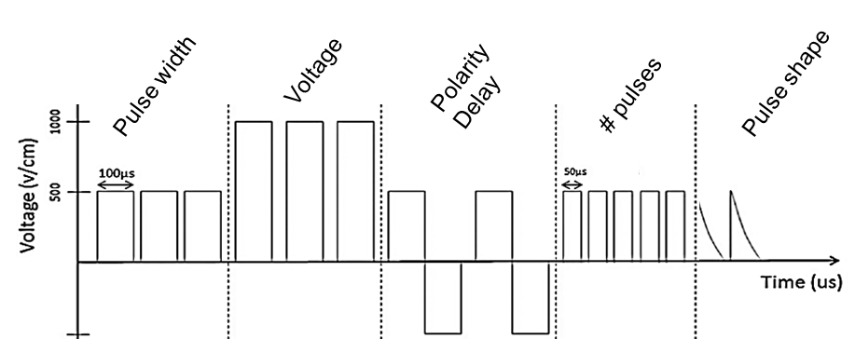
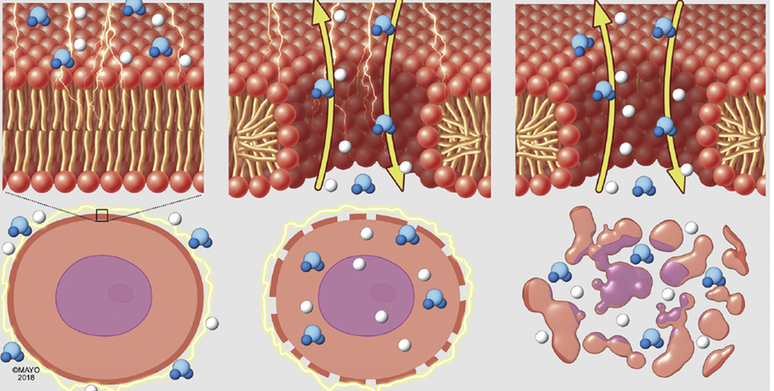
Current Ablation Technology
Cryo
Thermal ablation
Cryo
RF
New kid on the Block: PFA
“Pulsed Field Ablation”
RF
Series of high voltage short duration electric shocks → Disruption of cell membrane permeability

Slide 22
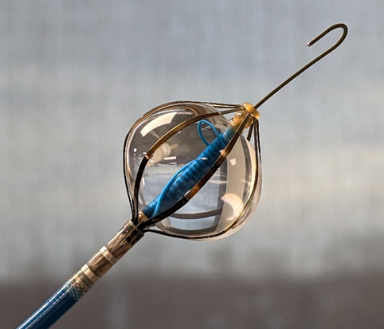
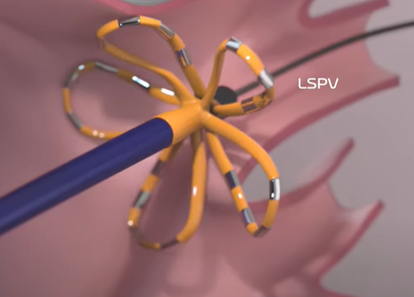
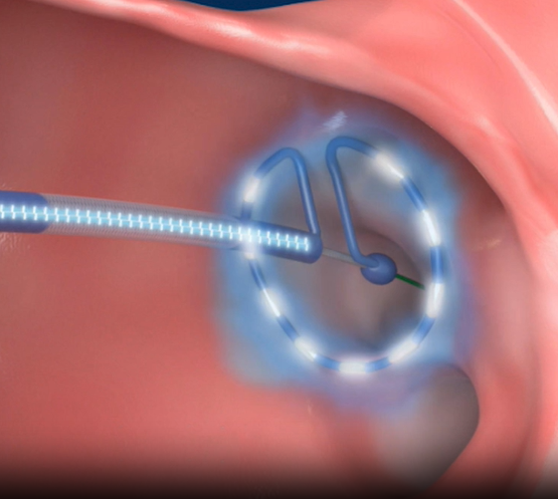
Current Catheters Under Clinical Evaluation for PFA

Slide 24
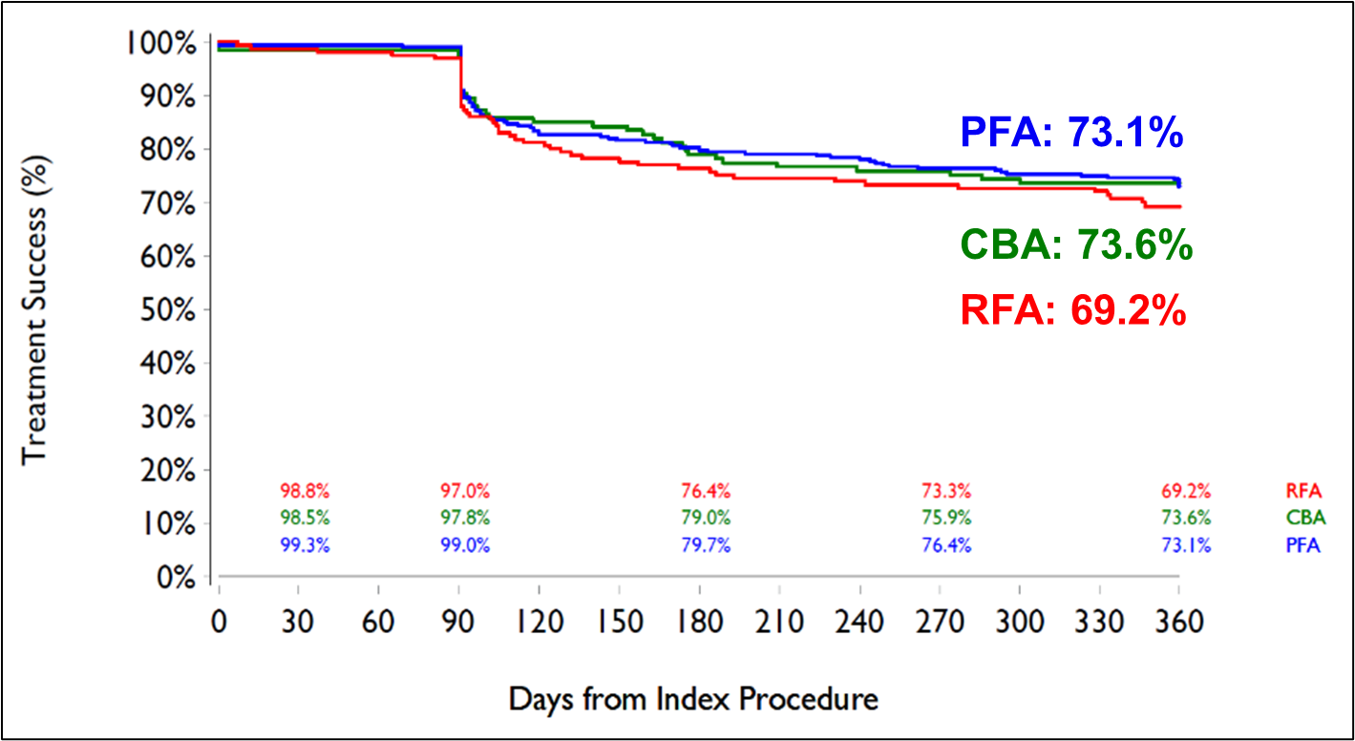
Advantages
1-Year Effectiveness by Ablation Modality (Parox AF)
Efficacy
ADVENT Study. NEJM Sept 2023 (ESC LBT 2023)

Slide 25
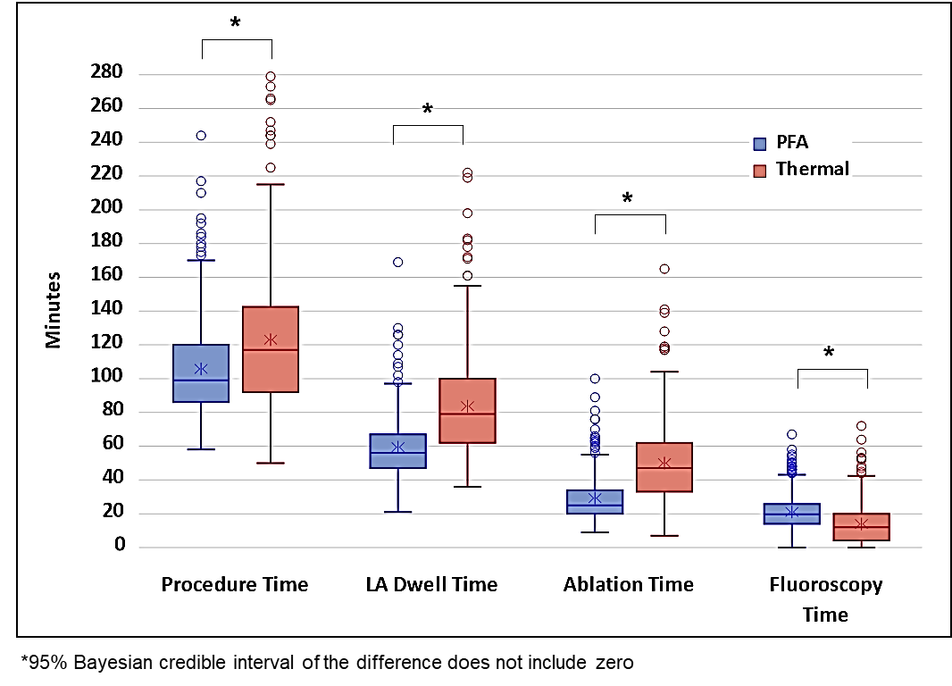
Advantages
Efficacy
Efficiency:
Less ablation time, less LA dwell time, shorter procedure time
Faster
ADVENT Study. NEJM Sept 2023 (ESC LBT 2023)

Slide 26
Advantages of PFA
Efficacy
Efficiency:
Less ablation time, less LA dwell time, shorter procedure time
Safety
No PV stenosis
Selective ablation: No collateral damage
Esophagus
Phrenic nerve
Faster
Safer

Slide 27
Advantages of PFA
Efficacy
Efficiency:
Less ablation time, less LA dwell time, shorter procedure time
Safety
No PV stenosis
Selective ablation: No collateral damage
Esophagus
Phrenic nerve
Faster
Safer

Slide 28
Early Ablation
PFA
OPTION Trial
Expanded Indication for LAAC

Slide 29
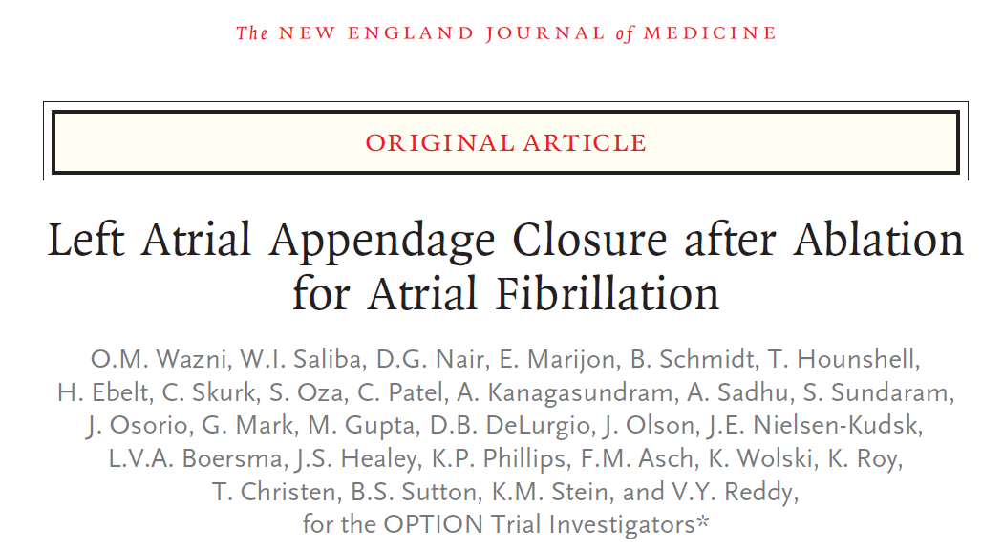
NEJM, November 16, 2024,
OPTION Trial

Slide 30
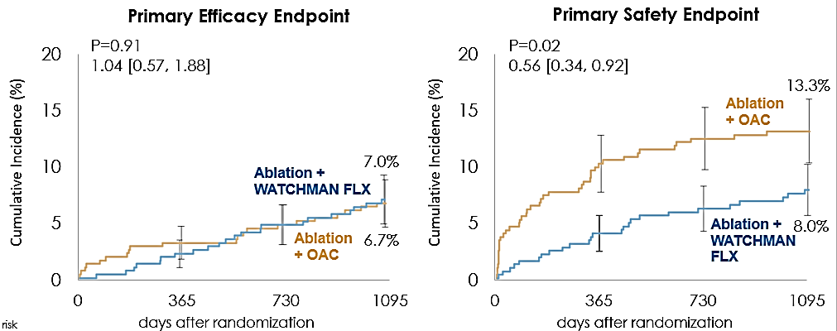
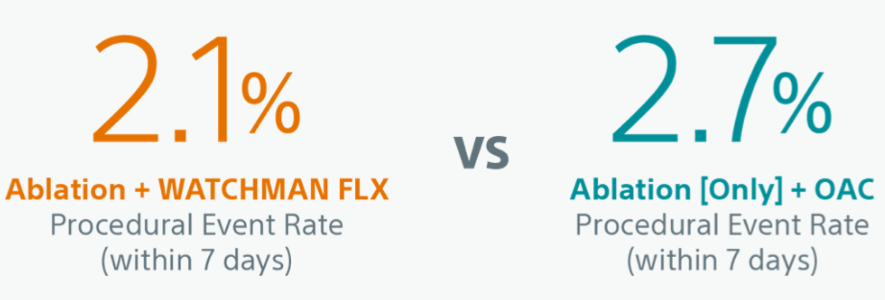
Concomittant Group
Similar efficacy but Improved safety (less bleeding) to OAC at 36 mo.
Concomitant Group
No Increase in Procedural Events with Concomitant
(PVI+LAAC vs PVI alone)
OPTION Trial
Saliba et al. AF symposium; 2025

Slide 31
Early Ablation
PFA
OPTION Trial
Expanded Indication for LAAC
New CPT code

Slide 32
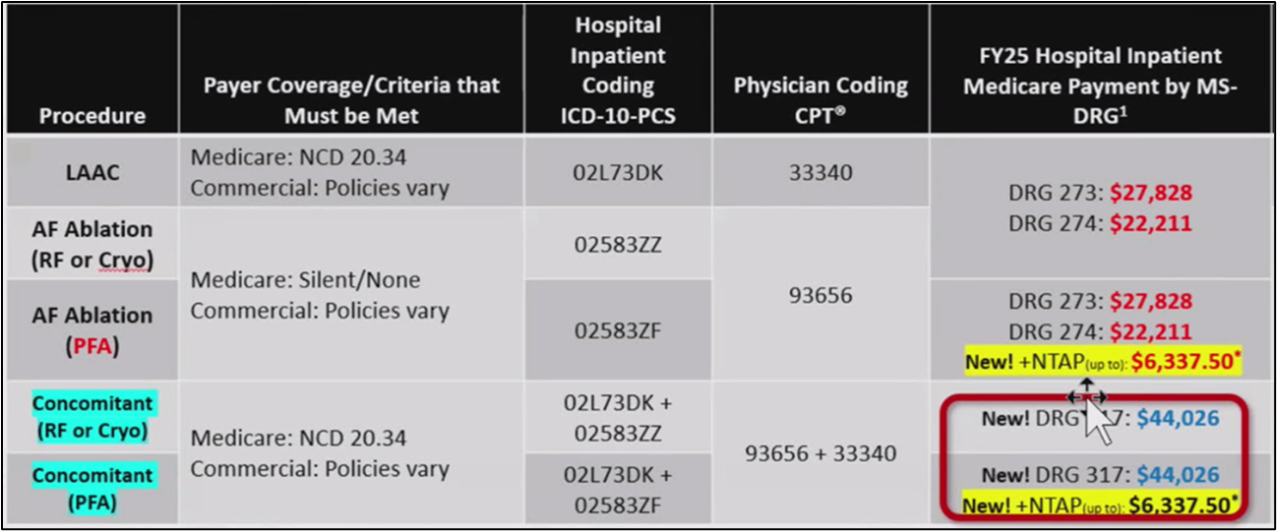
New MS-DRG 317
New CPT code

Slide 33
Indication for LAAC
Patient Selection
2. What Changed…
Indication for AF ablation
+
Symptomatic AF +/- AAD’s
CHADsVASc>2
unable to take long term OAC
Early Ablation
PFA
OPTION Trial
Expanded Indication for LAAC
New CPT code
Newer devices

Slide 34
2. Patients Referred for LAAC with a “softer” indication for Afib ablation
Patient Selection
Patients with Afib BUT “not commonly” considered for AF ablation
Asymptomatic Afib? … If they exist…
Overall low burden
Doing OK on AAD’s
Prior PVI ablation but with infrequent intermittent episodes
AF ablation not addressed
Permanent Afib …You can change the label…
Early Ablation?
Quick, safe and Easy
Need for touch up as long as you are there?
Develop indication for LAAC
Combined procedure

Slide 35
3. Patients with planned or inadvertent LAA isolation
Patient Selection
Q: Do you intentionally isolate the LAA anyway before Closure….?
2 days post ablation and LAA isolation
→ Clot in LAA despite anticoagulation

Slide 36
Patient Selection
Current practice
What changed
Intraprocedural consideration
Impact of new technology /Clinical Trials

Slide 37
Theoretical safety concerns
Focal edema
Landing site is usually distal to ablation site
Short Ridge
Short Ridge
LAA ostial edema
Landing site is @ ablation site

Slide 38
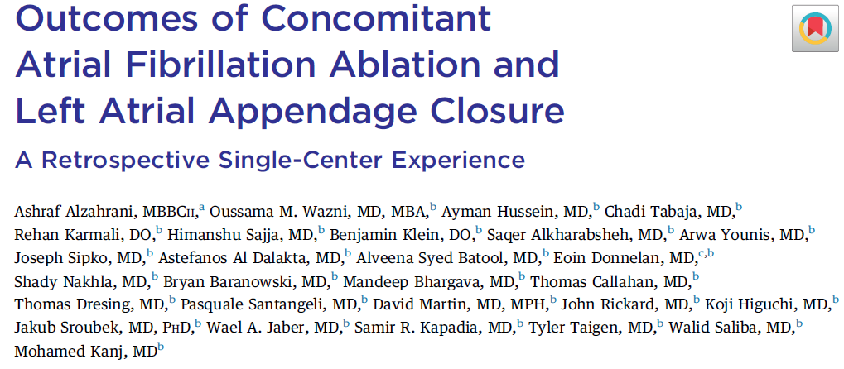
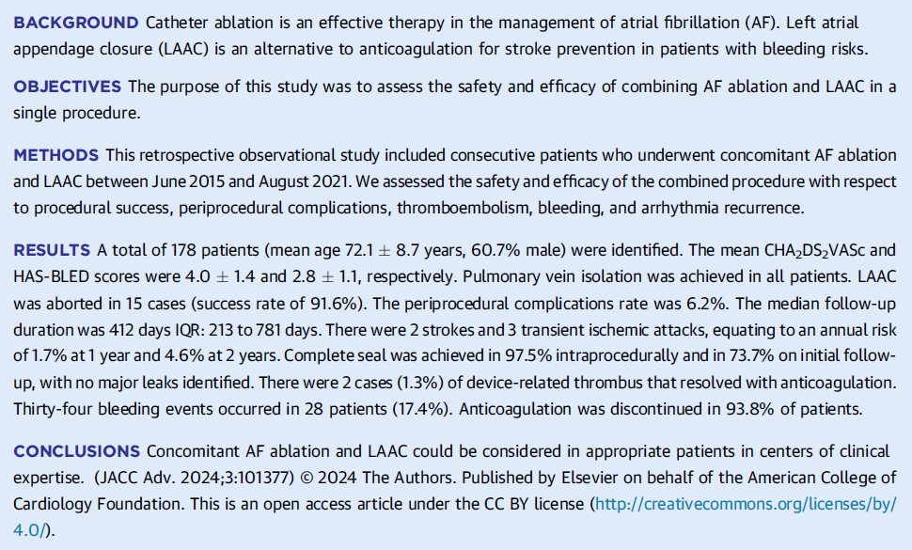

Slide 39
Tilting of device
Implant
Follow up

Slide 40
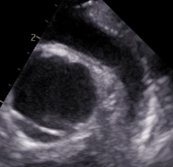
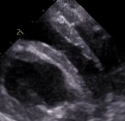
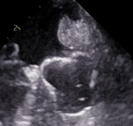
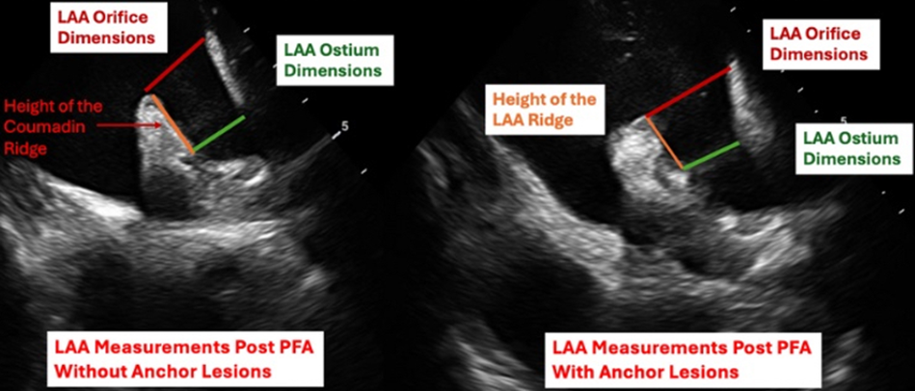
Any Concern with PFA ?... Edema…sizing…
Canine experiment
Safety concerns: Stability, PDL
Edema at Landing site
Ablation within LSPV
Short Ridge
Oversizing of the device
Target compression?
There is Edema
More diffuse vs. focal?
Baseline
Post-Ablation
Post-WM
LAA Orifice Diameter and Ridge Height Pre and Post PFA
Human PFA
Human PFA
Focal Edema
Not Diffuse
Baseline
Post Ablation ~ 10 min
Post Ablation ~ 1hr
D. Nair et al. AF Symposium Late Breaker 2025

Slide 41
Patient Selection
Current practice
What changed
Intraprocedural consideration
Impact of new technology and future Clinical Trials

Slide 42
Impact of Future Clinical Trials on Concomitant Procedure
CHAMPION
LAAC As an alternative option to OAC
LAOOS 4
LAAC + OAC in high stroke risk patients
OCEAN:
Do we need stroke prevention after successful PVI?
OAC vs. ASA

Slide 43
Conclusion
Patient selection for Combined AF ablation + LAA occlusion
Patients with current indication for AF ablation and LAAC
Patients referred for LAAC with softer indication for Ablation
Slightly more older and sicker patients with AF are getting ablation
“Expanded indication” based on OPTION trial results…
Know procedural limitations in anatomical variations
In the era of PFA It’s becoming more difficult
to NOT have a concomitant procedure

Slide 44
Questions for Concomitant Procedures
Which one do you do first….Does it matter?
Do you isolate the LAA anyway….?
Over the next 5 years: What is the % of concomitant procedure
In patients referred for ablation
In patients referred to LAAC

Slide 45
EARLY Detection and Intervention: AF as a Disease Continuum
Subclinical Markers and Risk Prediction for Incident AF
AF is a Chronic Progressive Disease
Clinical scores
classical risk factors
Imaging tools
Echo, CT ,MRI
Biomarkers : cardiac damage, stress
proinflammatory and profibrotic changes
Omics
genomic, proteomic, microbiome
7% Progression per year
Heart Failure
Valve Disease
Dementia
EKG: AI guided screening
Onset of Clinical AF
Comorbidities
Inflammation / Fibrosis / Atrial myopthy
Early Ablation
OAC or LAAC…………??
Risk Factors Modifications

Slide 46
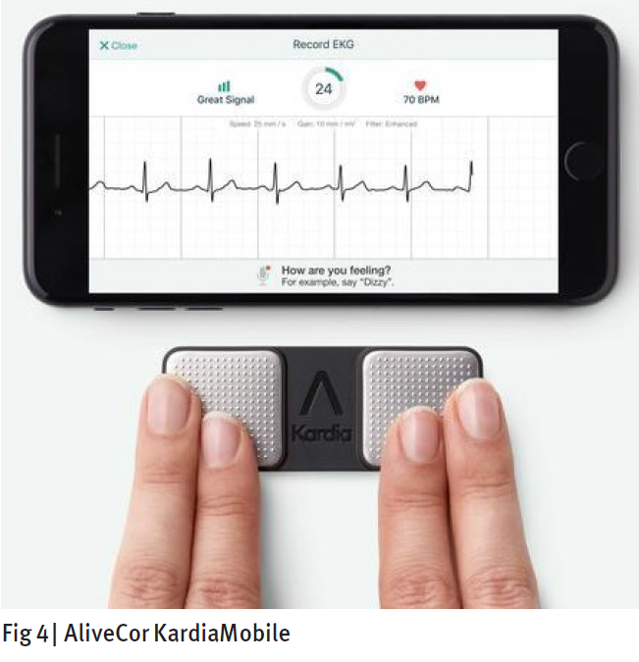
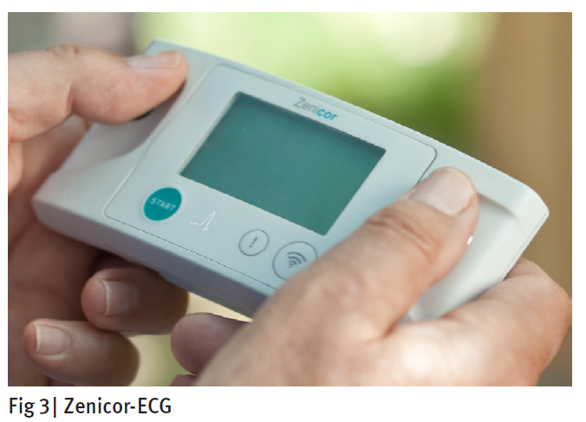
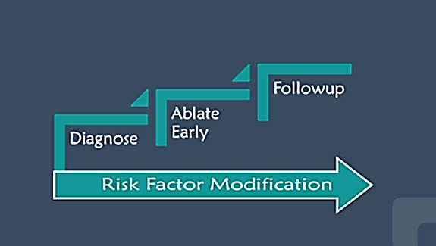
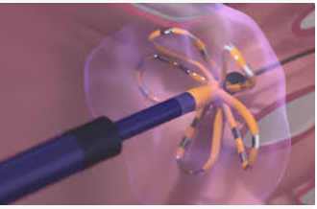
Next few years
Early detection
Early ablation (1st line therapy)
PFA Improved efficiency and safety
Combined procedure
Same day discharge
First Detected A.Fib
Same day Ambulatory
Ablation Centers
Combined procedure:
Ablation + LAAC
No Long term AAD
No Long term OAC

Slide 47
THANK YOU

