Slide 1
Lipid Review
What
When
Whom
Goal of therapy

Slide 2
45yo smoker with HTN and insomnia
On amlodipine and lisinopril
Lipids checked:
Chol 267
LDL 204
HDL 43
TG 98
Action taken- advise diet for lipids, prescribe trazodone for sleep

Slide 3
2 years later
Lipids never reanalyzed
Still smoking still on lisinopril amlodipine and trazodone
Presents with inferior STEMI: occluded anomalous Cx, 3-vessel CAD, MV PCI
Chol 249
TG 164
HDL 42
LDL 204

Slide 4
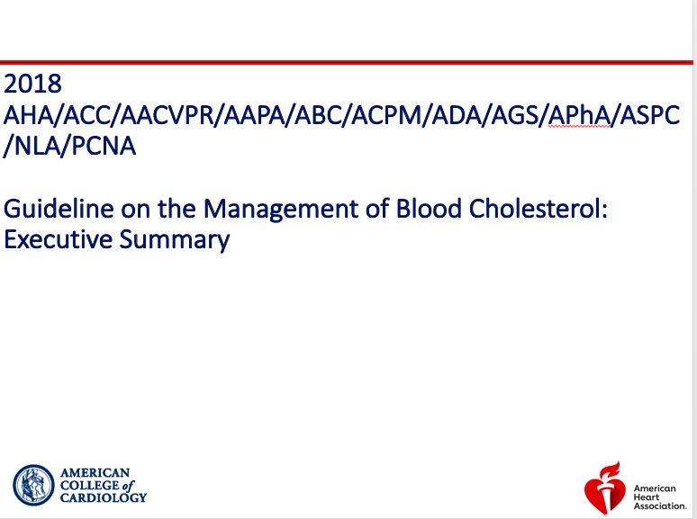

Slide 5
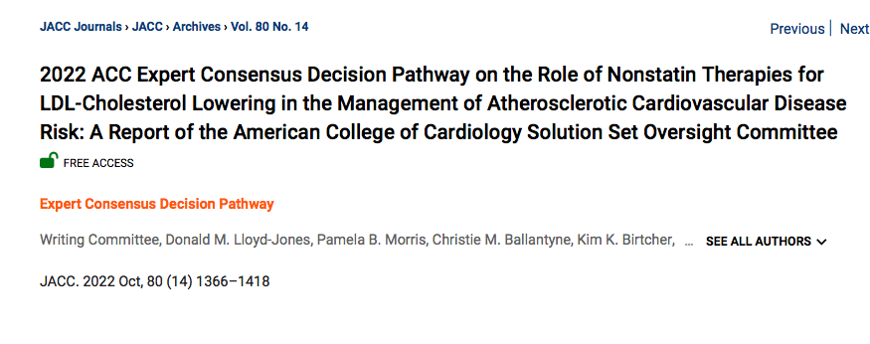

Slide 6
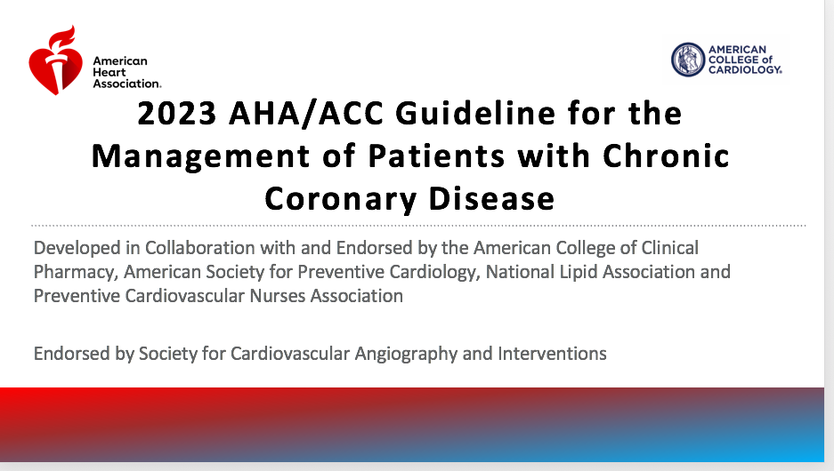

Slide 7
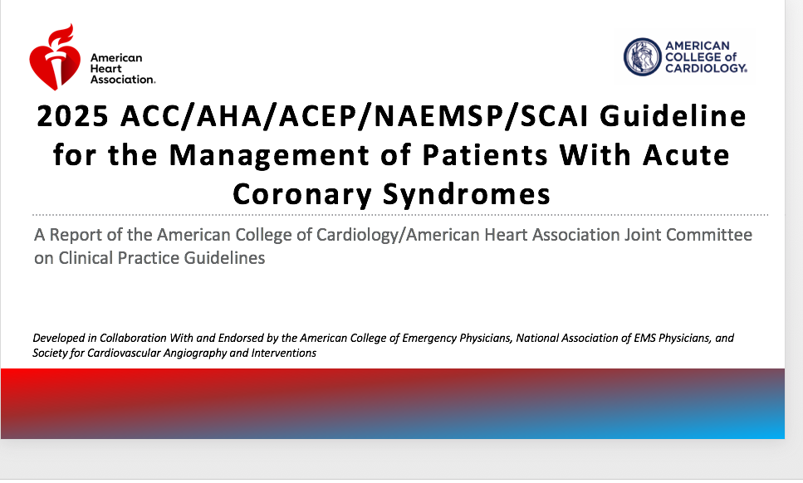

Slide 8
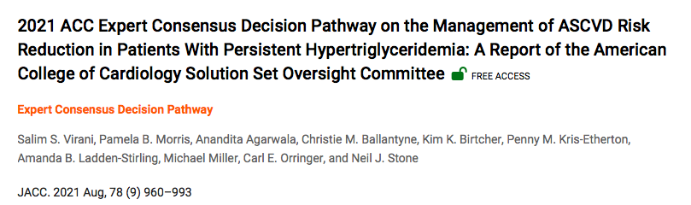

Slide 9
Primary Prevention
Age categories
0-19 – unless pt has familial hypercholesterolemia->diet/lifestyle
20-39 – statin for family history of CAD and LDL>160
40-75 – will be further stratified
>75 – “clinical assessment/risk discussion”

Slide 10
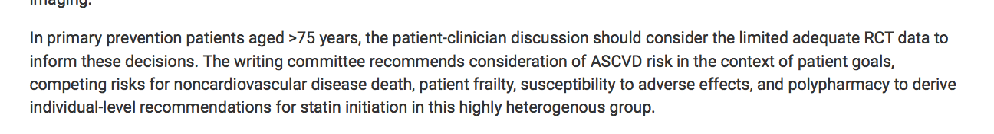
Primary Prevention Age >75

Slide 11
Age 40-75, Primary Prevention, 3 categories
LDL>190
Diabetics LDL 70-189
Non Diabetics LDL 70-189

Slide 12
Primary prevention Age 40-75 LDL>190
High dose statin- Don’t need to calculate 10 year risk
If max dose statin and LDL>100, add ezetimibe
If on max dose statin + ezetimibe LDL still>100 – adding PCSK9 inhibitor is reasonable if patient has increased ASCVD risk

Slide 13
Age 40-75 Primary Prevention - Diabetics
Age 40-75
If LDL>70: moderate intensity statin regardless of ASCVD risk
If age 50-75 or multiple risk factors: high dose statin

Slide 14
Age 40-75 non-diabetics Primary prevention LDL 70-189
Assess patient risk with Prevent risk calculator (or ASCVD risk calculator)
Ten year risk <5% -“low risk” – lifestyle/diet changes are only recommendation
Ten year risk 5-7.5% -“Borderline Risk” – if risk enhancers present consider moderate dose statin (2B)
Ten year risk 7.5-20% - “Intermediate Risk” – if risk enhancers present moderate dose statin (class 1), goal to lower LDL 30% - Consider calcium score
Ten year Risk > 20% - “High Risk” – high dose statin (class 1) to reduce LDL by 50%

Slide 15
What are the risk enhancing factors?
Lipoprotein (a) >50mg/dl
Apolipoprotein B >130mg/dl
CRP> 2.0mg/dl
ABI <0.9. (subclinical PVD)
TG persistently>175
LDL persistently>160
Family history of ASCVD (male <55yo, female<65yo)
CKD
metabolic syndrome
Hx pre eclampsia or premature menopause
South Asian
Chronic inflammatory disease – RA psoriasis HIV

Slide 16
What About Coronary Calcium? 2018 guidelines
Role primarily limited to those patients <75 with intermediate risk
Ca score 0 -> may with hold statin (with exception of patients with strong Fhx, DM or smokers)
Ca score 1-99 ->favors statin especially if age>55yo
Ca score >100 or >75th percentile for age/sex/race statin therapy is indicated

Slide 17
Subclinical Atherosclerosis:2022 update
Ca score 1-99 or <75th percentile – moderate to high intensity statin
Ca score 100-999 or >75th percentile –high intensity statin. If LDL doesn’t decrease by 50% or LDL remains >70, addition of ezetimibe is recommended
If Ca score >1000 – high intensity statin, ezetimibe f LDL doesn’t decrease by 50% or LDL remains>70. If still not above 70 add PCSK9 inhibitor

Slide 18
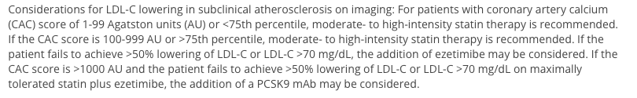

Slide 19
Incidental Coronary Calcium
90% of these patients have an indication for statin without the presence of coronary calcification
In age>75 again an ascvd risk discussion should be made with the patient prior to starting therapy
This is not an indication for ischemia testing in itself

Slide 20
Secondary Prevention in Patients With History of Clinical ASCVD
60yo presented with angina in 2022. +Fhx, HTN on moderate dose statin
CTO of RCA severe disease in circumflex – Cx PCI 7/2022
Persistent CP c/o – sought CTO specialist – PCI of RCA 10/2022
Crestor 40mg, ezetimibe 10mg
Chol 108
Triglycerides 70
HDL 37
LDL 57
“I want inclisiran”

Slide 21
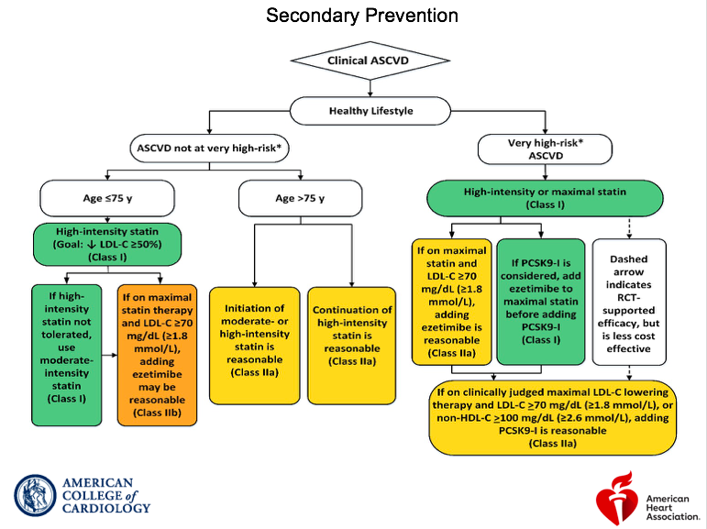
2018

Slide 22
What is the Risk of a Second Event?
MI recurrence rate
5.7% at 6m
7.7% at 1 year,
11.7% at 3 years
14.3% at 6 years

Slide 23
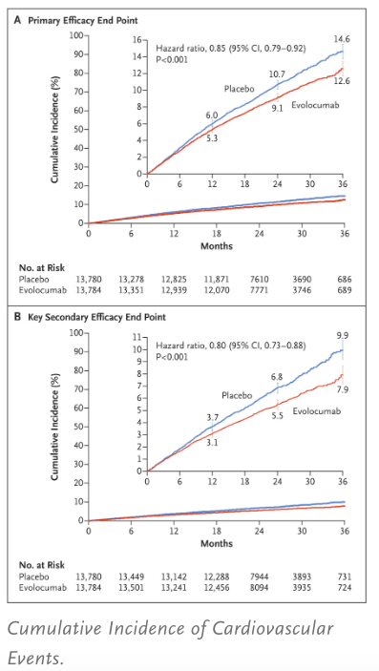
FOURNIER

Slide 24
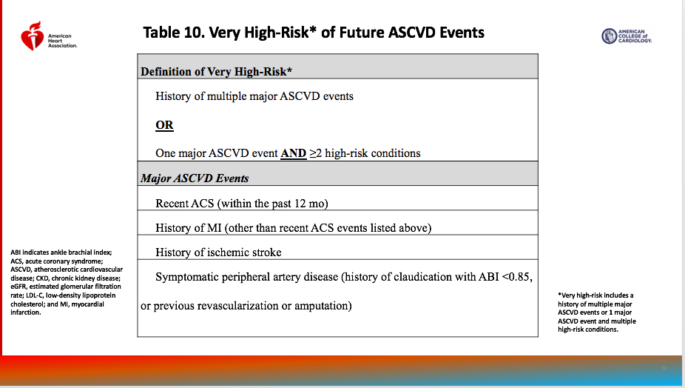

Slide 25
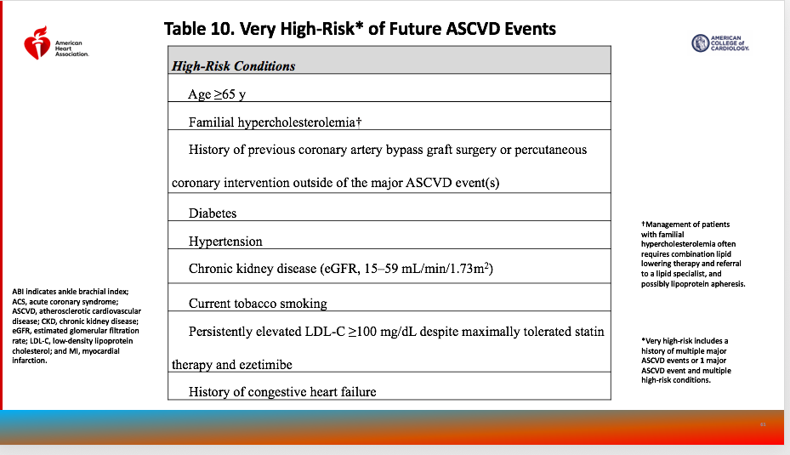

Slide 26
CTT (Cholesterol Treatment Trialists)
Meta-analysis from 5 randomized controlled trials
Showed LDL-C lowering with high intensity statins compared with moderate intensity statins: reduced vascular events by 15% in patients with established ASCVD
Greater absolute LDL reductions were associated with greater reduction in MACE
The greatest absolute benefit from statin therapy is observed in those with the highest baseline LDL-C

Slide 27
Meta Analysis - 2018
Although the more the absolute decrease in the LDL, the greater the absolute risk reduction
On average there is a 20% relative risk reduction for every 39mg/dl decrease in LDL-C regardless of baseline LDL value

Slide 28
For Those Not at Very High Risk: Secondary Prevention
Age <75
High intensity statin – goal is 50% reduction of LDL
If high intensity statin not tolerated, can use moderate intensity
If LDL remains> 70 – add Ezetimibe (class 2a)
Age>75
Moderate or high intensity statin
LDL goal not specified

Slide 29
2022 Update Secondary Prevention: Not at Very High Risk
High dose statin – goal is 50% reduction and LDL<70
If not at goal can consider non-statin therapy as needed to achieve goal
In order:
1. Zetia
2. PCSK9 inhibitor
3. Bempedoic acid or inclisiran:

Slide 30
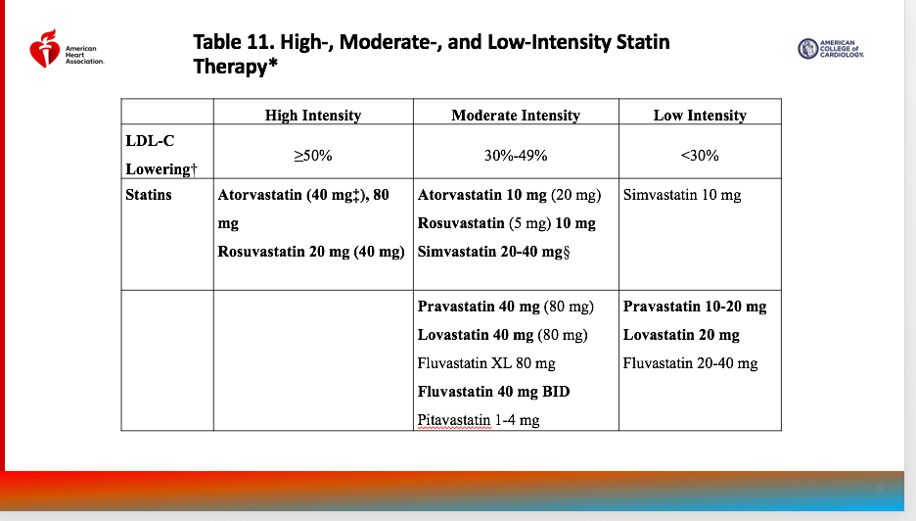

Slide 31
LDL reductions
Doubling of a statin dose –lowers LDL additional 6%
Ezetimibe – lower LDL 18% when added to statin
PCSK9 inhibitor- lower LDL 60% when added to statin
Bempedoic acid- lower LDL 17-18% when added to stain
Bempedoic acid/Ezetimibe combo – 38% LDL reduction on top of statin
Inclisiran – lowers LDL 50%

Slide 32
2022 Update – Secondary Prevention: For Those at Very High Risk
High dose statin – goal is 55 reduction of LDL and LDL < 55
If goal not achieved consider addition of non-statin
In order
1. Ezetimibe and/or PCSK9 inhibitor
2. Bempedoic acid or Inclisiran

Slide 33
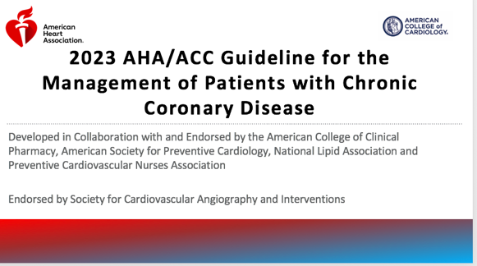

Slide 34
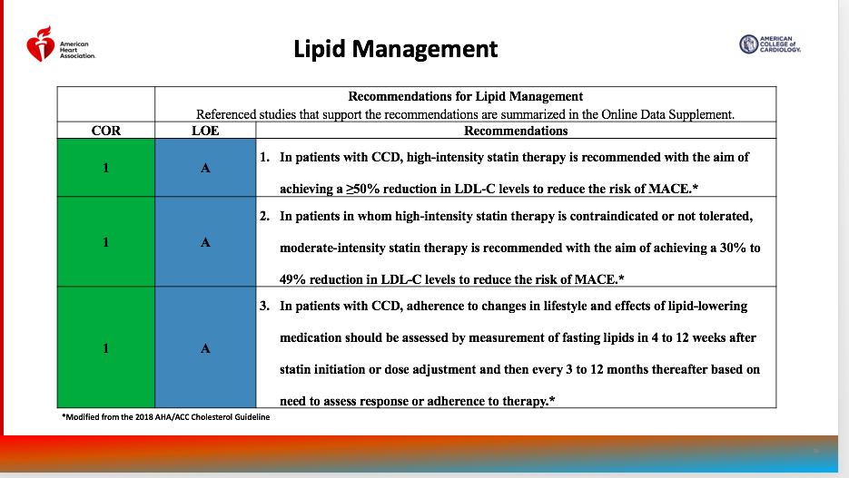

Slide 35
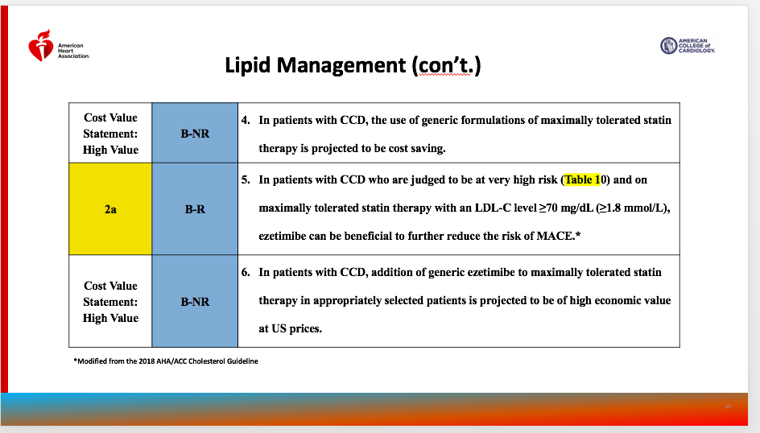

Slide 36
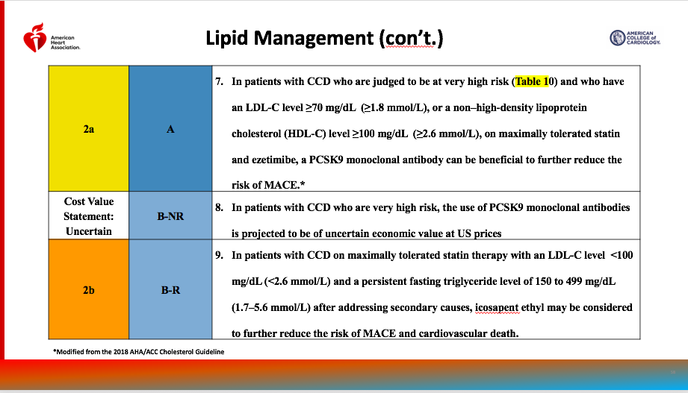

Slide 37
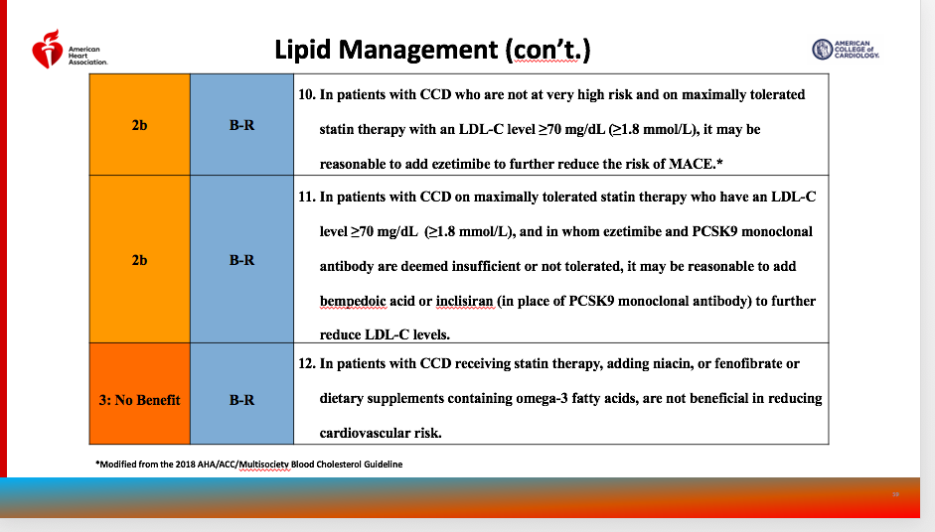

Slide 39
Triglycerides are to be Addressed After LDL is at Goal
2b recommendation to treat persistently elevated TG 150-499 with icosapent ethyl.
No role for fibrate therapy or fish oil omega 3 FA niacin in primary or secondary prevention of ASCVD
Treating TG>500 is to reduce risk of pancreatitis – not to reduce ASCVD events

Slide 40
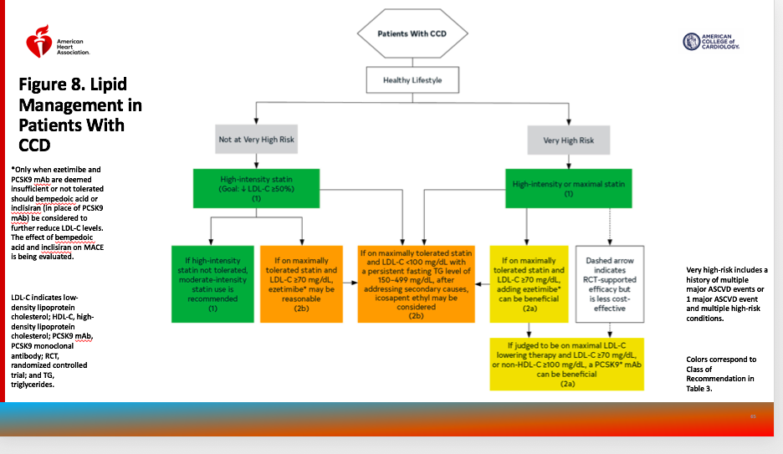

Slide 41
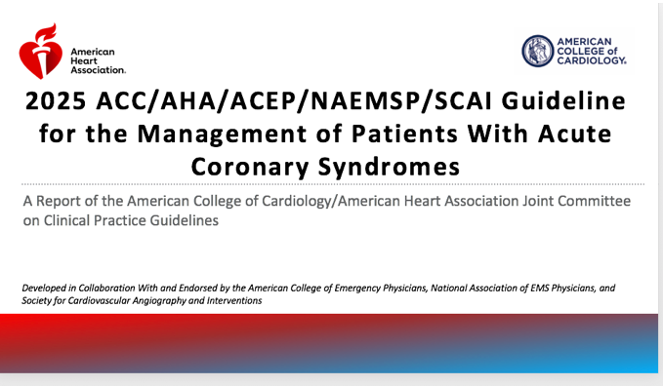

Slide 42
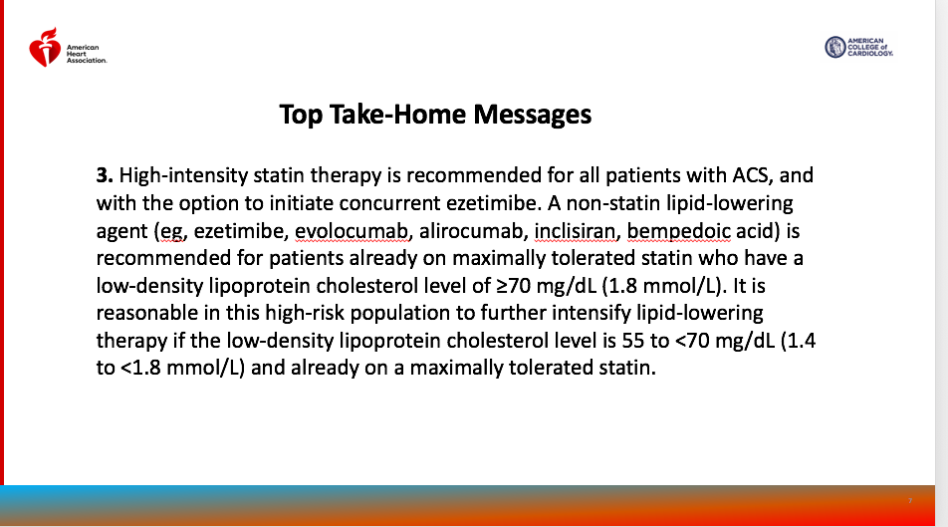

Slide 43
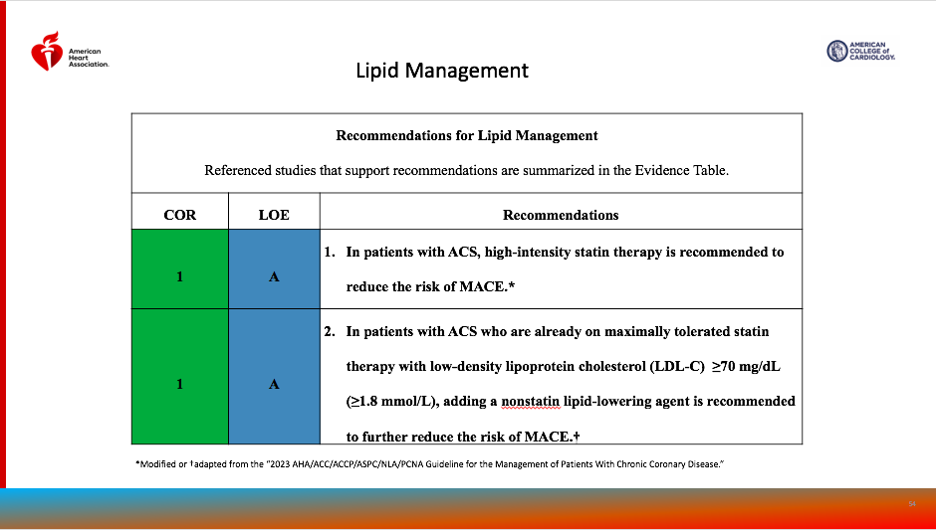

Slide 44
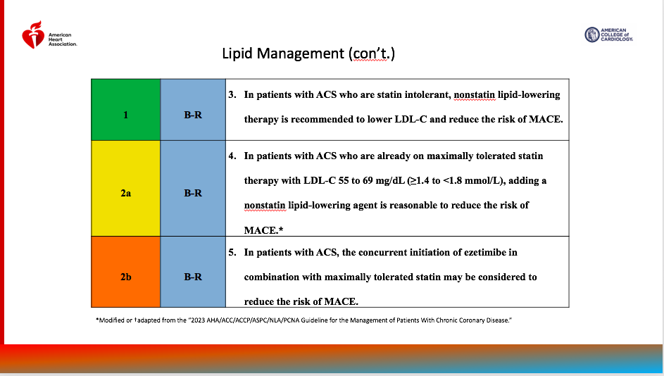

Slide 45
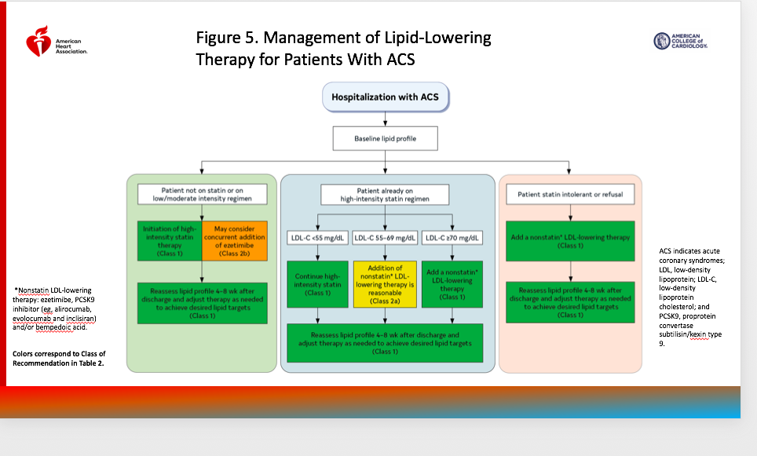

Slide 46
Back to Our Patient With His LDL of 57
Choices:
Continue rosuvastatin and ezetimibe
Remember – need to lower his LDL by 39mg/dl to give him a 20% relative risk reduction so he needs to get to an LDL of 18 – so he would need a 68% reduction in his current LDL
His risk (using the smart 2 risk score - a secondary prevention risk score used by the ESC) = 12% ten year risk
So if we get his his LDL to 18, his absolute risk reduction will be 0.24% per year

Slide 47
He got his inclisiran
LDL <10
Chol 69
HDL 45
Tg 79

