Slide 1
Vascular case presentation
Muhammad Asad Khan, MD, FACS, RVT
Vascular Surgeon
St. Joseph’s Health, Syracuse NY

Slide 2
Complex thoracoabdominal aneurysm with dissection
First surgery- 12/2021
Second surgery- 10/2022
Third surgery – 5/2023
Fourth surgery- 2/2025

Slide 3
First Surgery- 2021
61 years
Known connective tissue disorder
Open aortic valve and ascending aortic repair 2007
Known aortic dissection type B
Progressive shortness of breath
Increased descending thoracic aortic aneurysm to 7.7
Increased AAA to 5.1

Slide 4
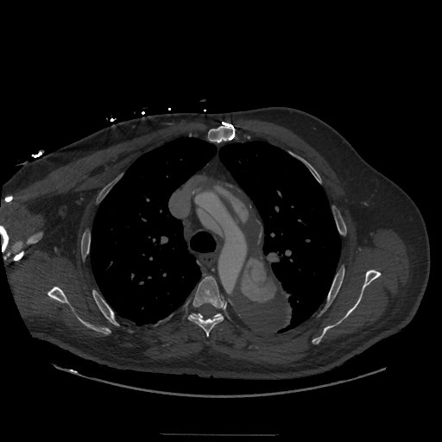

Slide 5
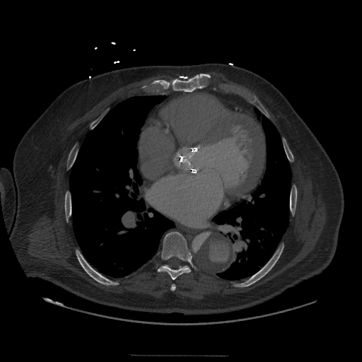

Slide 6
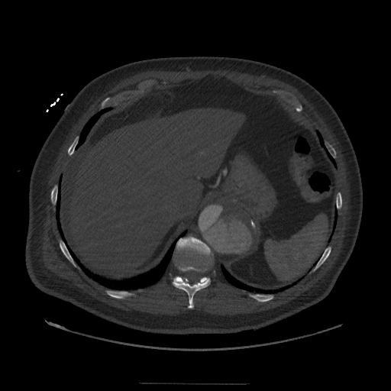

Slide 7
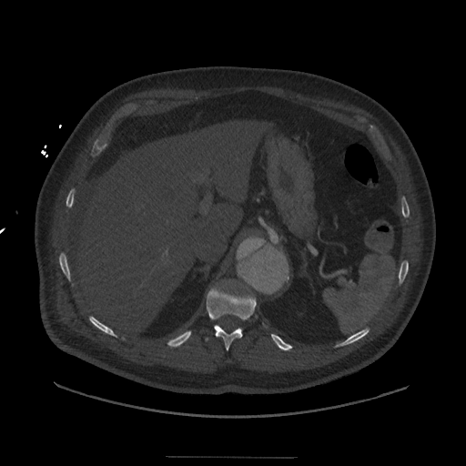

Slide 8
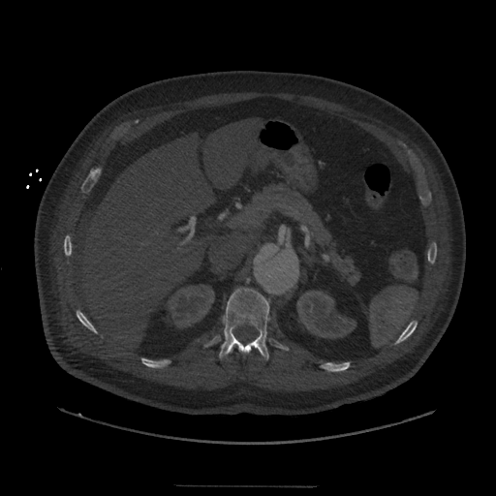

Slide 9
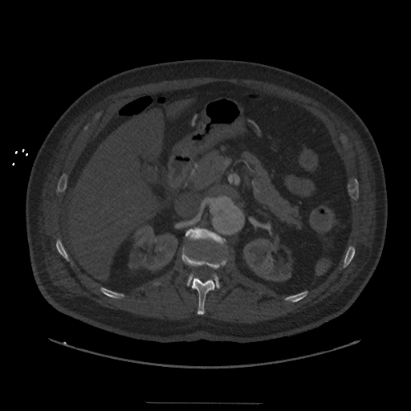

Slide 10
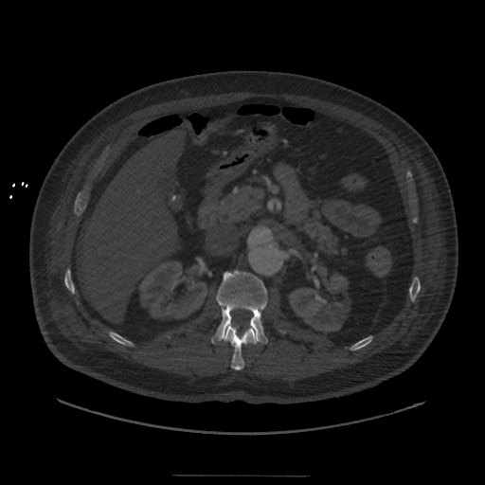

Slide 11
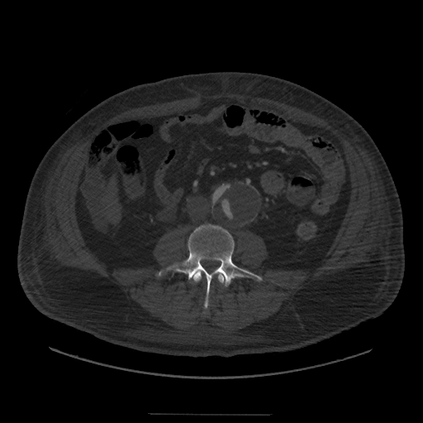

Slide 12
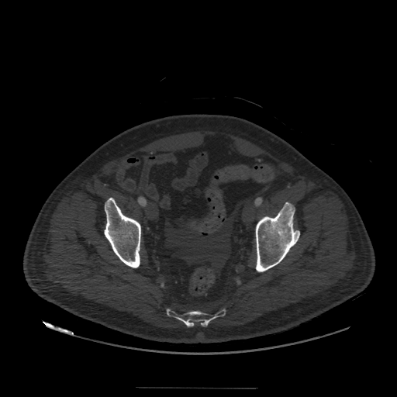

Slide 13
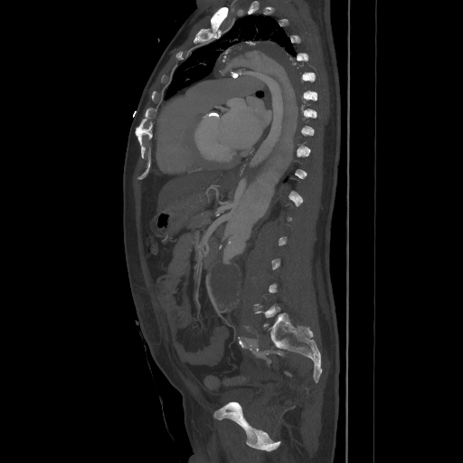

Slide 14
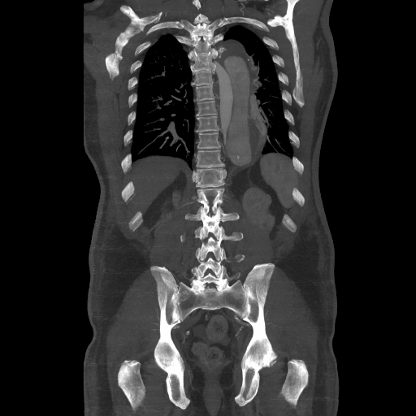

Slide 15
Surgery 2021
Left subclavian artery cutdown.
Right groin cutdown redo.
Left groin cutdown.
Endovascular repair thoracic aortic aneurysm with Medtronic Valiant device.
Left to right femoral-to-femoral bypass using 8 mm Hemashield graft.
TAVR subclavian approach

Slide 16
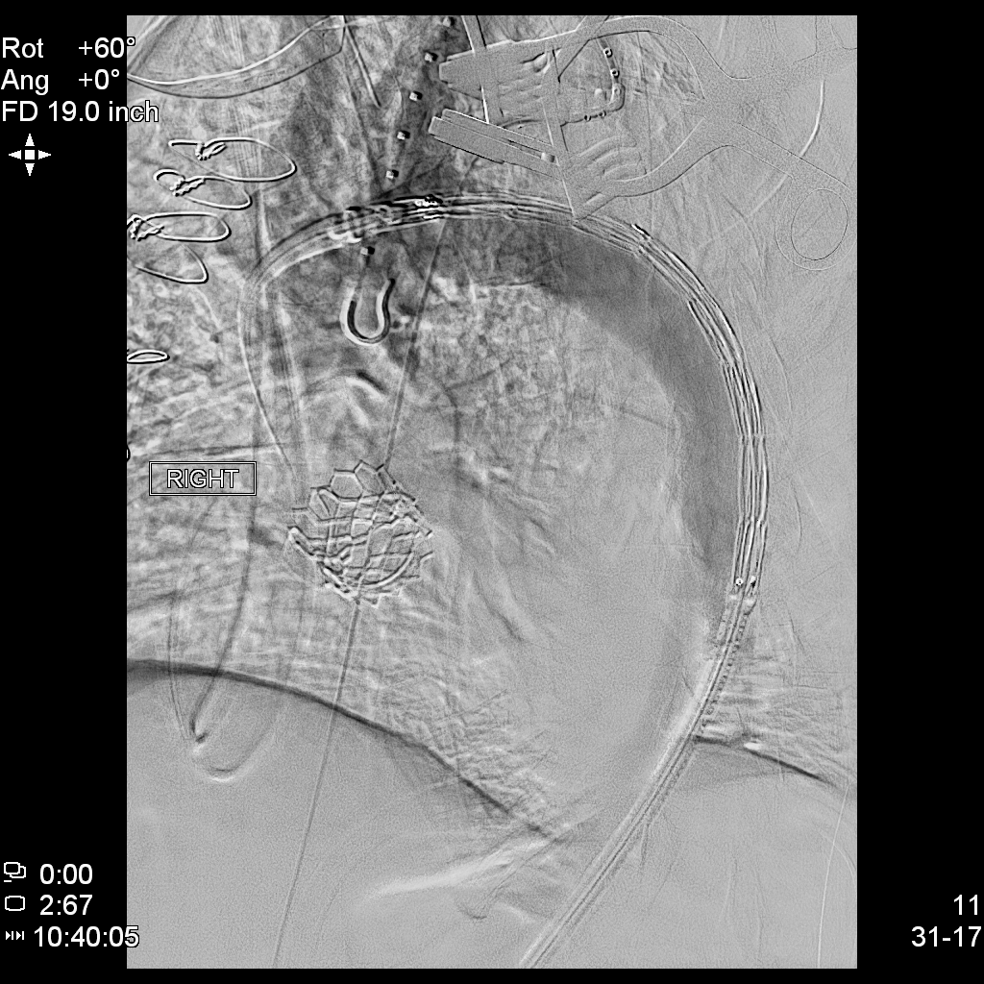

Slide 17
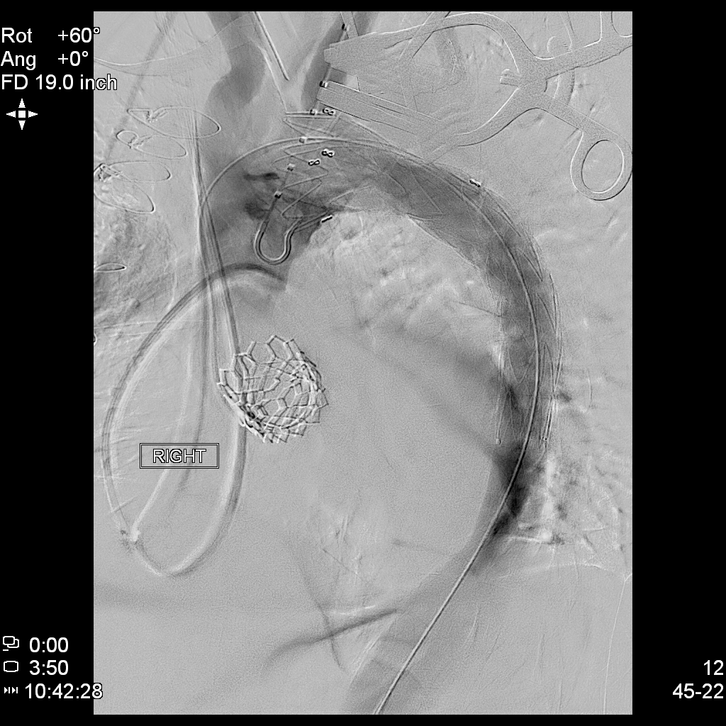

Slide 18
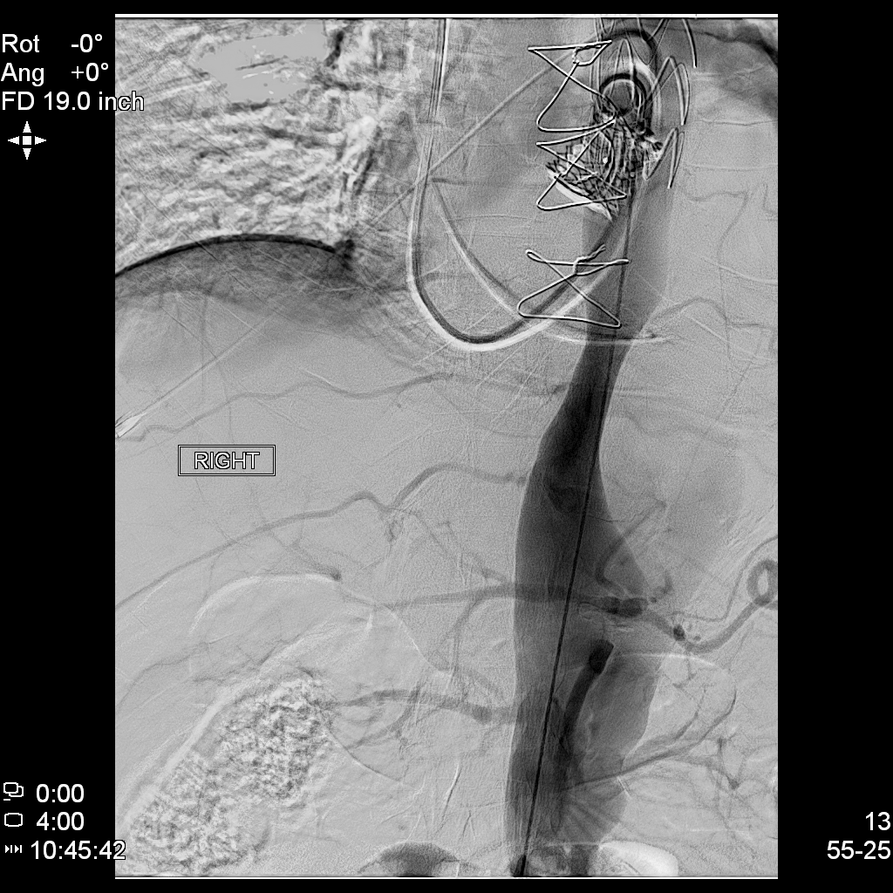

Slide 19
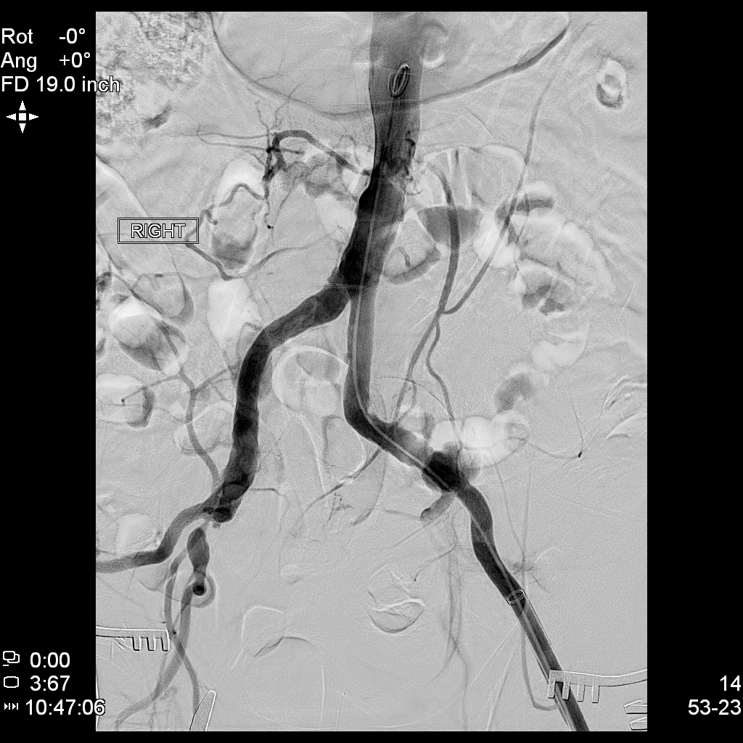

Slide 20
Second Surgery- 2022
Increased descending thoracic aortic aneurysm to 6 to 7
Increased AAA to 5.4

Slide 21
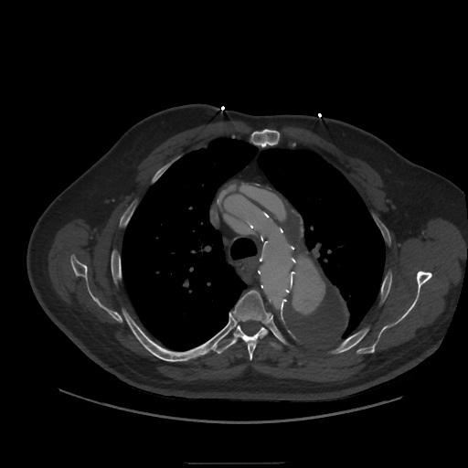

Slide 22
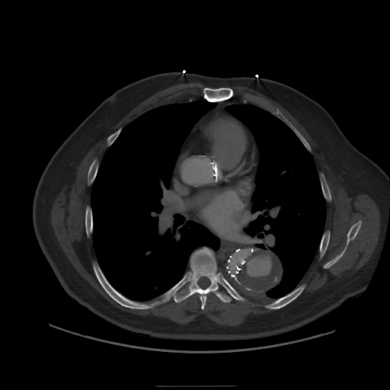

Slide 23
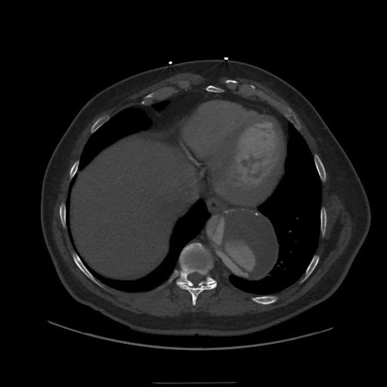

Slide 24
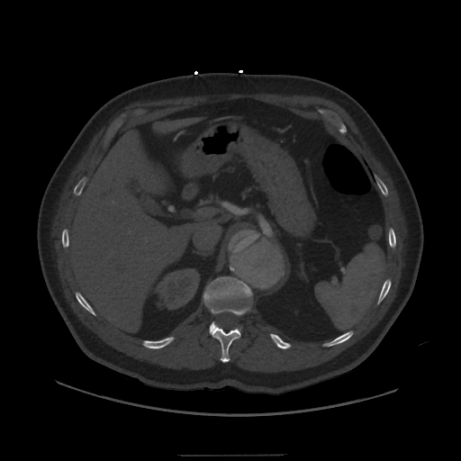

Slide 25
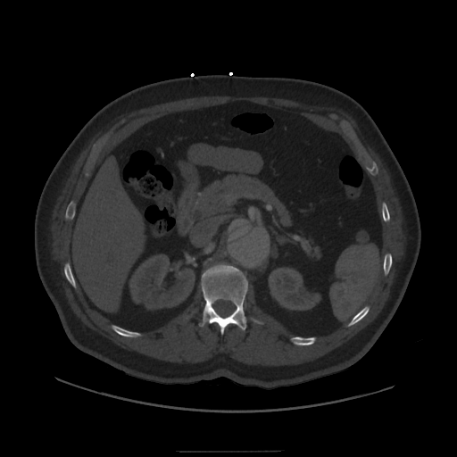

Slide 26
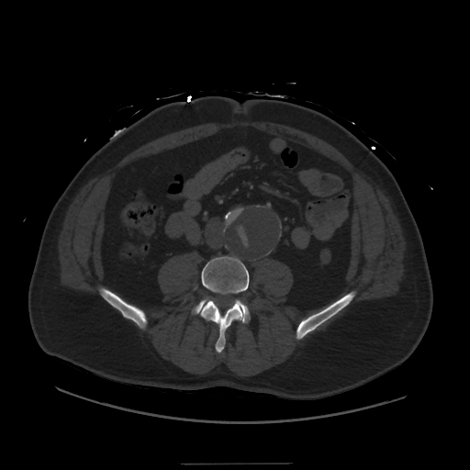

Slide 27
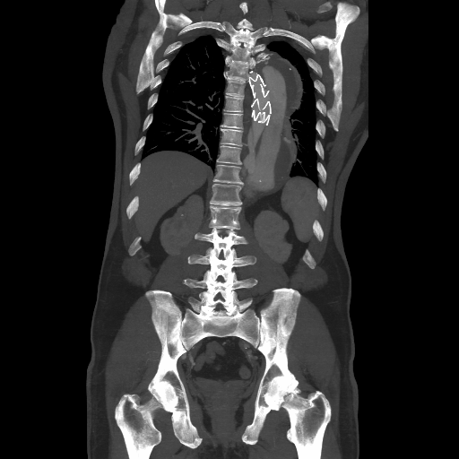

Slide 28
Second Surgery -2022
Endovascular repair of thoracoabdominal aneurysm using a Medtronic Valiant stent system, 38 x 38 x 200 mm.
Redo right groin dissection.

Slide 29
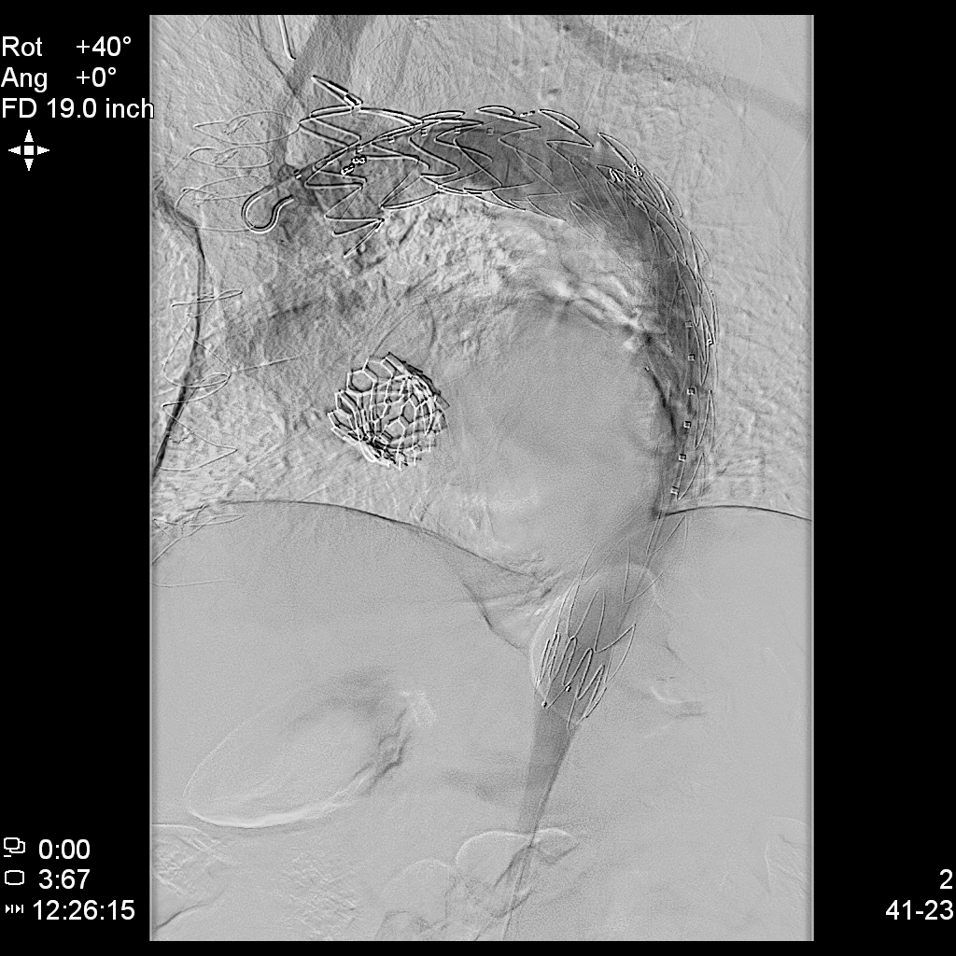

Slide 30
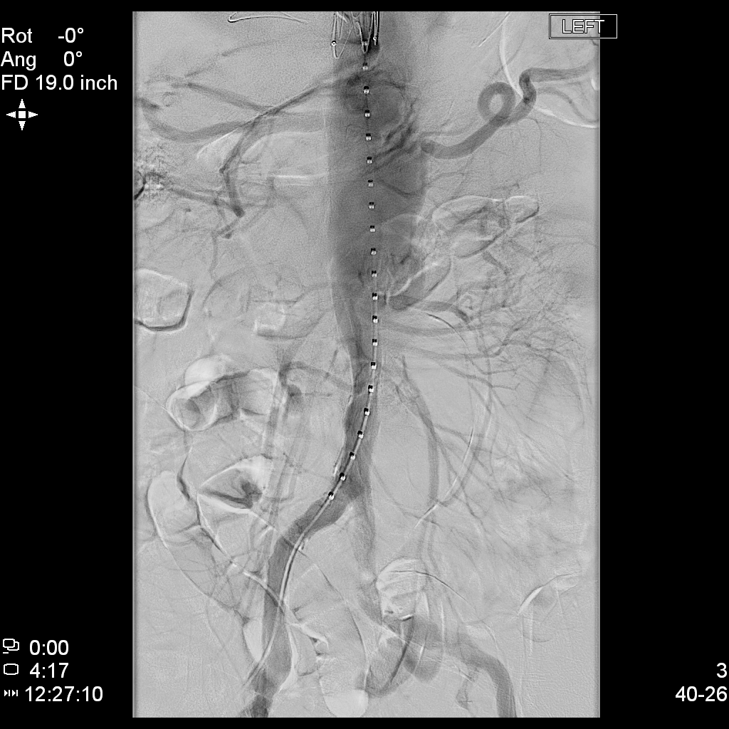

Slide 31
Third Surgery- 2023
Increased thoracic from 7 to 9
AAA still 5.4

Slide 32
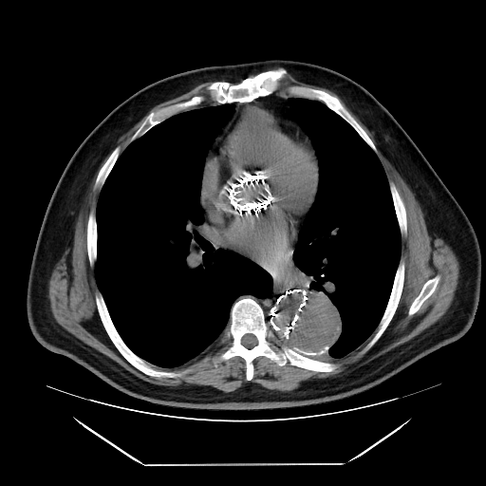

Slide 33
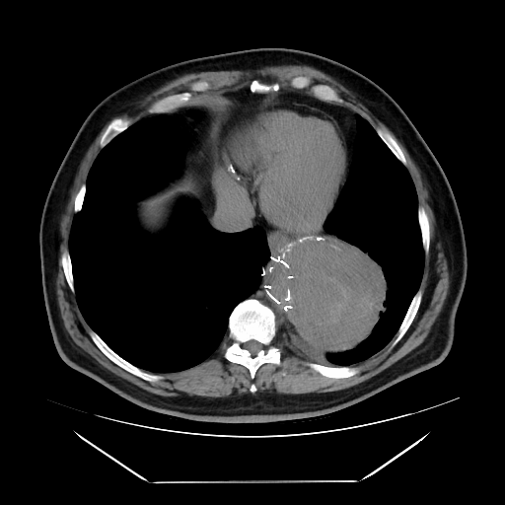

Slide 34
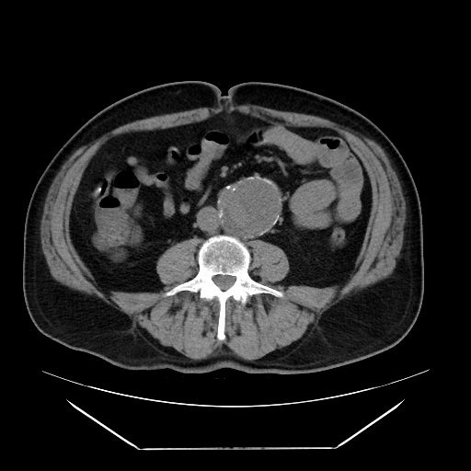

Slide 35
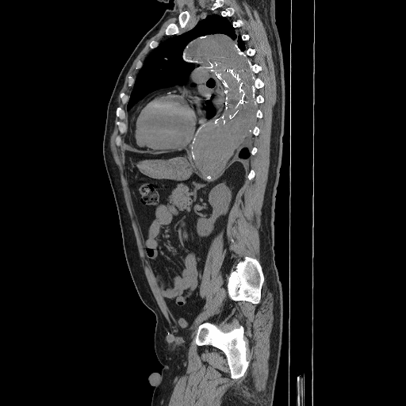

Slide 36
Third Surgery- 2023
Endovascular repair of thoracoabdominal aneurysm using Medtronic Valiant Captivia device.
Celiac artery angiogram.
Celiac artery balloon expandable stent placement, 7 x 57 mm.
Bilateral redo groin dissection.

Slide 37
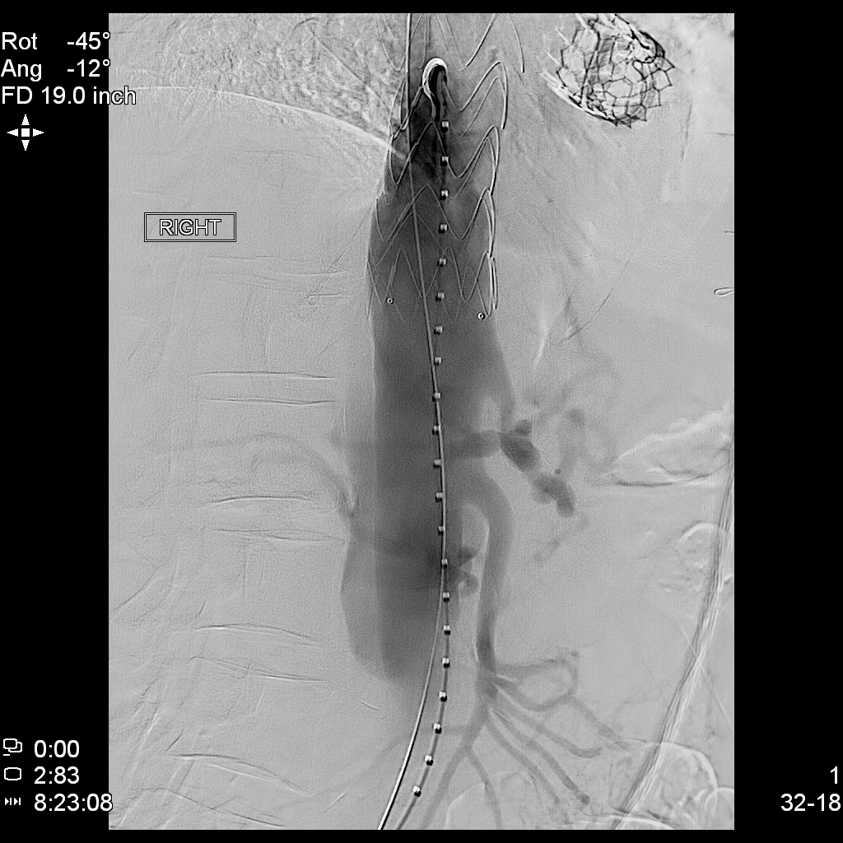

Slide 38
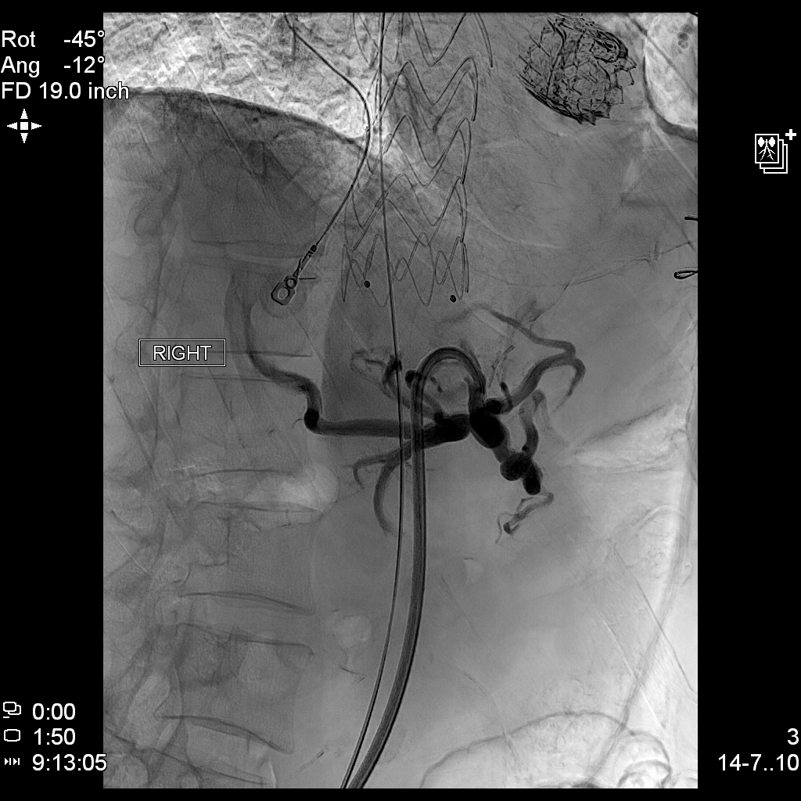

Slide 39
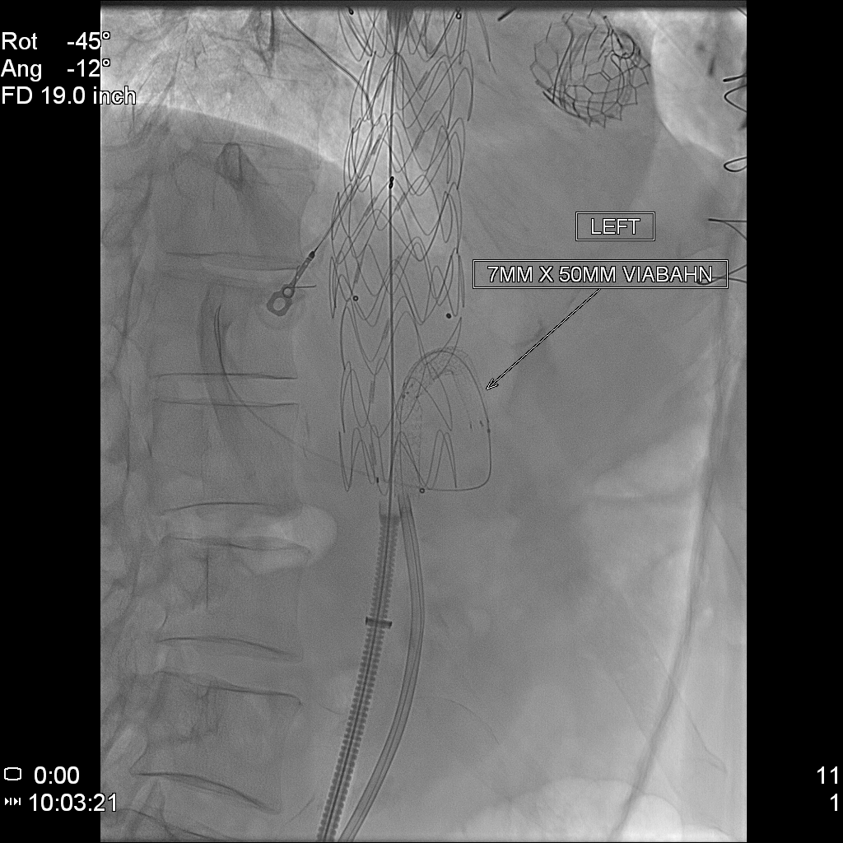

Slide 40
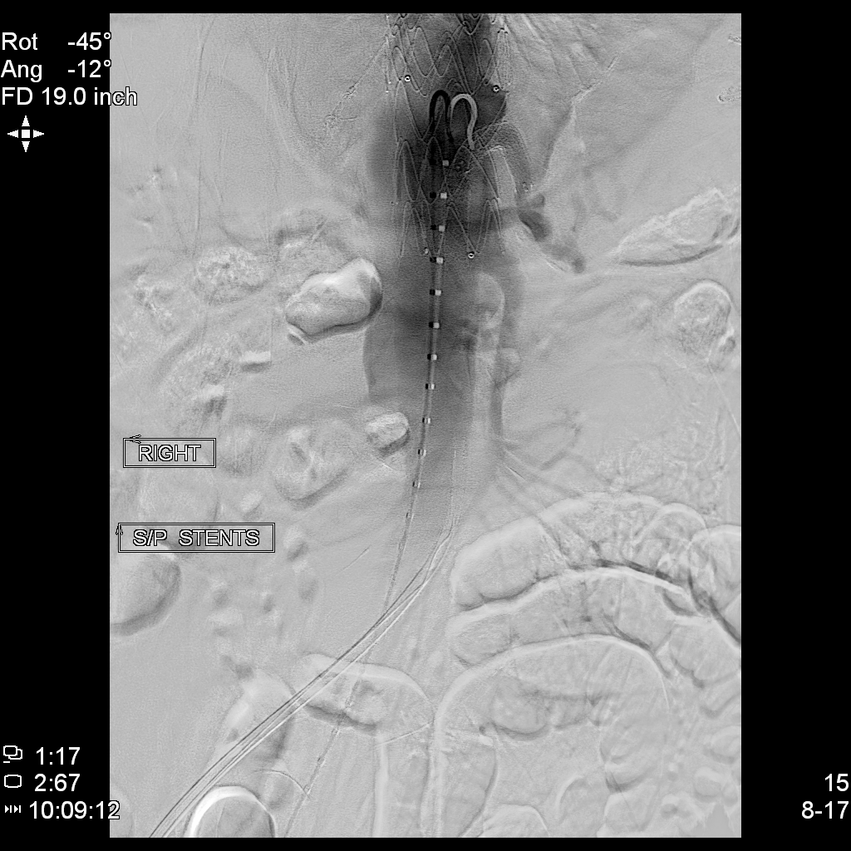

Slide 41
Fourth Surgery- 2025
Severe abdominal/chest pain
Shock
Infrarenal AAA 8 cm with rupture- previously 5.4

Slide 42
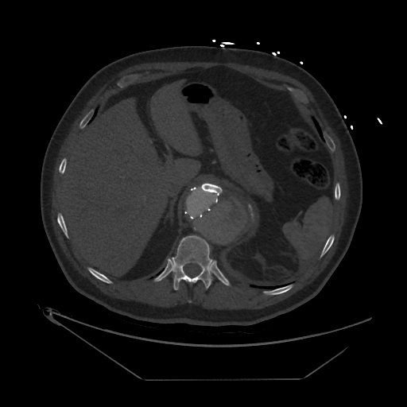

Slide 43
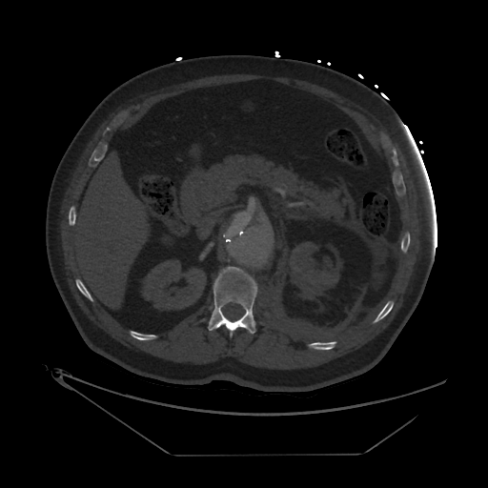

Slide 44
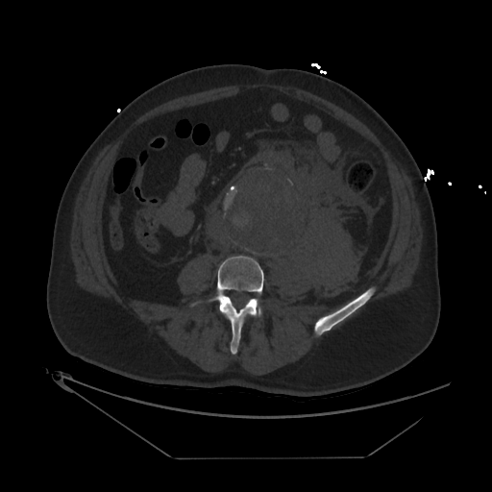

Slide 45
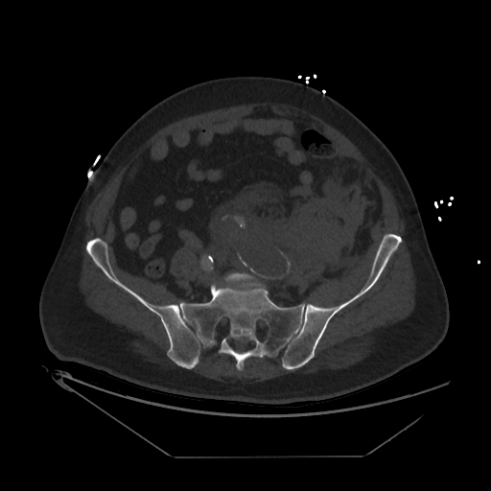

Slide 46
Fourth Surgery- 2025
Endovascular repair of ruptured juxtarenal abdominal aortic aneurysm using endovascular Medtronic stent.
Right subclavian cutdown.
Right renal artery self-expanding covered stent placement.
Right renal artery angioplasty.
Redo bilateral groin dissections.

Slide 47
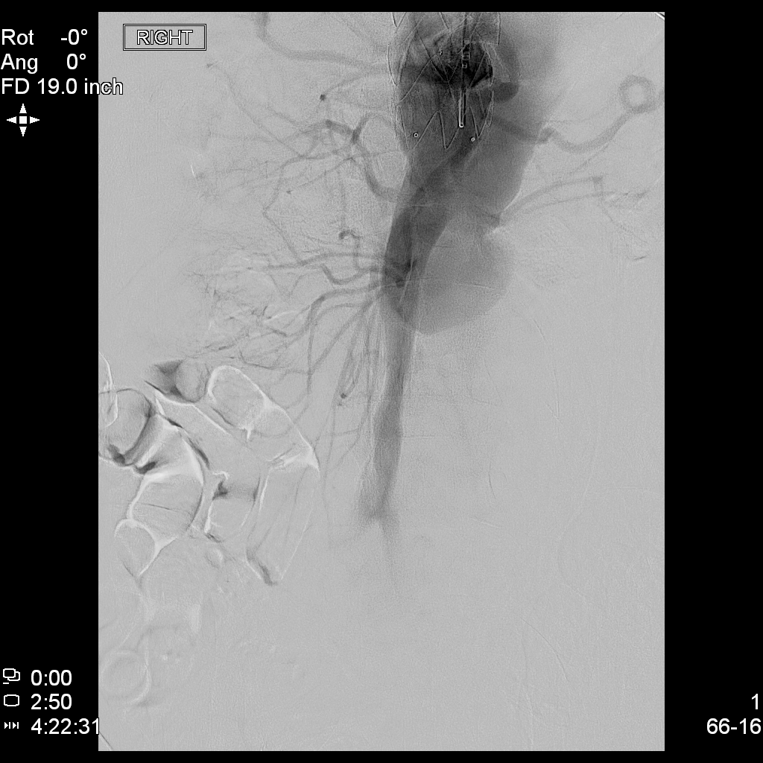

Slide 48
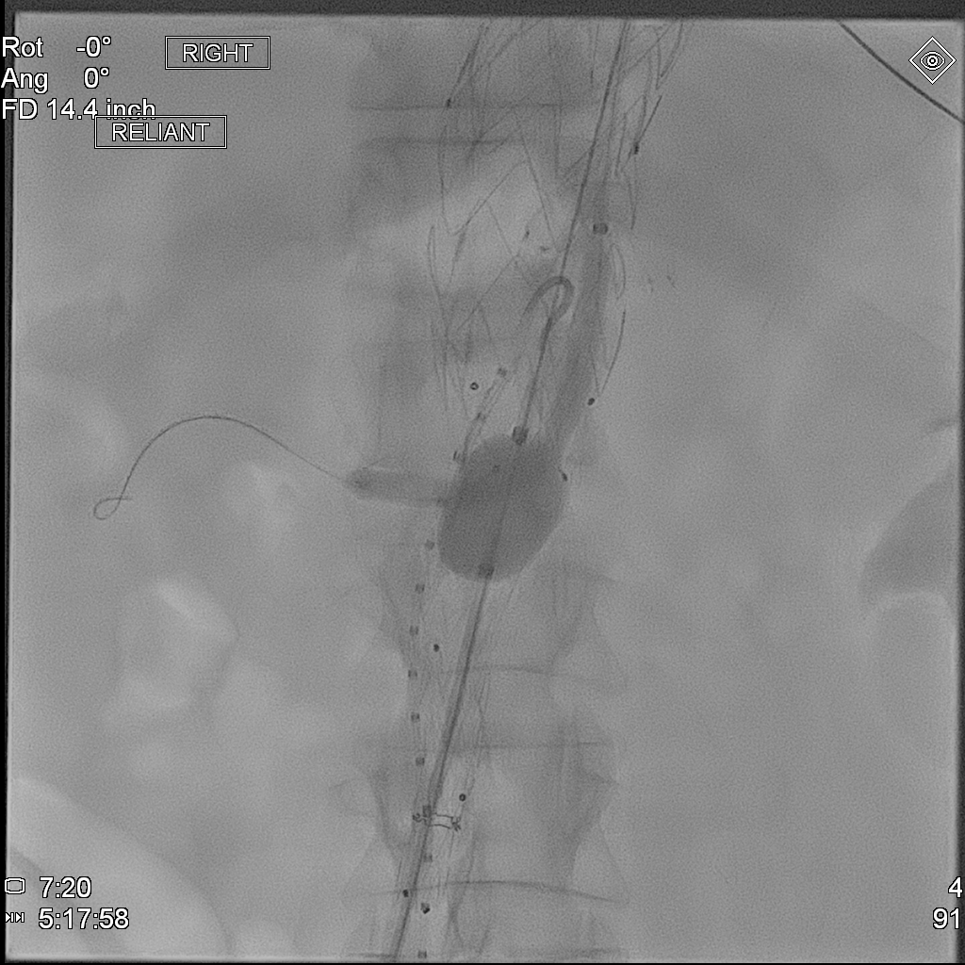

Slide 49
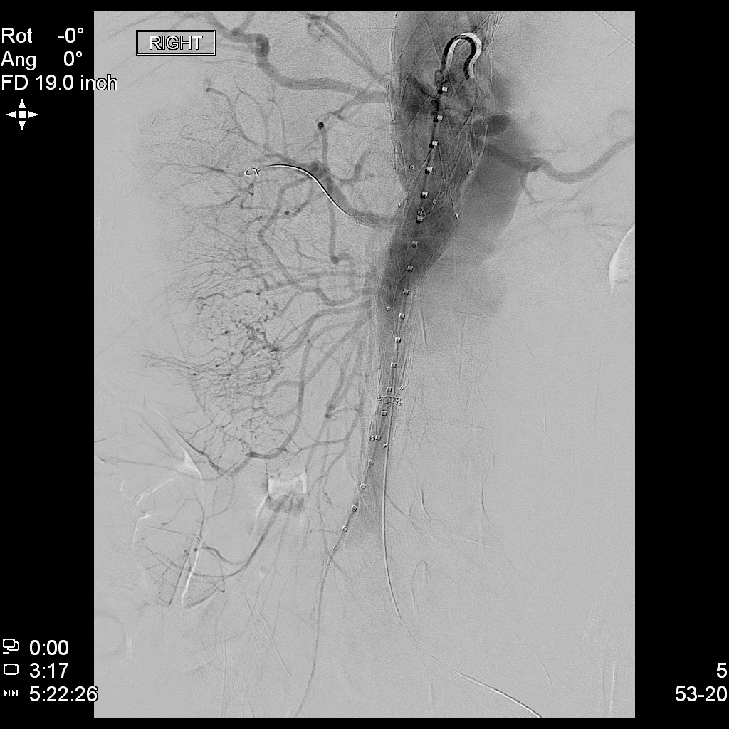

Slide 50
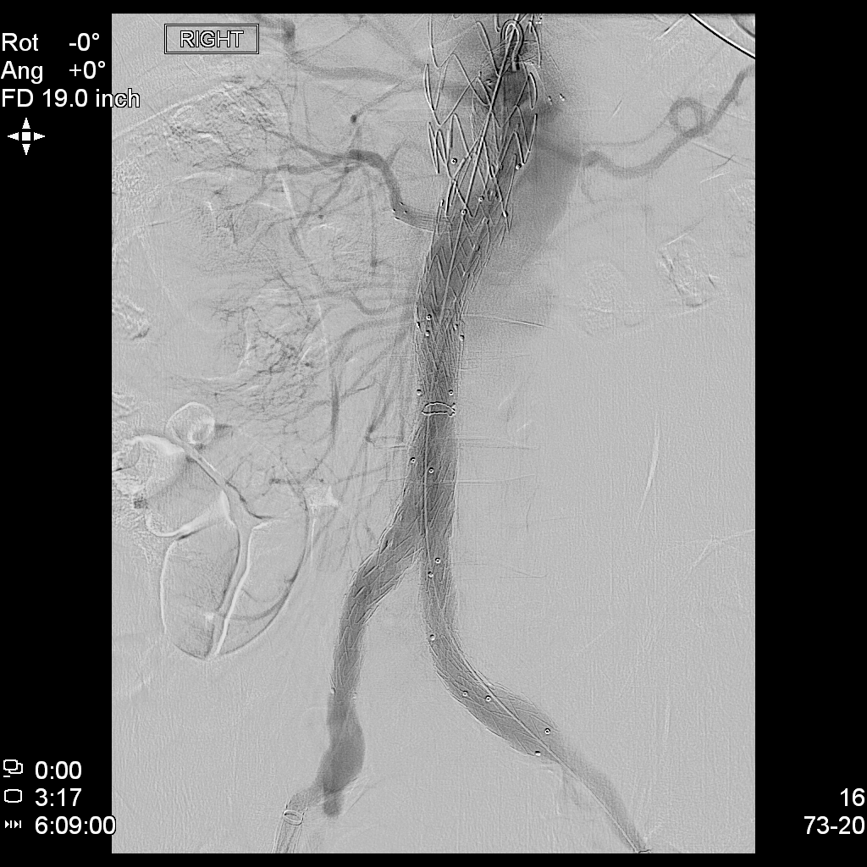

Slide 51
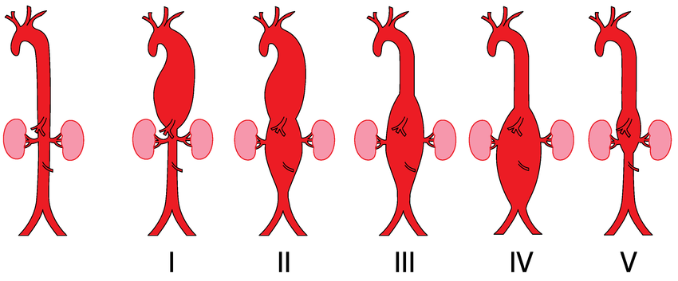
Thoracoabdominal aneurysms

Slide 52
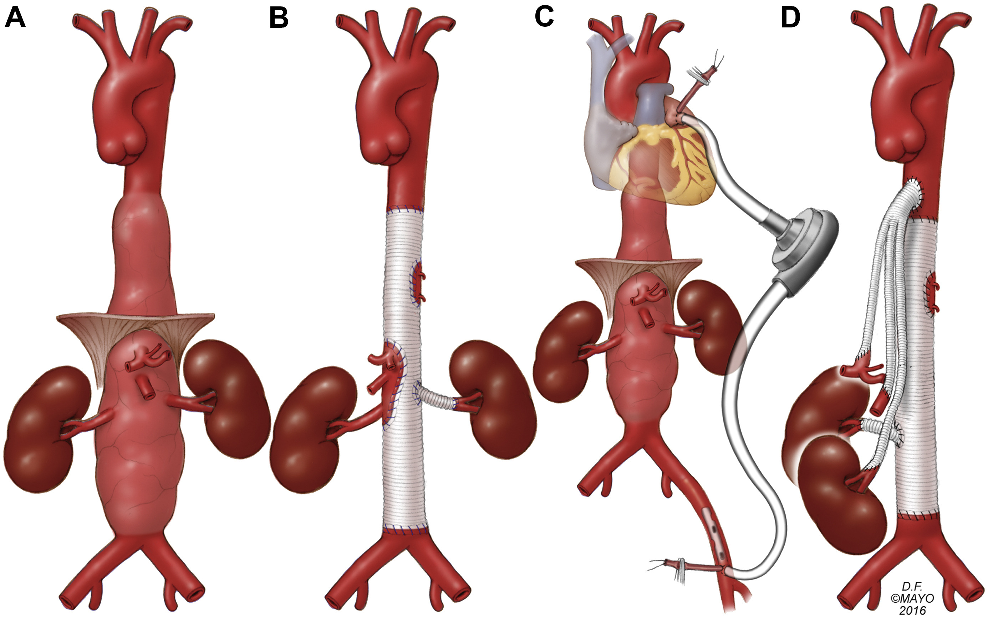
Open repair
Comparison of open surgical techniques for repair of types III and IV thoracoabdominal aortic aneurysms. Rana, Muhammad A. et al. Journal of Vascular Surgery, Volume 67, Issue 3, 713 - 721

Slide 53
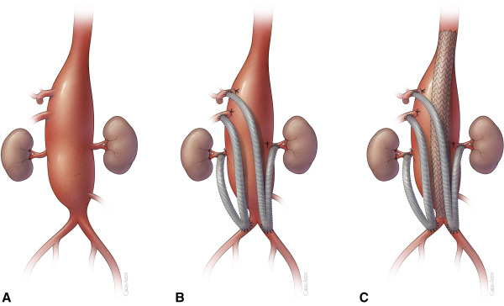
Hybrid repair
Total abdominal debranching hybrid thoracoabdominal aortic aneurysm repair versus chimneys and snorkels
Tanaka, Akiko et al. JTCVS Techniques, Volume 10, 28 - 33

Slide 54
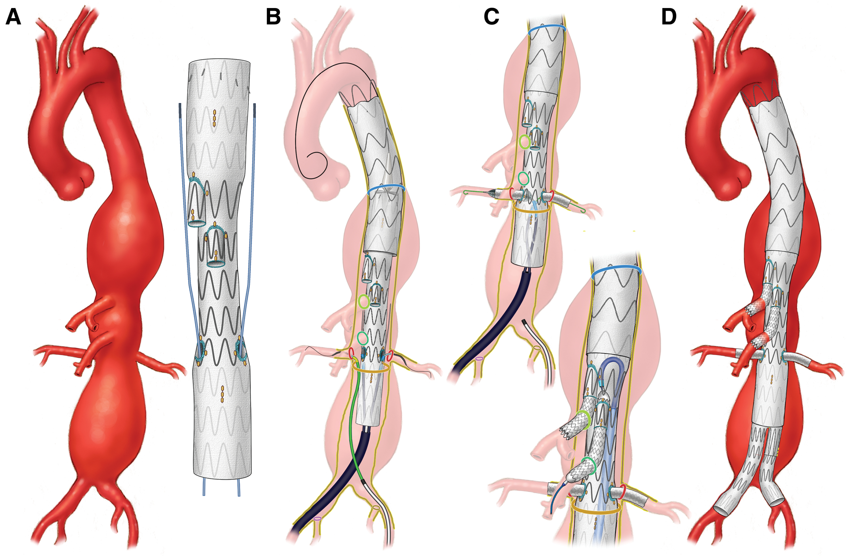
Endovascular repair- fenestrated
Gustavo S. Oderich, Thomas L. Forbes, Rabih Chaer, Mark G. Davies, Thomas F. Lindsay, Tara Mastracci, Michael J. Singh, Carlos Timaran, Edward Y. Woo, Reporting standards for endovascular aortic repair of aneurysms involving the renal-mesenteric arteries, Journal of Vascular Surgery, Volume 73, Issue 1, Supplement,

Slide 55
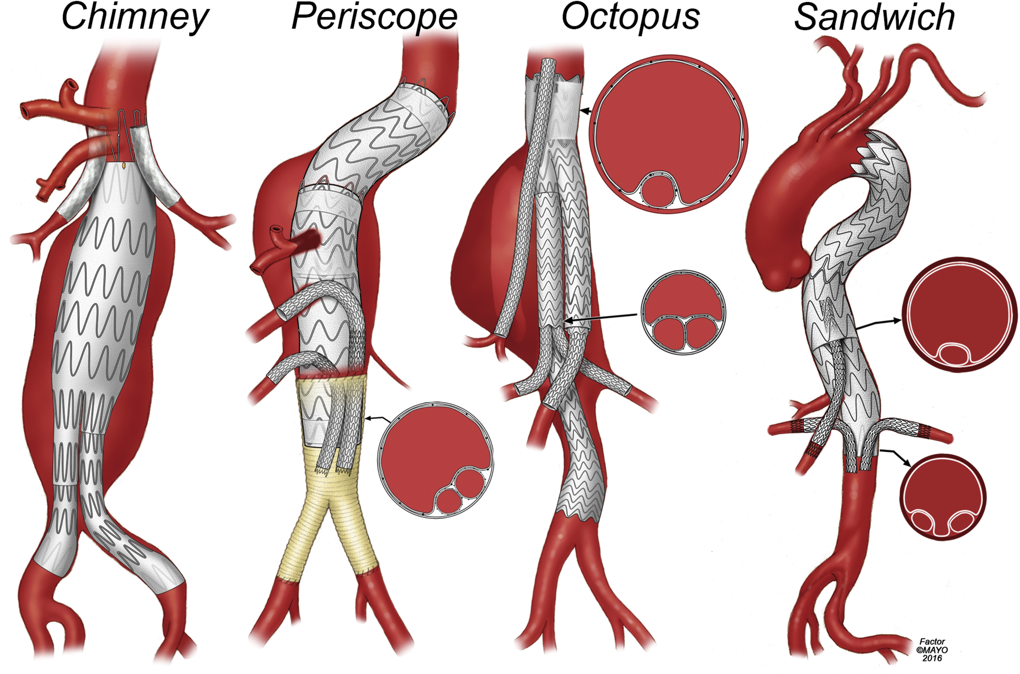
Endovascular repair- chimney
Reporting standards for endovascular aortic repair of aneurysms involving the renal-mesenteric arteries Oderich, Gustavo S. et al. Journal of Vascular Surgery, Volume 73, Issue 1, 4S - 52S

Slide 56
Thank you

