Slide 1
Renal Denervation
The New Frontier
Ayman Iskander, MD
St. Joseph Cardiovascular Symposium
April 2025

Slide 2
Hypertension is common

Slide 3
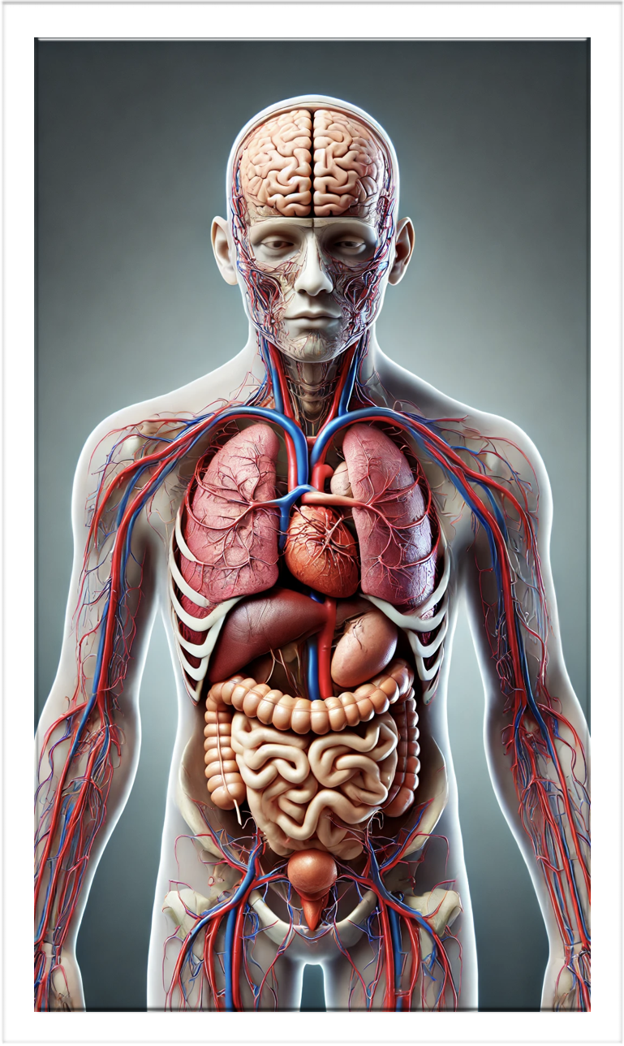
Hypertension is devastating
Brain
Stroke
Dementia
Aneurysm
ICH
HTN Encephalopathy
Eyes
Visual Loss
CV
CAD / MI
CHF
Aneurysms
Kidneys
CKD - ESRD
Bone
Bone loss
GU
ED

Slide 4
Hypertension aka. The Silent Killer is a Killer

Slide 5
Hypertension aka. The Silent Killer is a Killer

Slide 6
Hypertension Treatment is VERY effective

Slide 7
Hypertension treatment reduced morbidity & mortality
the Lancet
Blood pressure lowering for prevention of cardiovascular disease and death: a systematic review and meta-analysis
Volume 387, Issue 10022P957-967March 05, 2016

Slide 8
Hypertension Treatment

Slide 9
Hypertension - the burden
Only
18-23%
Controlled

Slide 10
Hypertension is vastly untreated

Slide 11
Hypertension is vastly untreated

Slide 12
Untreated Hypertension - Resistant HTN
True resistant hypertension
Pseudo resistant hypertension
Tolerance
Non adherence

Slide 13
Untreated Hypertension - Tolerance

Slide 14
Untreated Hypertension - Compliance

Slide 15
Hypertension Treatment - The Need

Slide 16
Hypertension Treatment - The Need

Slide 17
Hypertension Treatment - The Need
Lifestyle
Modification
Pharmaco-
Therapy
Lifestyle
Modification

Slide 18
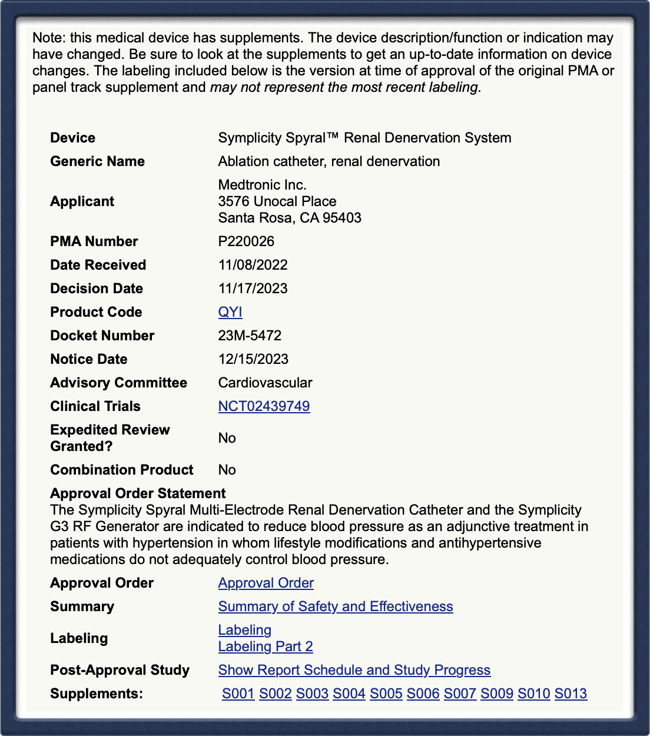
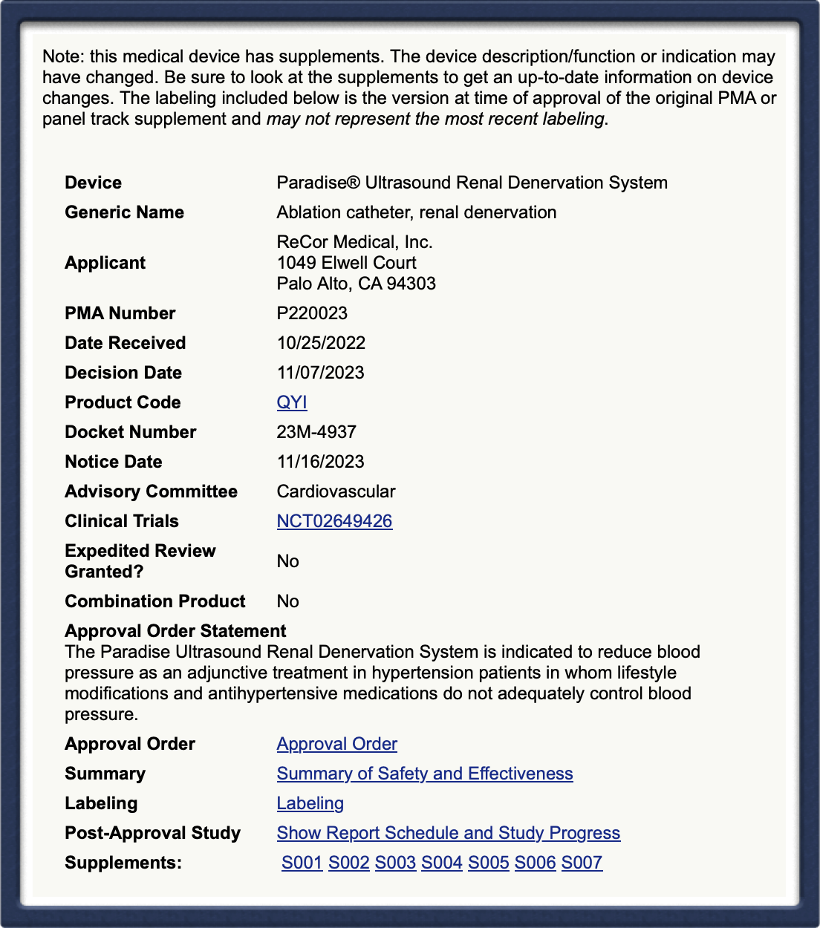
RDN - Current Status
Medtronic Simplicity Spyral
&
ReCor Paradise
Received FDA approval
in November 2023

Slide 19
RDN - Current Status - US

Slide 20
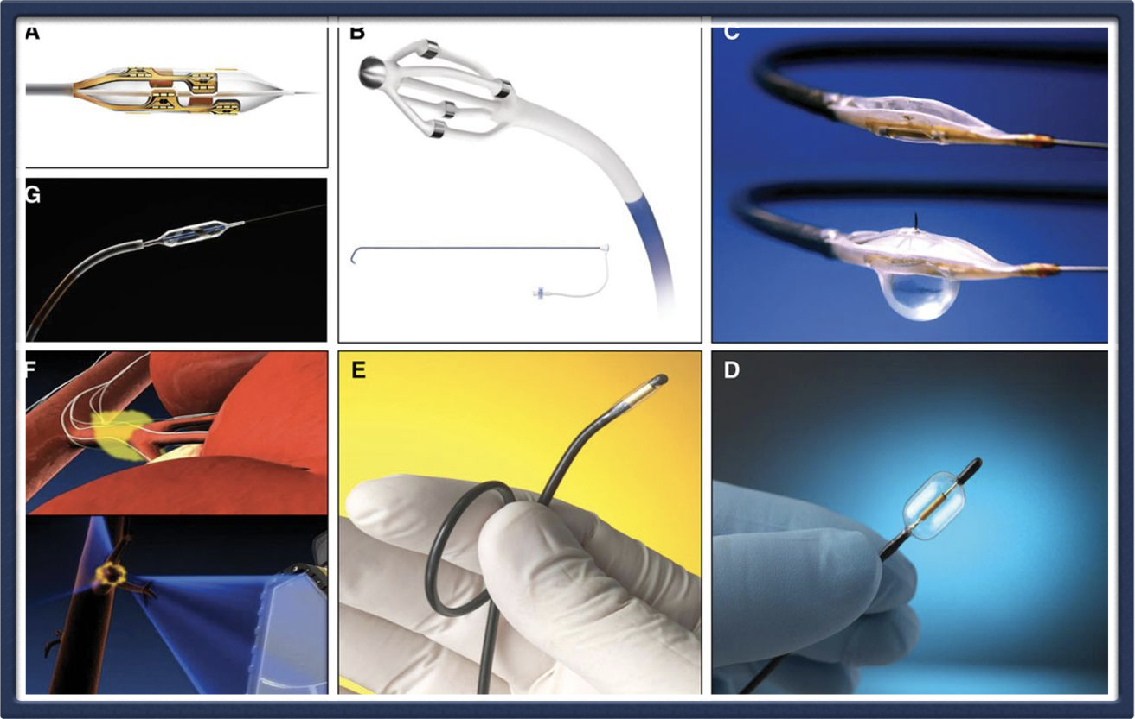
RDN - Current Status - Europe (CE marked)

Slide 21
Renal Denervation (RDN)

Slide 22
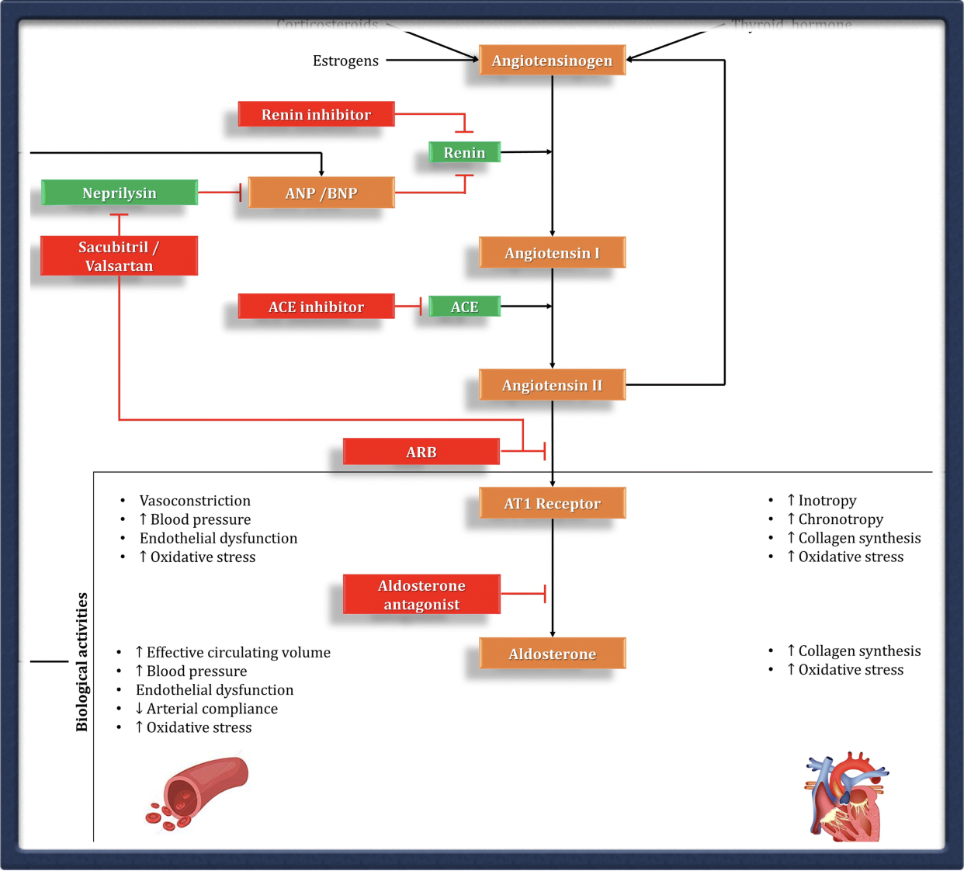
Renal Denervation (RDN)

Slide 23
Renal Denervation
Does it work ?

Slide 24
RDN - Does it work?

Slide 25
RDN - Does it work?
Bhatt et al, N Engl J Med 2014;370:1393-1401

Slide 26
RDN - Does it work?
Bhatt et al, Lancet 2022 Oct 22;400(10361):1405-1416

Slide 27
RDN - Does it work?
Problems with Simplicity HTN 3
Trial design
Technology

Slide 28
RDN - Does it work?
Technology
Simplicity Spiral
Multielectrode catheter
Simplicity Gen3
Generator
Side branch
Ablation

Slide 29
RDN - Does it work?
Design

Slide 30
RDN - Does it work?
Spiral HTN
Clinical Program

Slide 31
RDN - Does it work?
Spiral HTN
Clinical Program

Slide 32
RDN - Does it work?

Slide 33
Renal Denervation
Is it durable ?

Slide 34
RDN - Is it durable?

Slide 35
RDN - Is it durable?

Slide 36
Renal Denervation
Is it safe ?

Slide 37
RDN - Is it safe ?

Slide 38
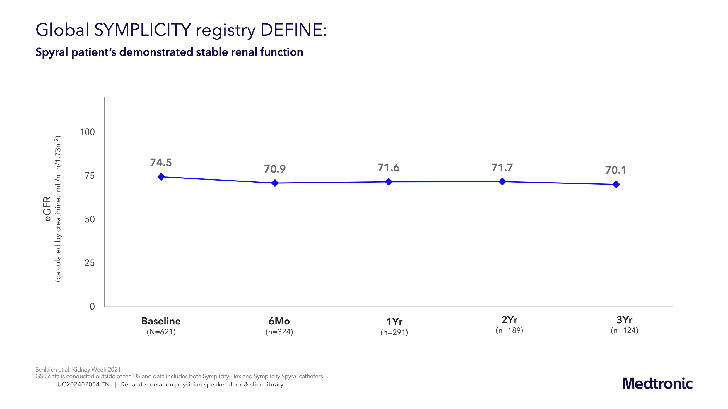
RDN - Is it safe ?

Slide 39
Renal Denervation
Who should get it ?

Slide 40
Shared decision
Patient
Referring
Physician
Interventionalist

Slide 41
Shared decision
Exclude “true” resistant hypertension
Reinforce compliance
Attempt to control BP with 2 drugs
Consider adherence, tolerance, side effects and D-D interactions
Referring
Physician
Patient
Interventionalist

Slide 42
Shared decision
Patient
Accept a slight risk of invasive procedure
Anticipate 5-10 mmHg reduction of SBP (i.e this is curative)
Anticipate to come off 1 to 2 drugs
Referring
Physician
Interventionalist

Slide 43
Shared decision
Interventionalist
Weigh the risk vs benefit of the procedure
Perfect skills with the procedure
Be specialized in endovascualr procedures
Referring
Physician
Patient

Slide 44
Is RDN cost-effective
Catheter-Based Radiofrequency Renal Denervation in the United States:
A Cost-Effectiveness Analysis Based on Contemporary Evidence
JSCAI, Volume 3, Issue 10102234October 2024

Slide 45
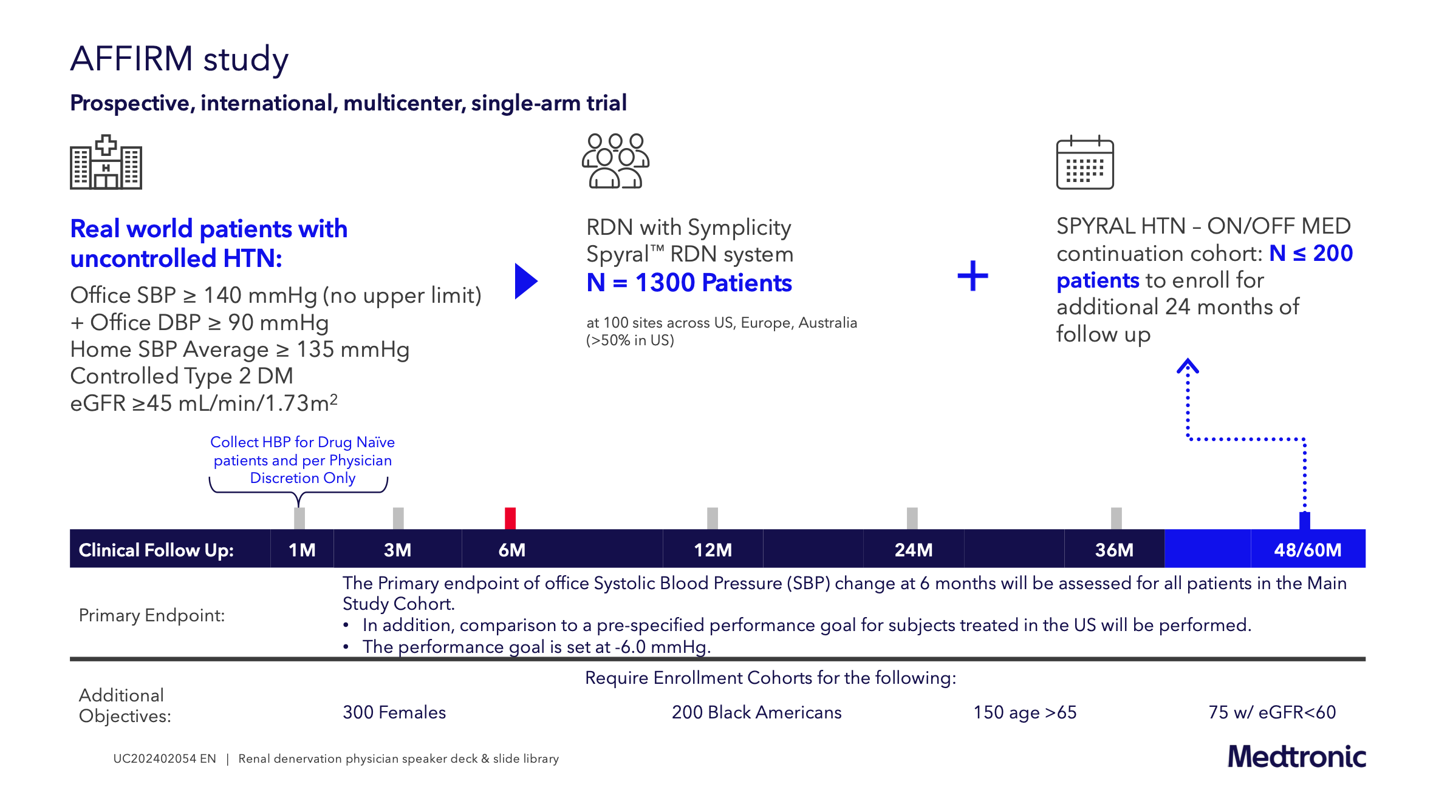
Current Research Projects

