Slide 1
Temporary Mechanical Circulatory Support (MCS) in Acute Decompensated Heart Failure (ADHF) and Cardiogenic Shock (CS).
Updates and Current Landscape

Slide 2
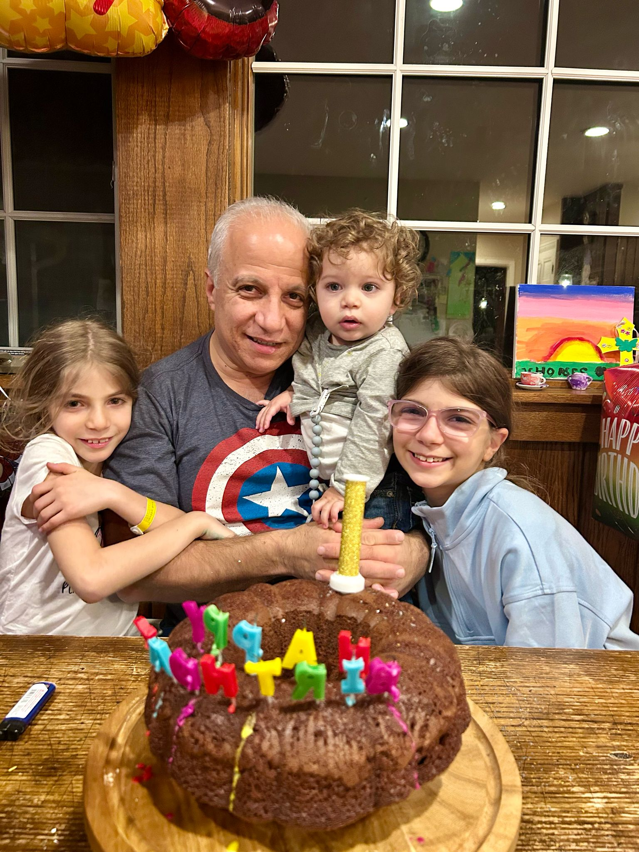

Slide 3
Background
Acute heart failure (HF) carries an unacceptably high mortality burden, necessitating continual advancements in therapeutic strategies to improve patient outcomes.
Temporary mechanical circulatory support (t-MCS) has emerged as a crucial intervention in the management of cardiogenic shock complicating acute heart failure, providing a bridge to recovery or to a durable version of mechanical support.

Slide 4
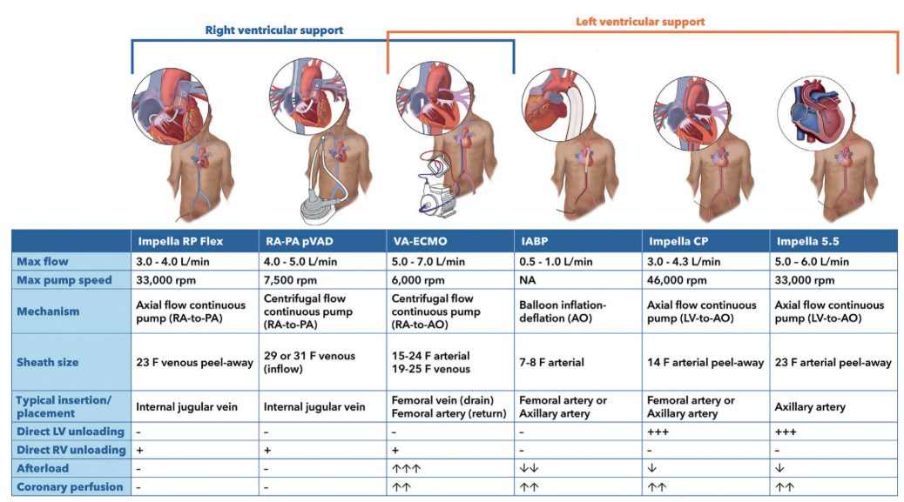
COMMON tMCS DEVICES USED

Slide 5
Intra-Aortic Balloon Pump (IABP)
Contraindications
Arrhythmias (Sync)
> mild AI
Vascular access

Slide 6
IABP: benefits
IABP support modestly enhances CO, particularly beneficial in scenarios with disproportional left ventricle (LV) afterload elevation. (Decreasing SVR in CS and potentially in venting the LV in VA-ECMO).
The prevalence of functional mitral regurgitation (MR) associated with worsening LV systolic dysfunction is sensitively addressed by IABP’s afterload reduction.
The modulation of splanchnic blood flow by IABP may prove beneficial, especially in hypoperfused ADHF cases with moderate/severe kidney dysfunction.
The combination of afterload reduction with myocardial perfusion improvement also ameliorates the arrhythmic substrate.the arrhythmic substrate.

Slide 7
IABP: Evidence and indications
Limited Evidence in post-AMI CS. Less frequently used in this subset.
Modest and mostly retrospective evidence in ADHF.
Still a part of the armamentarium, used mostly to improve coronary perfusion post MI and in patients awaiting CABG.
Niche indication for post- MI VSD and acute MR.
Use when larger access is not available for the insertion of other devices.
LV venting in conjunction with VA-ECMO in patients with mechanical AV or LV thrombus. (some intrinsic LV function must be present)

Slide 8
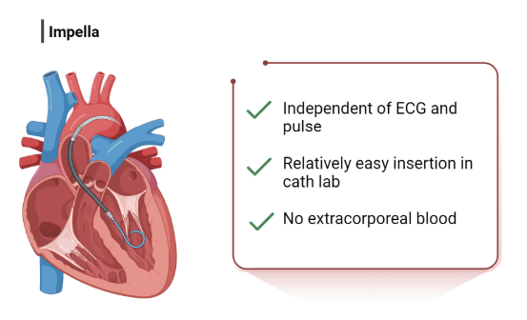
Impella
Contraindications
Mechanical AV.
LV thrombus.
Severe PVD (CLI).
Caution with VSD.
Intolerance to anticoagulation)

Slide 9
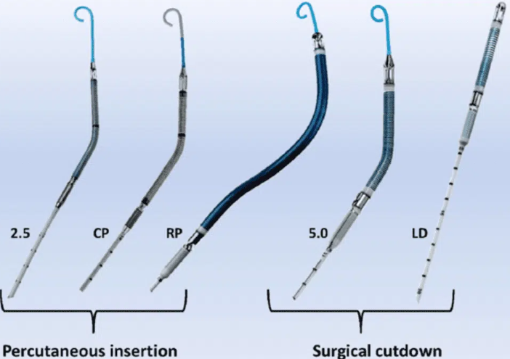
Impella Variations
ECP Impella with 9Fr. at insertion and removal expandable pump generates up to 5 l/min

Slide 10
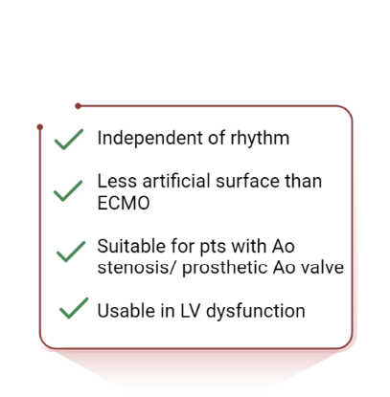
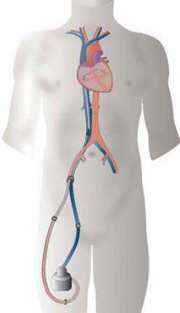
TandemHeart

Slide 11
TandemHeart
Oxygenated blood is suctioned from the left atrium and pumped back into the arterial circulation bypassing the left ventricle. Generates 4 l/min.
21 Fr. suction Catheter inserted to LA via transseptal.
Blood pumped back through 16-17 Fr. Femoral arterial cannula.
More difficult insertion requires TS with risk of tamponade, vascular complications, etc…

Slide 12
TandemHeart
Evidence is based on observational data and case studies.
Insertion through TS limits its wide application.
May increase the LV afterload which would require LV venting.
Useful in prosthetic valves and aortic stenosis and isolated LV failure.
Main application is bridge to LVAD as prognosis is grim when used as bridge to recovery (Survival 23%).

Slide 13
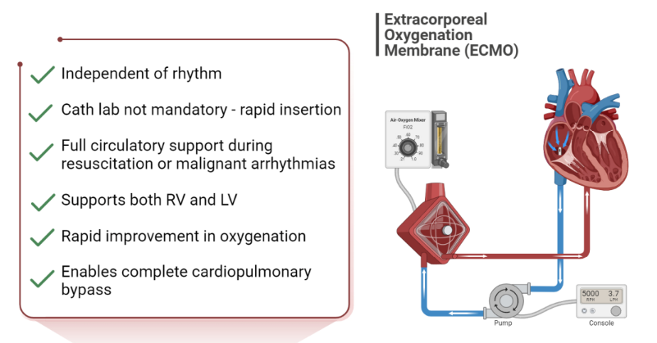
ECMO

Slide 14
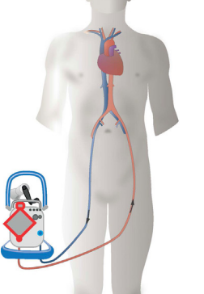
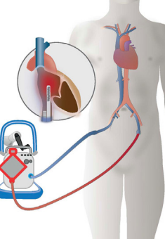
ECMO
VA-ECMO
VV-ECMO

Slide 15
VA-ECMO
Peripheral (Fem-fem, Ax-Ax…) or central cannulation if PVD.
18-28 Fr. vein/ 16-19 Fr artery.
Increases the LV afterload which would require LV venting (IABP, ECpella, LA cannula (LA-VA), LV cannula, Septostomy).
Limb ischemia: need for APC.
Harlequin or North-South syndrome in delayed lung recovery requires adding a venous cannula.(V-VA-ECMO).
Weaning with Impella.

Slide 16
VA-ECMO Applications
Bridge to LVAD or Transplant in ADHF (HF-CS).
Bridge to recovery (where there is hope of recovery) in AMI and myocarditis with Shock (AMI-CS).
E-CPR in qualified patients post cardiac arrest (consider age, pre-existing comorbidities and MIRACLE-2 score).

Slide 17
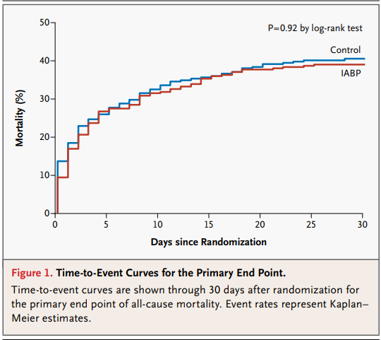
Evidence for IABP in CS post AMI
IABP-SHOCK II
2012
N=600
IABP vs. MEDICAL

Slide 18
Evidence for Impella in CS post AMI
Impella Support for Acute Myocardial Infarction Complicated by Cardiogenic Shock.
Matched-Pair IABP-SHOCK II Trial 30-Day Mortality Analysis.
Circulation.2019;139:1249–1258.

Slide 19
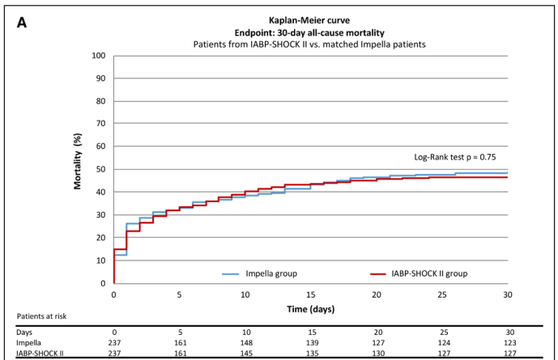
Evidence for Impella in CS post AMI
Circulation.2019;139:1249–1258

Slide 20
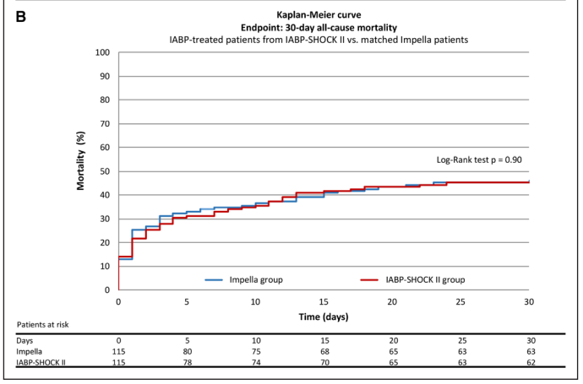
Evidence for Impella in CS post AMI
Circulation.2019;139:1249–1258

Slide 21
Microaxial Flow Pump or Standard Care in Infarct-Related Cardiogenic Shock (DanDer-Shock Trial) N Engl J Med 2024;390:1382-1393
350 patients (Median LVEF ~ 25%) suffering from STEMI and cardiogenic shock randomized Impella vs. standard care.
Impella led to lower risk of death from any cause at 180 days (45.8% vs. 58.5%, HR 0.74; 95% CI, 0.55 to 0.99; p = 0.04).
However, the risk of adverse events, specifically the need for renal replacement therapy, was observed more frequently in those who randomized to MCS compared to those who were treated according to the standard of care (41.9% vs. 26.7%, RR 1.98; 95% CI, 1.27 to 3.09).

Slide 22
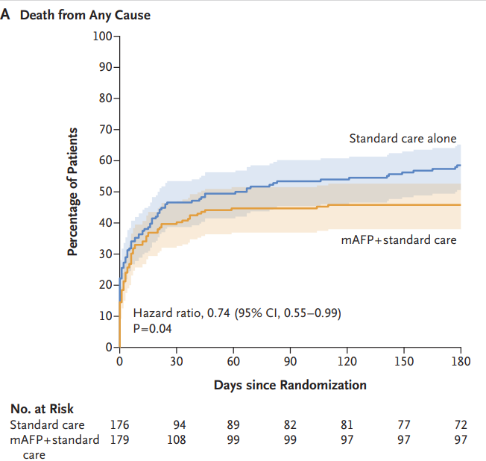
Microaxial Flow Pump or Standard Care in Infarct-Related Cardiogenic Shock (DanDer-Shock Trial) N Engl J Med 2024;390:1382-1393

Slide 23
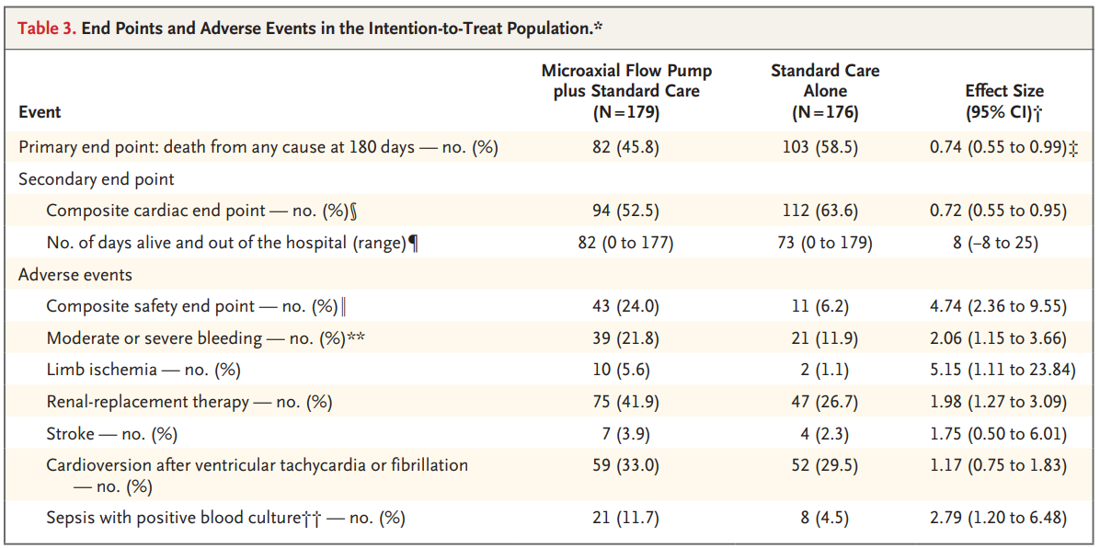
Microaxial Flow Pump or Standard Care in Infarct-Related Cardiogenic Shock (DanDer-Shock Trial) N Engl J Med 2024;390:1382-1393

Slide 24
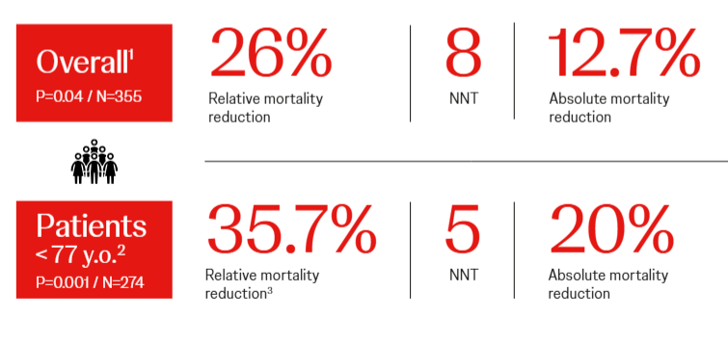
Microaxial Flow Pump or Standard Care in Infarct-Related Cardiogenic Shock (DanDer-Shock Trial) N Engl J Med 2024;390:1382-1393

Slide 25
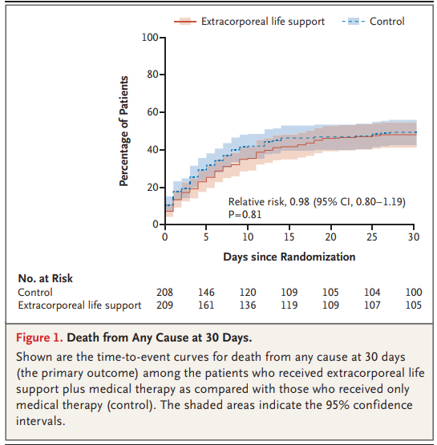
Extracorporeal Life Support in Infarct-Related Cardiogenic Shock (ECLS-SHOCK Trial) N Engl J Med 2023;389:1286-1297

Slide 26
Current Practice
The attempt to achieve hemodynamic stabilization in patients with severe or rapidly deteriorating infarct-related cardiogenic shock (AMI-CS) is the most common indication for initiation of MCS therapy.
The use of ECLS and other techniques for mechanical circulatory support increased substantially when percutaneous systems became widely available and after studies showed a lack of survival benefit for the intra-aortic balloon pump as a former standard of hemodynamic support.
On the basis of findings from observational studies, current international guidelines and scientific statements support a strategy of mechanical circulatory support, albeit based on weak levels of evidence.

Slide 27
Weight of Evidence
So far, randomized trials that have evaluated the effect of ECLS in patients with post infarct cardiogenic shock have shown neutral results.
One Randomized Trial (Dan-Ger Shock) showed survival benefit of Impella vs. standard of care in this population. This came with a substantial increase in serious bleeding, CLI and AKI.
IABP data is weak and a randomized trial showed no advantage of counterpulsation over standard care alone in post-infarct CS.
TandemHeart requires TS and its use is therefore limited for this indication.

Slide 28
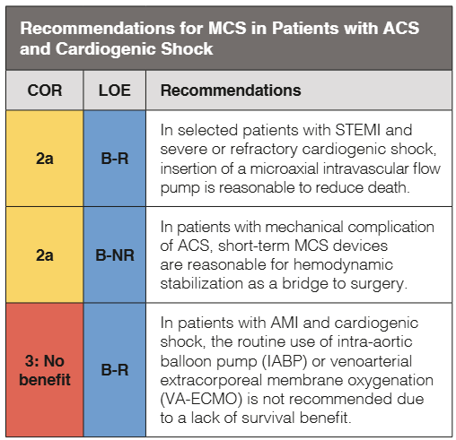
Guidelines

Slide 29
Transient MCS is useful as a bridge to transplant or LVAD in ADHF.
It may be of benefit as a bridge to recovery in reversible causes of acute heart failure (myocarditis etc…) and in high-risk procedures (PCI, VT ablation).
The body of evidence is limited in post-MI cardiogenic shock (Impella) as benefit is often offset by frequent complications. Patient selection (Dan-Ger excluded comatose patient post OHCA), careful access choice and management, team approach may help decrease complications and improve outcomes.

Slide 30
2025 Concise Clinical Guidance:
An ACC Expert Consensus Statement on the Evaluation and Management of Cardiogenic Shock

Slide 31
SHOCK TEAM
Early screening and recognition of AMI-CS.
Transfer to the appropriate unit or center.
Use of biomarkers (lactates, ALT etc..) of end organ hypoperfusion.
Frequent concomitant use of EKG and echocardiography assessing LV/RV.
Invasive hemodynamic monitoring (PAPI <0.9 , RA/PCWP ratio >0.6 etc…)
Early escalation of therapy before irreversible damage.
Guidance on inotropes, PEEP etc…

Slide 32
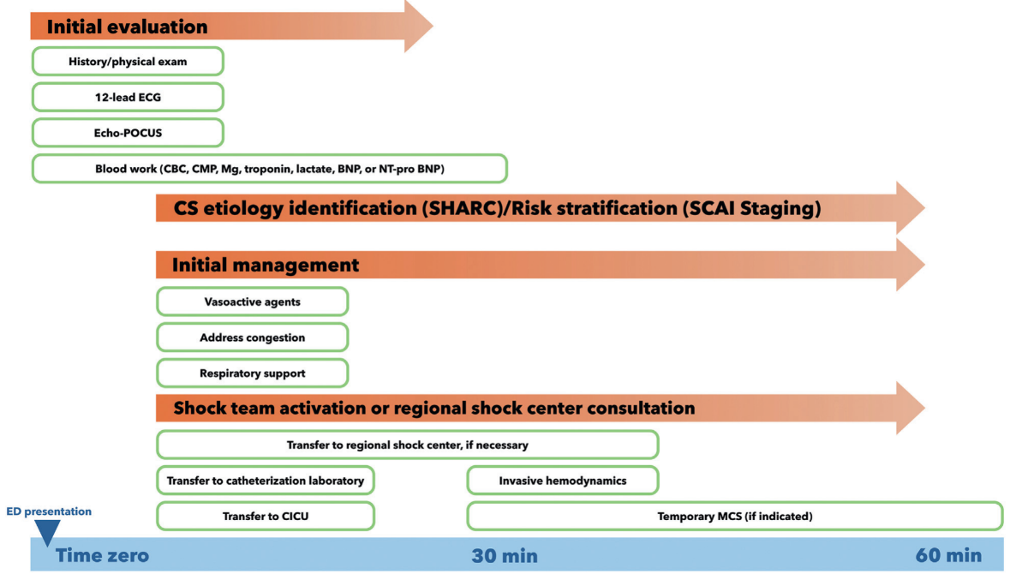

Slide 33
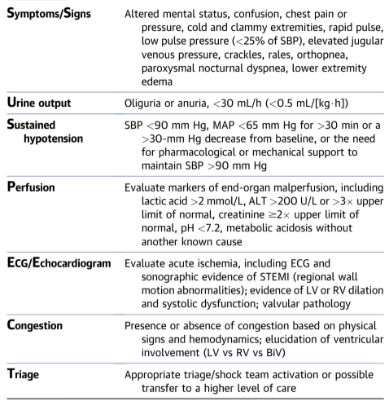
EARLY IDENTIFICATION
(SUSPECT-CS).

Slide 34
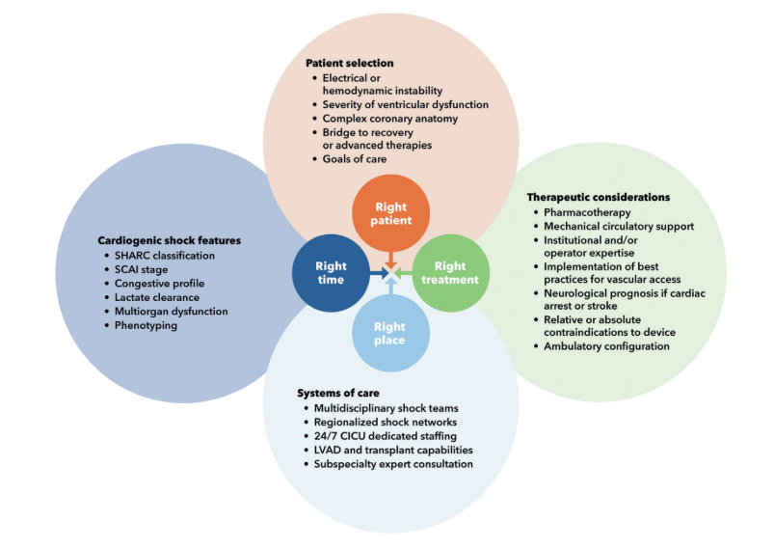
GOAL

Slide 35
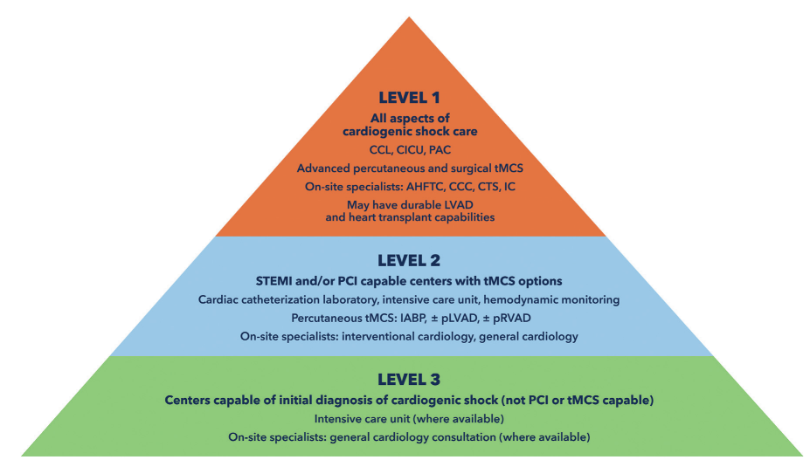
KNOW YOUR LIMITS

Slide 36
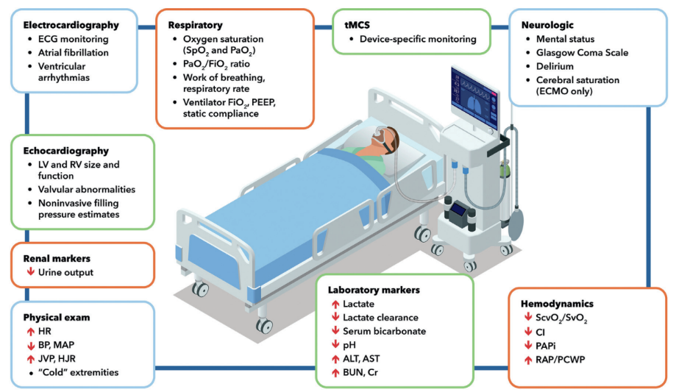
MONITORING

Slide 37
VASOPRESSORS
Lowest dose possible.
Avoid pure vasoconstrictors (Neo, vaso): reflex brady and increased SVR lead to decreased CO.
No study showed advantage of one inopressor over another.
Caution with milrinone in renal failure.
Transrenal perfusion gradient (MAP-CVP).
LEVOSIMENDAN:
calcium sensitizer (Binds to troponin C, making it more sensitive to calcium thereby improving interaction between troponin C and I)
improves contractility and induces vasodilatation (ATP-sensitive K channels)
T1/2 is 1 hour but active metabolite 80 h

Slide 38
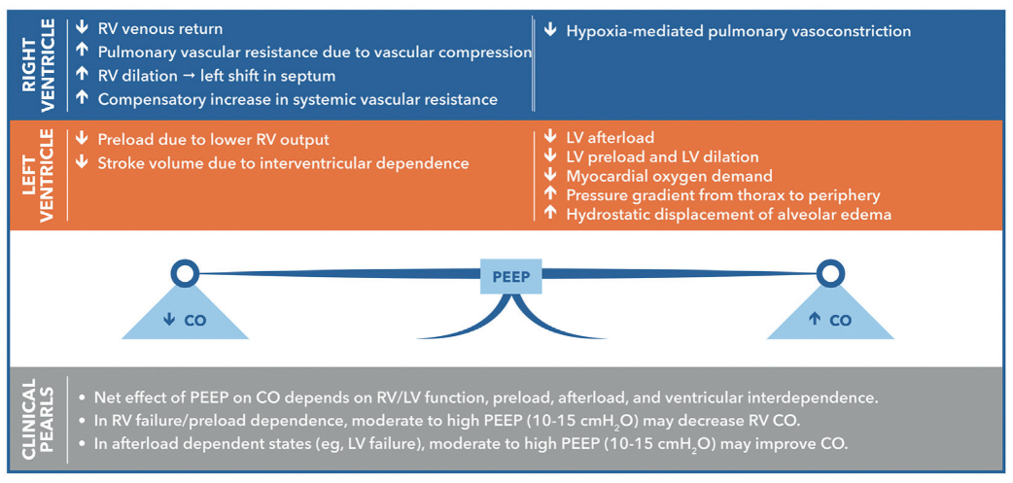
VENTILATION

Slide 39
VENTILATION

Slide 40
RV INFARCT-CS
PAPi < 0.9 (PAPs-PAPd)/CVP
Rarely isolated. Most frequently associated with LV failure.
Treatment cornerstone:
optimize RV-preload (CVP 12-14).
decrease RV-afterload (decreasing PCWP/PAP by unloading LV first ie impella CP first unless EDP is normal).
Avoid ventricular interdependence (maintain CVP/Wedge optimal ratio).
Avoid high PEEP.
Improved CVP is early sign of recovery.

Slide 41
Thanks!

Slide 42
