Slide 1




Cardiac CT in Risk Stratification and Management of Chronic Coronary Syndromes
Rhanderson Cardoso, MD, FACC
Assistant Professor of Medicine
Brigham and Women’s Hospital
Harvard Medical School
Notes:
Early phase and delayed phase without filling defect
3 pulmonary veins – shared ostia
4 pulmonary veins
Add MESA risk stratification
Add for young patients
Add influence of CAC on patient and physician behavior

Slide 2



Disclosures
Research funding, Cleerly, Inc

Slide 3
57-year-old woman with chest pain and no known CAD
Symptoms:
Nonexertional substernal chest pain, without radiation
Pressure-like, mild-to-moderate in intensity
Ongoing for 6 months, on average once a week, but variable
Risk factors:
Hypertension, hyperlipidemia, obesity, former smoker

Slide 4
57-year-old woman with chest pain and no known CAD
Medications:
amlodipine 5 mg daily
Lifestyle:
Works as a teacher, no regular physical activity, quit smoking 15 years ago
Exam:
HR 68 bpm, BP 136/74 mmHg, BMI 31 Kg/m²
Normal cardiac, pulmonary, and vascular exam
Notes:
Within the past year

Slide 5
57-year-old woman with chest pain and no known CAD
Labs:
CBC, BMP unremarkable
TC 210 mg/dL, HDL 54 mg/dL, LDL-C 132 mg/dL
Prior testing:
No prior chest CT or stress testing
Notes:
Within the past year

Slide 6
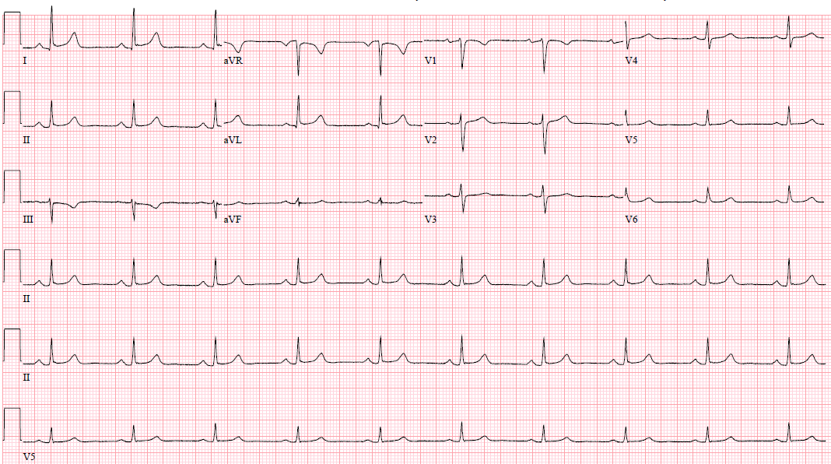
Notes:
Within the past year

Slide 7
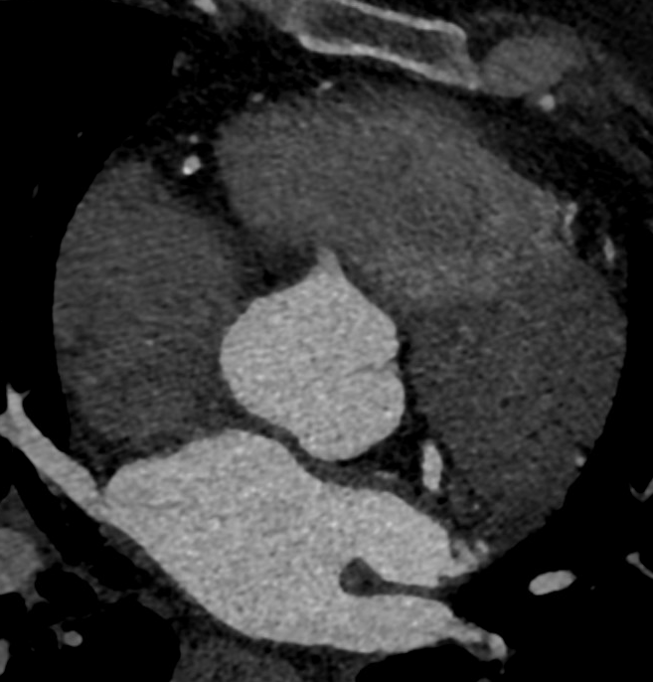
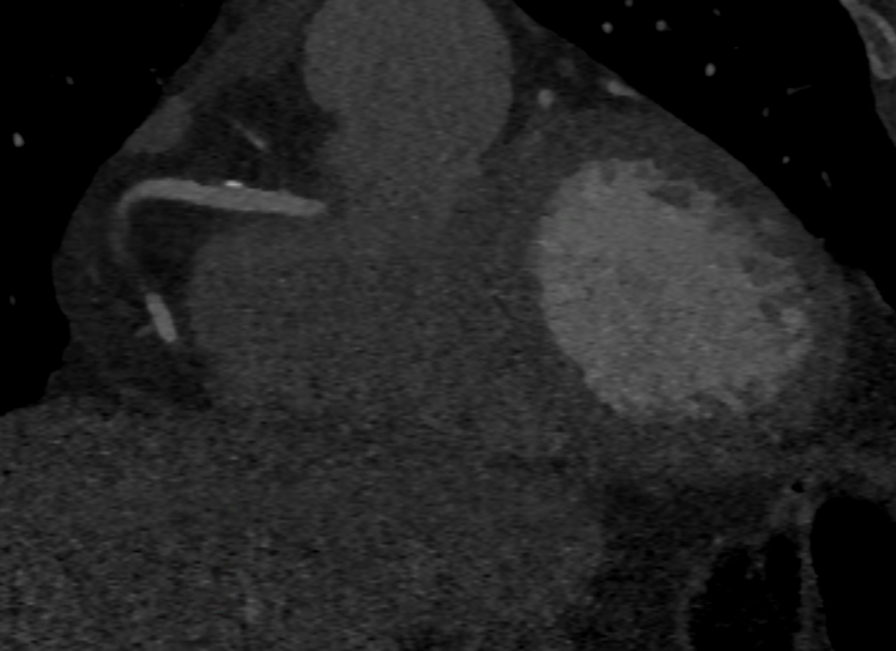
RCA

Slide 8
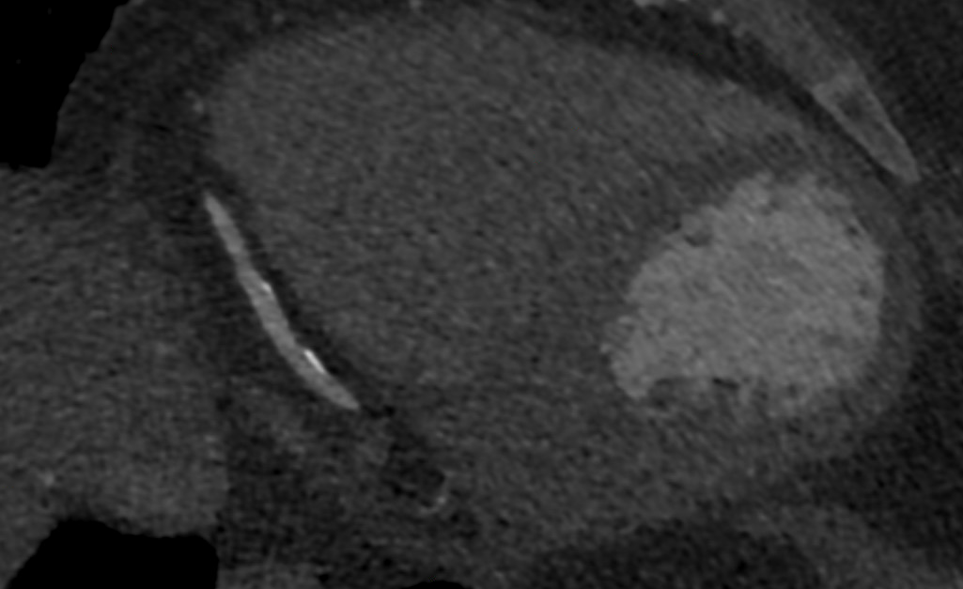
RCA

Slide 9
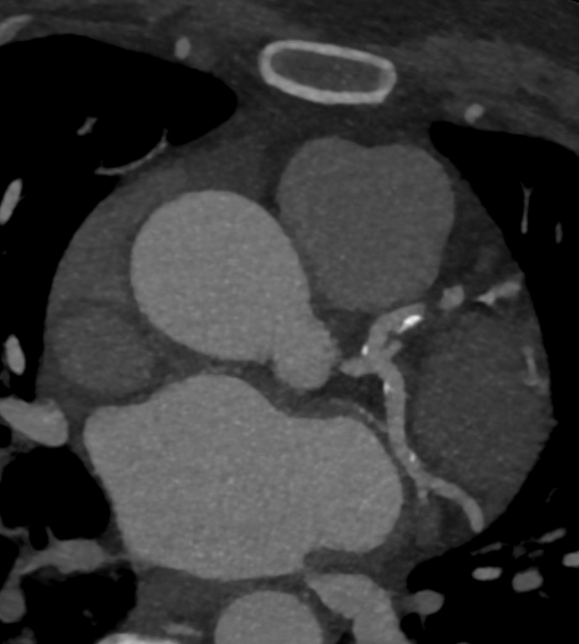
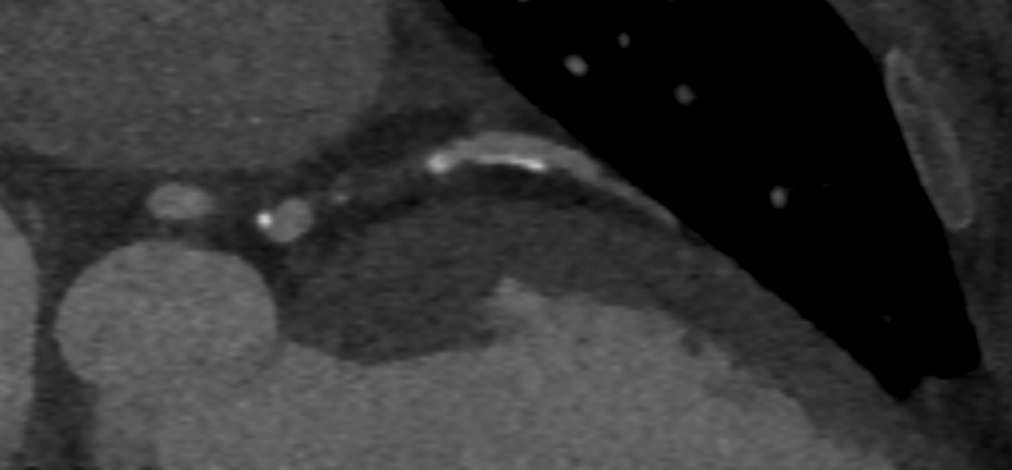
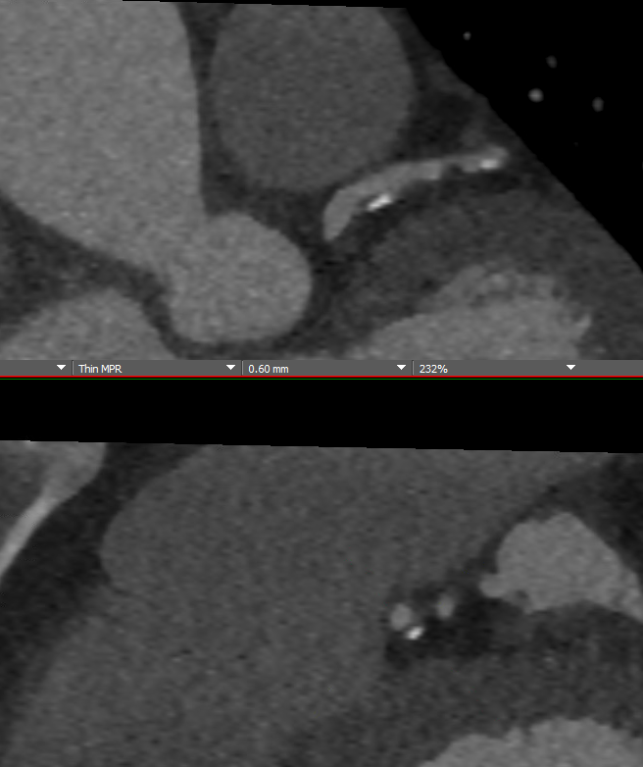
Notes:
Mild stenosis on the proximal LD

Slide 10
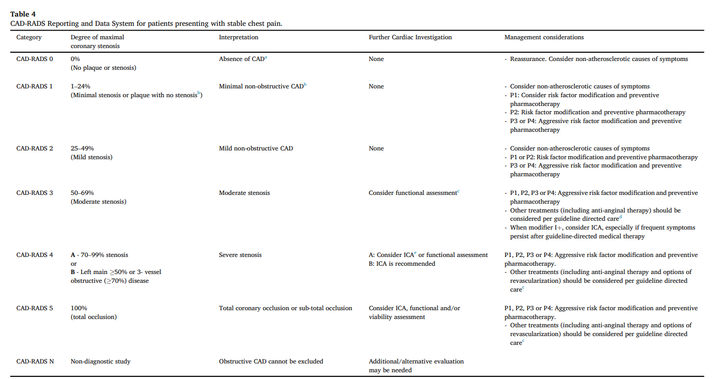

Slide 11
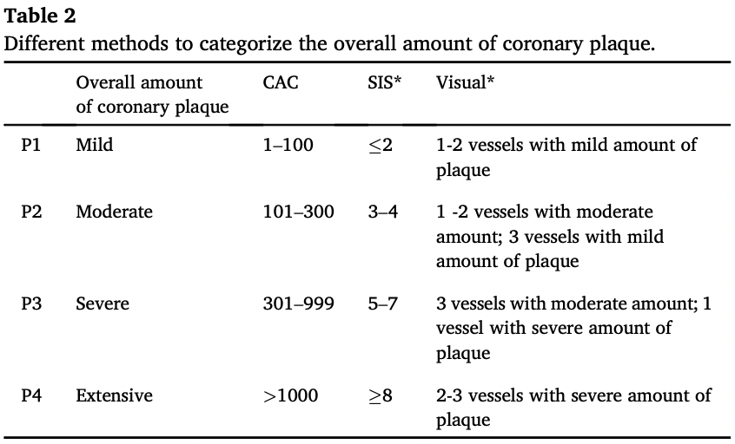

Slide 12
Final report
CAD-RADS 1/P3: Consider non-atherosclerotic causes of symptoms. Aggressive risk factor modification and preventive pharmacotherapy.
Notes:
Within the past year

Slide 13
Outline and learning objectives
Recall guideline recommendations for CCTA vs. functional testing in stable chest pain.
Understand traditional (current) methods of assessing plaque burden.
Discuss the impact of plaque burden for ASCVD risk and prognosis.
Analyze plaque burden and apply to patient care.
Quantitative plaque assessment and challenges in clinical practice.
Notes:
Within the past year

Slide 14
Outline and learning objectives
Recall guideline recommendations for CCTA vs. functional testing in stable chest pain.
Understand traditional (current) methods of assessing plaque burden.
Discuss the impact of plaque burden for ASCVD risk and prognosis.
Analyze plaque burden and apply to patient care.
Quantitative plaque assessment and challenges in clinical practice.
Notes:
Within the past year

Slide 15
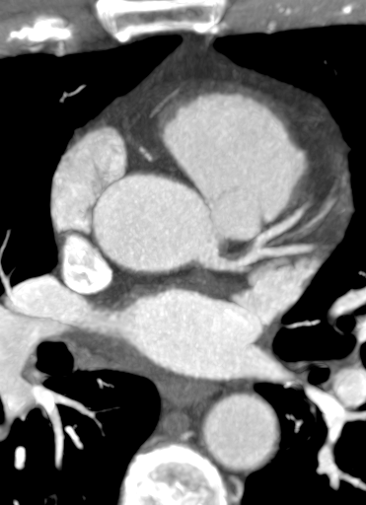
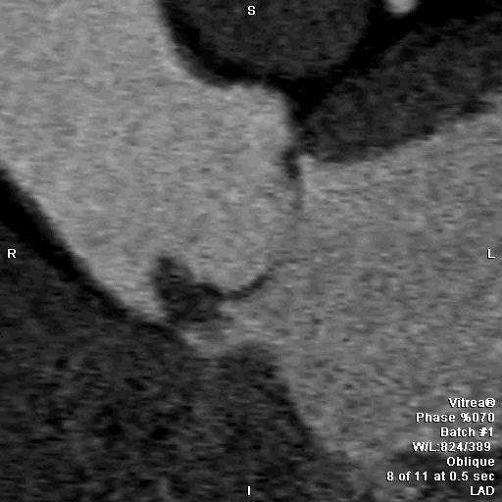
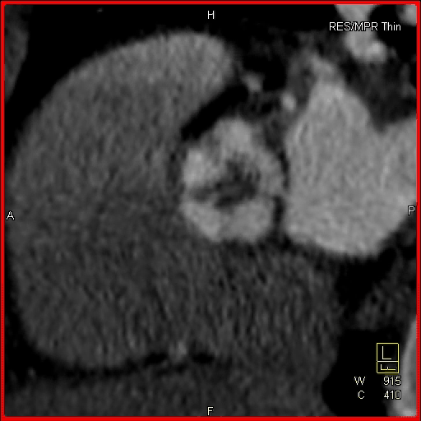
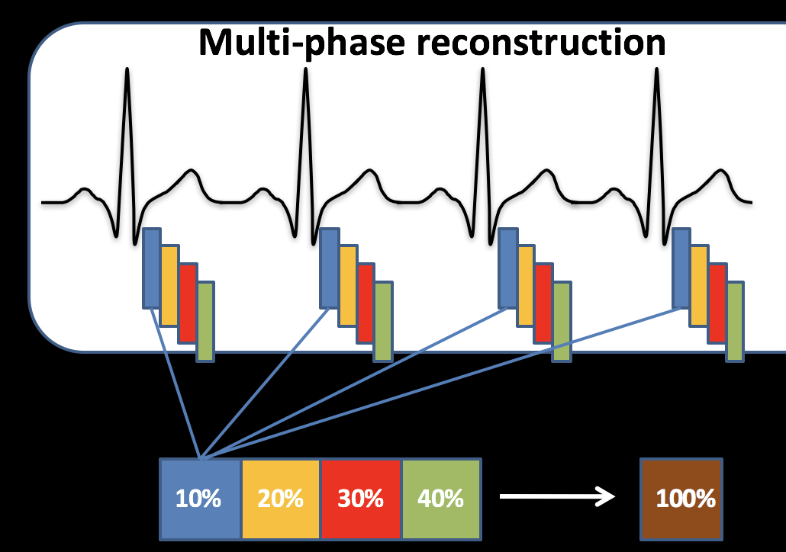
Different types of cardiac CT
Coronary Calcium Coronary CTA Multiphase Cardiac CT
Evaluate Valves
Cardiac Function
Quick
Inexpensive
Low radiation dose
Reproducible
Powerful prognostic data
Can identify non-calcified plaque
Evaluate for obstructive CAD
Requires IV contrast

Slide 16
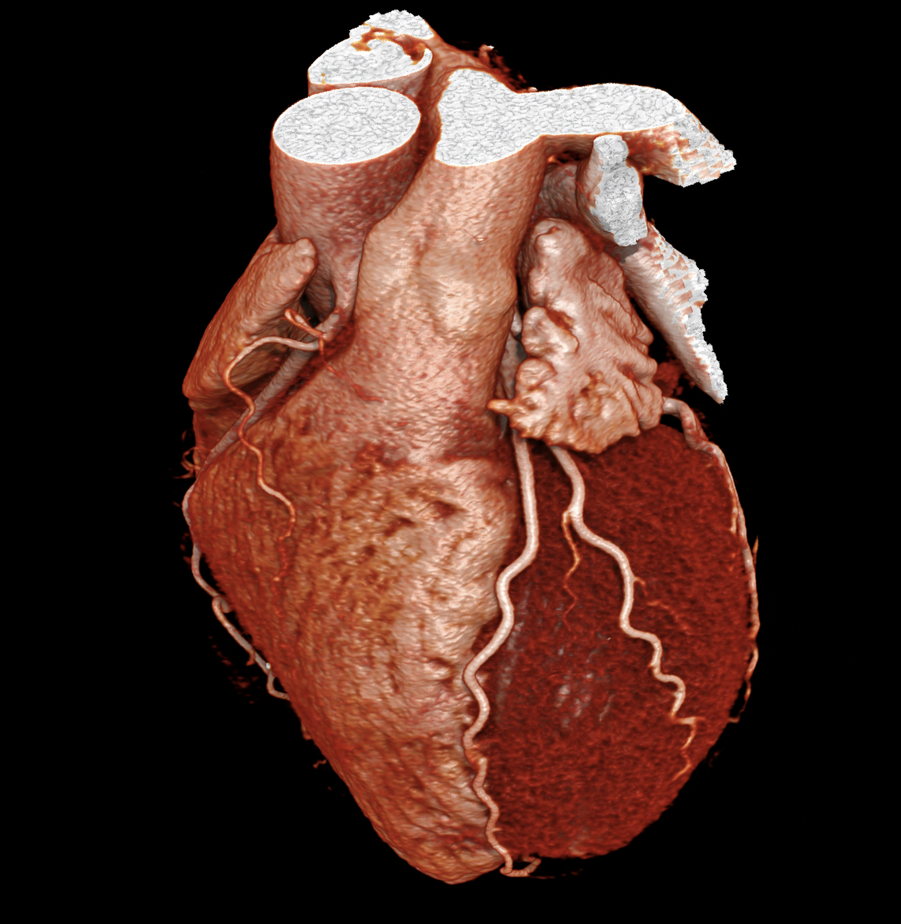
Coronary CT
Angiography

Slide 17
Stenosis severity
CAD-RADS 0 – no stenosis
CAD-RADS 1 – minimal (1-24%) stenosis
CAD-RADS 2 – mild (25-49%) stenosis
CAD-RADS 3 – moderate (50-69%) stenosis
CAD-RADS 4 – severe stenosis (70-99%)
CAD-RADS 5 – total occlusion (100%)
Notes:
Within the past year

Slide 18
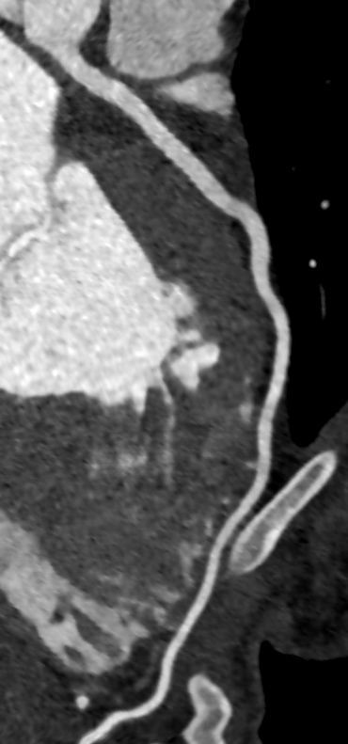
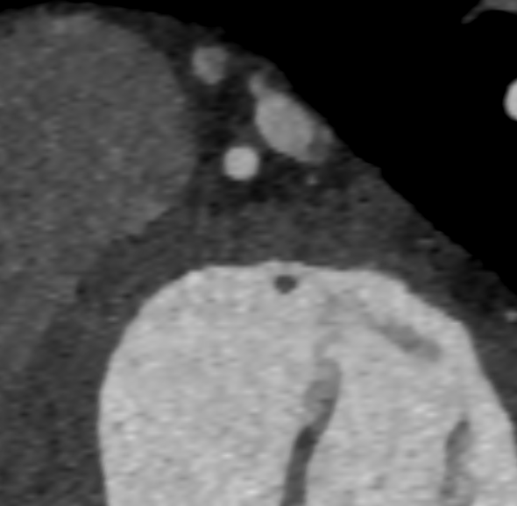
No stenosis (CAD-RADS 0)
Notes:
Within the past year

Slide 19
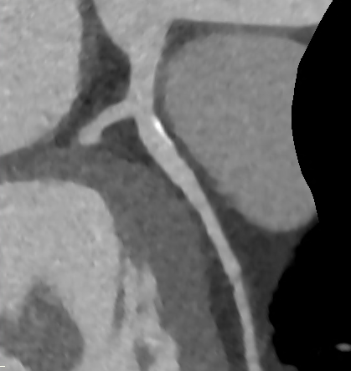
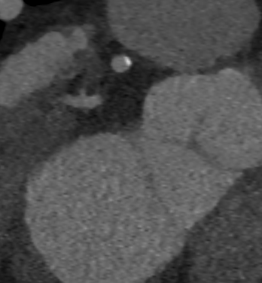
Minimal stenosis (CAD-RADS 1)
Notes:
Within the past year

Slide 20
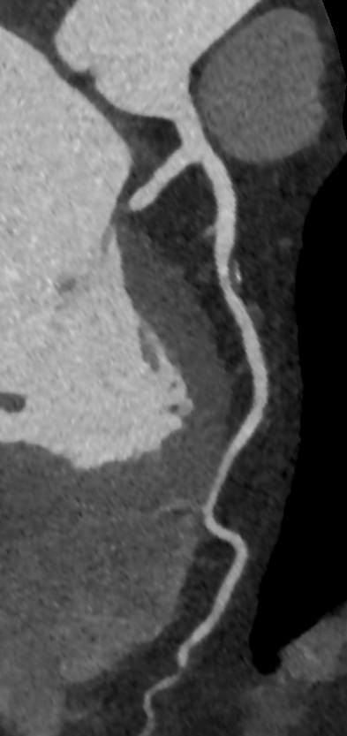
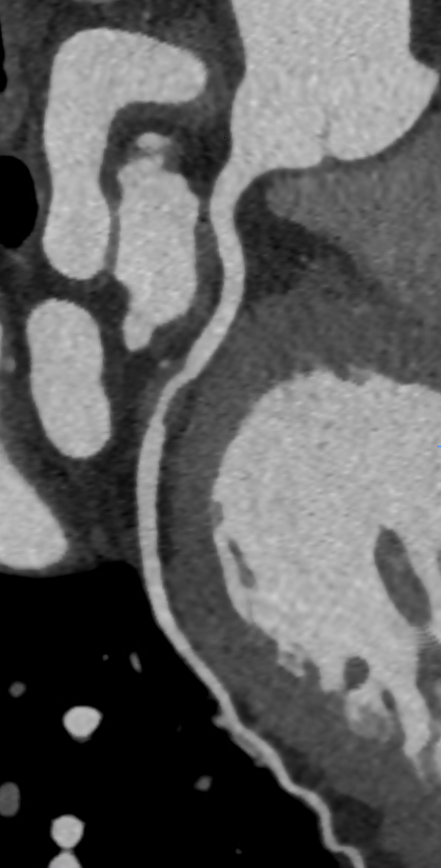
Moderate stenosis (CAD-RADS 3)
Notes:
Within the past year

Slide 21
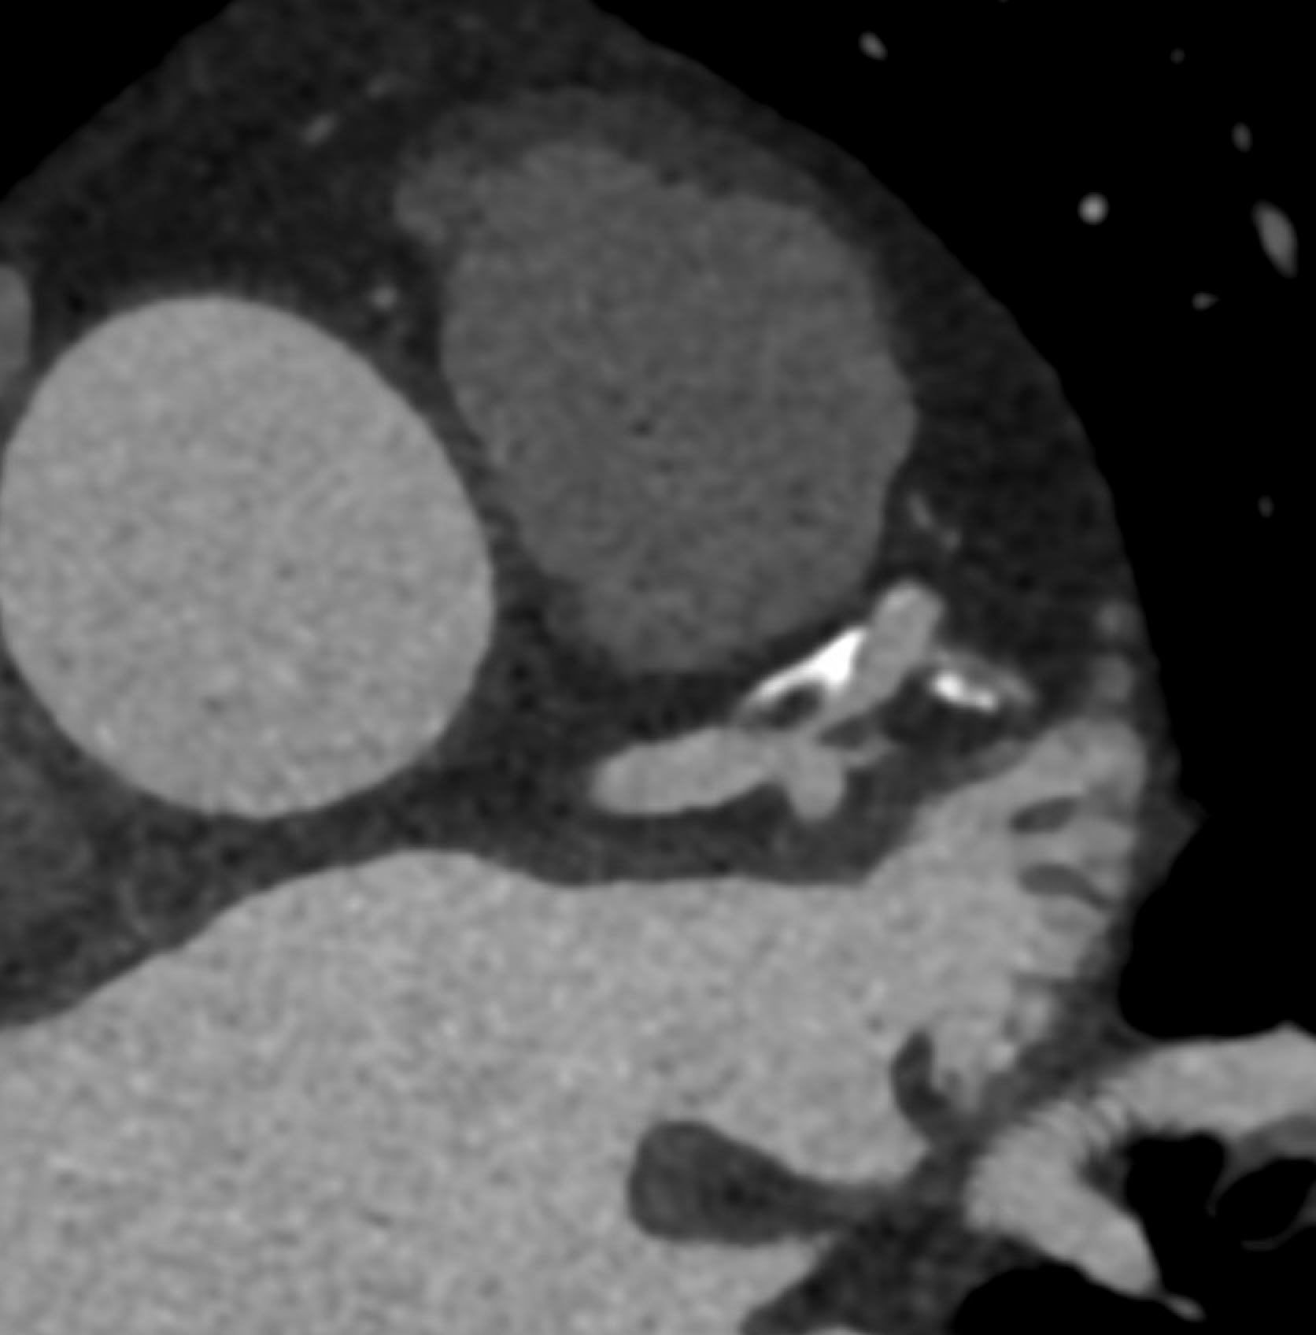
Severe stenosis (CAD-RADS 4)
Notes:
Within the past year

Slide 22
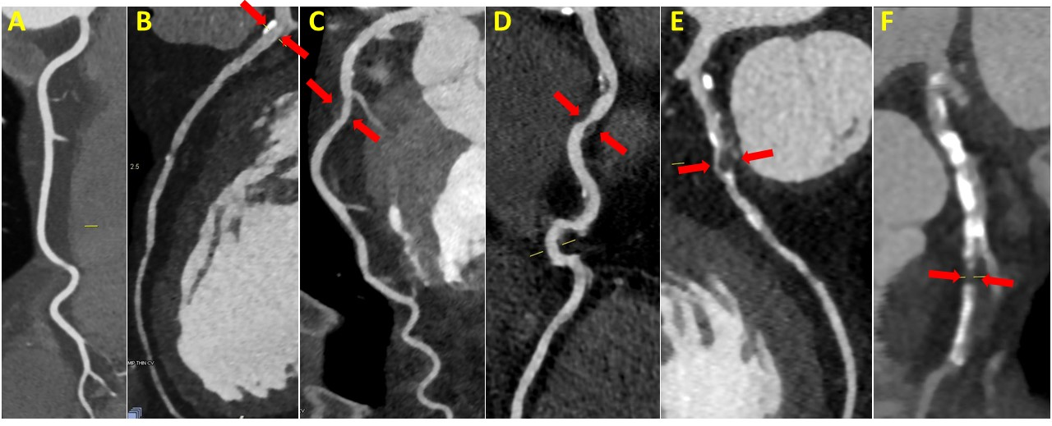
Coronary CTA: Spectrum of Stenosis
Normal
Minimal
Mild
Moderate
Severe
Occluded
Notes:
Figure 2: CAD-RADS: Coronary Artery Disease - Reporting and Data System classification.
A) CAD-RADS 0 : coronary with no plaque or stenosis (0%)
B) CAD-RADS 1 : there is a small amount of calcified plaque in the proximal segment of the coronary resulting in minimal stenosis (1-24%) (red arrows)
C) CAD-RADS 2 : there is a small amount of non-calcified plaque in the mid segment of the coronary resulting in mild stenosis (25-49%) (red arrows)
D) CAD-RADS 3 : there is a moderate amount of calcified and non-calcified plaque the coronary resulting in moderate stenosis (50-69%)of the mid segment (red arrows)
E) CAD-RADS 4 : there is a large amount of calcified and non-calcified plaque the coronary resulting in severe stenosis (70-99%) of the mid segment (red arrows)
F) CAD-RADS 5 : there is a large amount of calcified and non-calcified plaque the coronary resulting in total occlusion (100%) of the mid segment (red arrows)

Slide 23
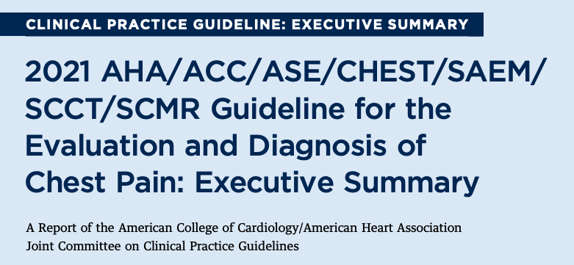
Gulati et al. J Am Coll Cardiol 2021.

Slide 24



CORONARY CT ANGIOGRAPHY
INVASIVE CORONARY ANGIOGRAPHY

Slide 25
2021 Chest Pain Guidelines
Among patients with stable angina but no known CAD who require further testing, non-invasive testing is recommended.
Referring patients directly to invasive angiography is not supported by guidelines!
Even among highest risk patients, only ~50% likelihood of obstructive CAD.
Notes:
Within the past year

Slide 26
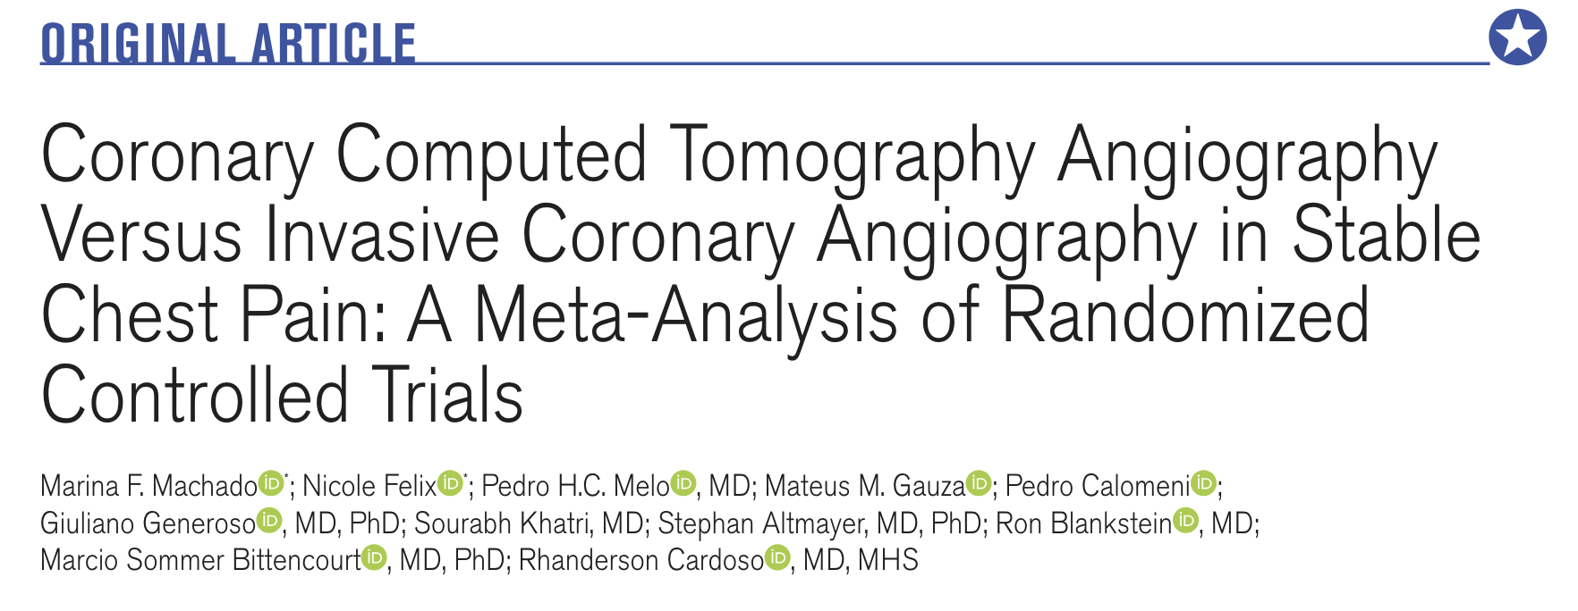
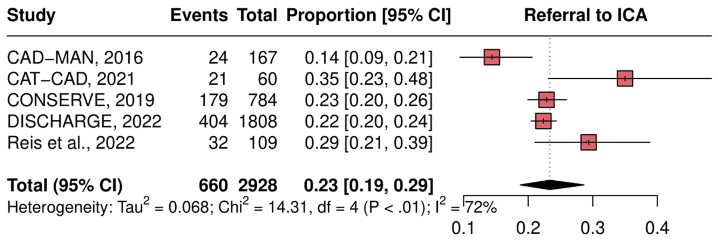
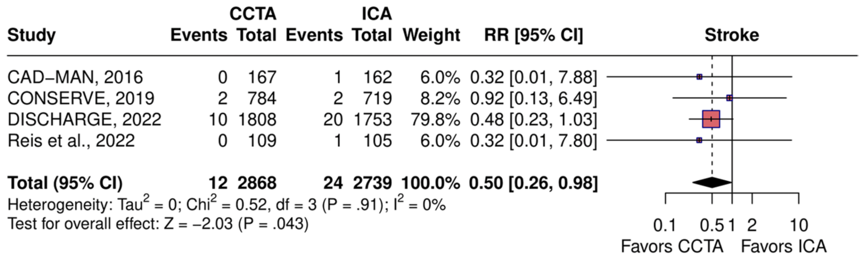
CCTA vs. Invasive Angio Meta Analysis
5 randomized trials
5727 patients w/ stable chest pain, who were initially referred to ICA
CCTA avoided the need for ICA in 77% of patients otherwise referred for ICA.

Slide 27
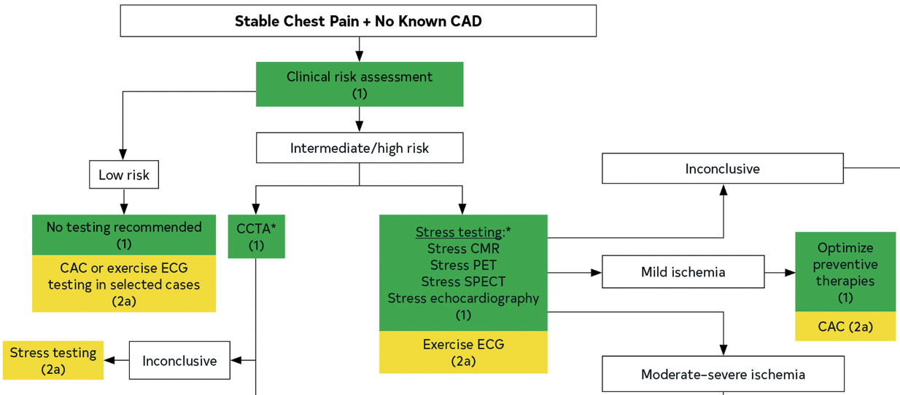

Slide 28
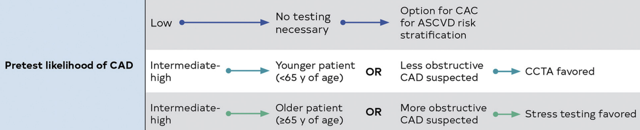
CCTA is favored for those in whom the results are more likely to modify preventive care
< 65 years old
Not on optimal preventive therapies
Notes:
Within the past year

Slide 29
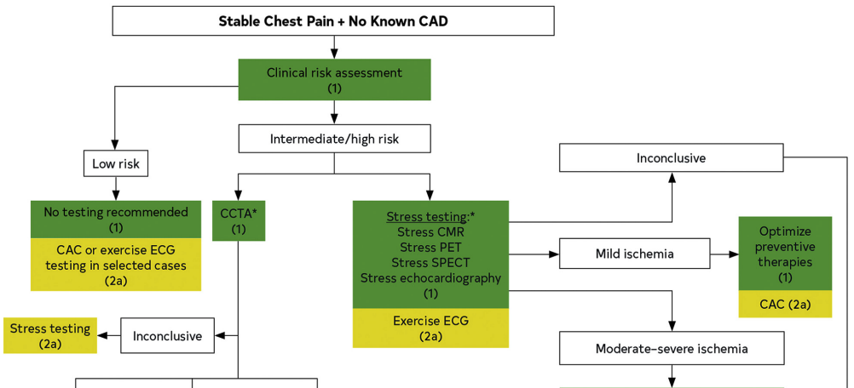
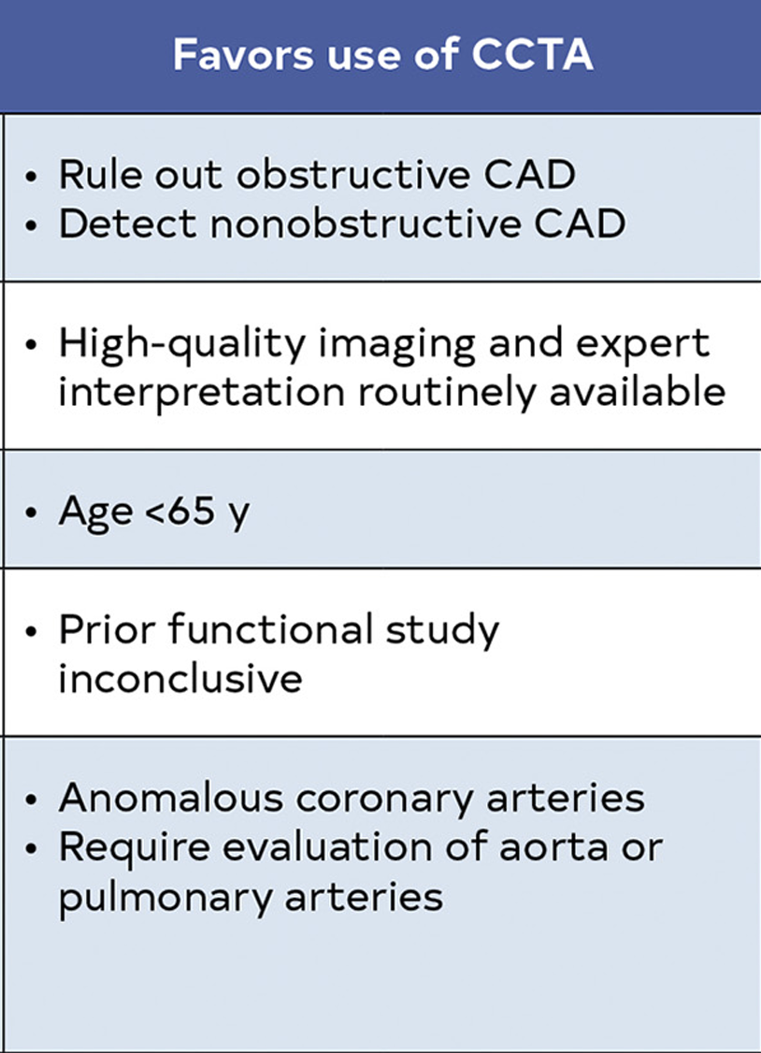
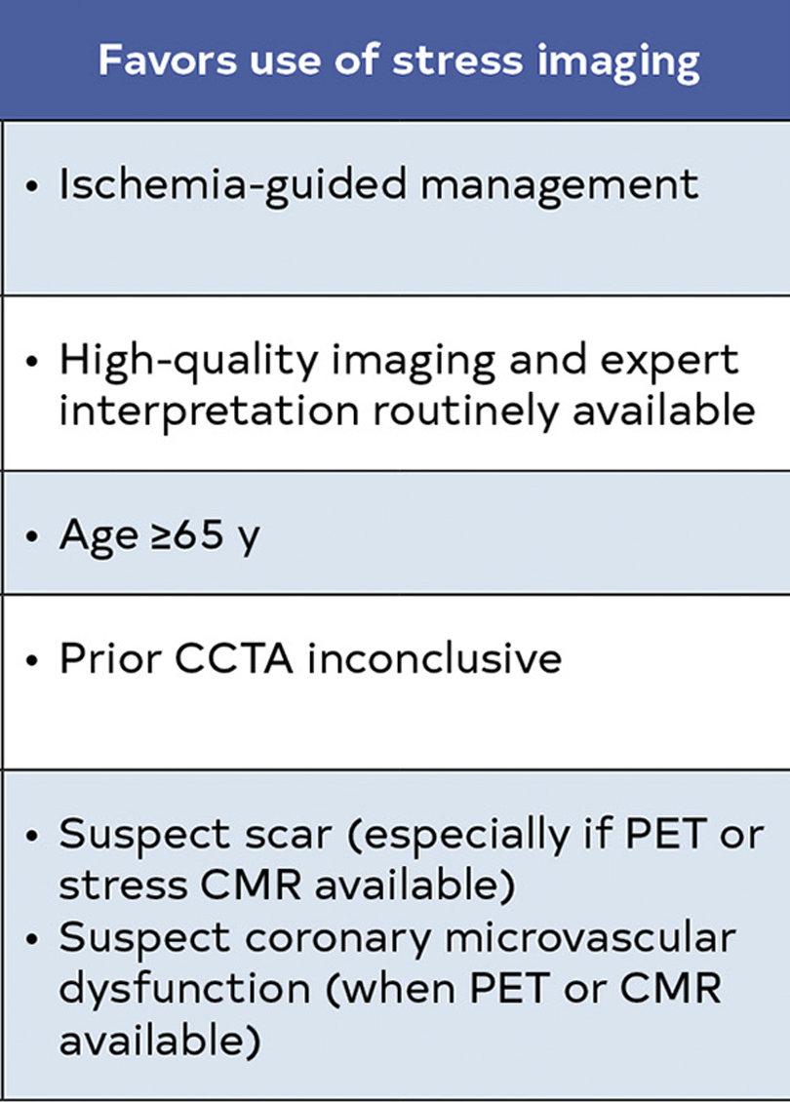
“CCTA preferable in those <65 years of age and not on optimal preventive therapies”
“Stress testing favored in those >65 years of age (with a higher likelihood of ischemia)”
Notes:
Within the past year

Slide 30
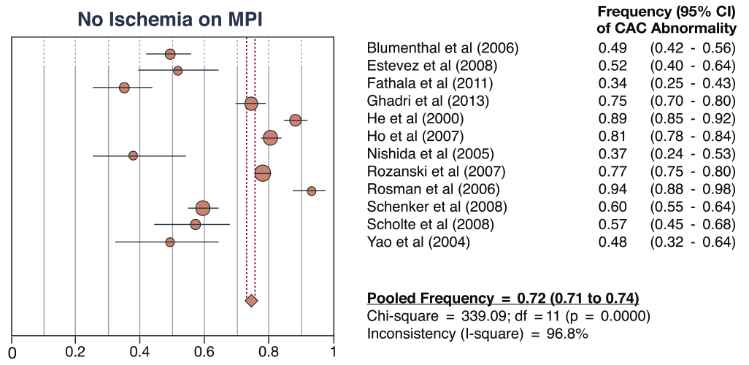
What is the prevalence of CAC > 0 in patients with a normal stress test?
Bavishi et al. J Am Coll Cardiol Img 2016;9:580-9
Notes:
20 studies reported frequencies of stress-induced myocardial ischemia by various CAC categories.
Up to 50% have CAC ≥ 100

Slide 31

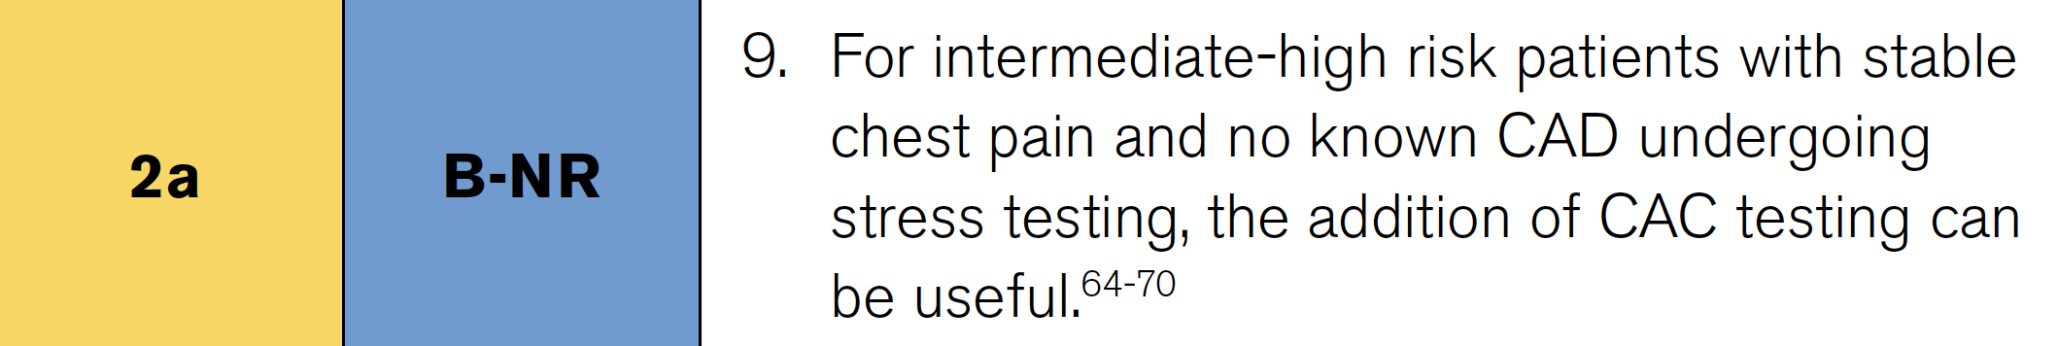
In patients with no known CAD who have stress testing, add CAC
Gulati et al. Circulation 2021;22:e368-454.

Slide 32
In the PROMISE trial, most patients with events in functional testing arm had no ischemia
CAC distribution
Events (n=133)
Functional testing
Events (n=132)
CAC 0 (35%)
16%
Normal (78%)
57%
1-99 (32%)
23%
Mildly abnormal (9%)
7%
100-400 (18%)
30%
Moderately abnormal (5%)
10%
> 400 (15%)
31%
Severely abnormal (8%)
26%
Budoff et al. Circulation 2017;136:1993–2005
Notes:
Green box
Stable chest pain (or dyspnea) and intermediate pretest probability for obstructive coronary artery disease were randomized to FT (exercise electrocardiography, nuclear stress, or stress echocardiography) or anatomic testing.
We evaluated those who underwent CAC testing as part of the anatomic evaluation (n=4209) and compared that with results of FT (n=4602).
During the median follow-up of 26.1 months. Event rate 3% in both arms
3263 (67.5%)
underwent nuclear stress testing, 1083 (22.4%)
stress echocardiography, and 491 (10.2%)

Slide 33
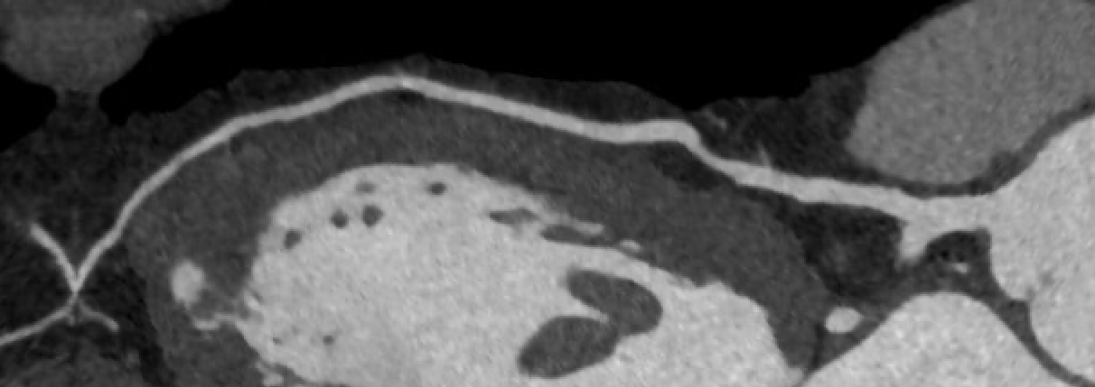
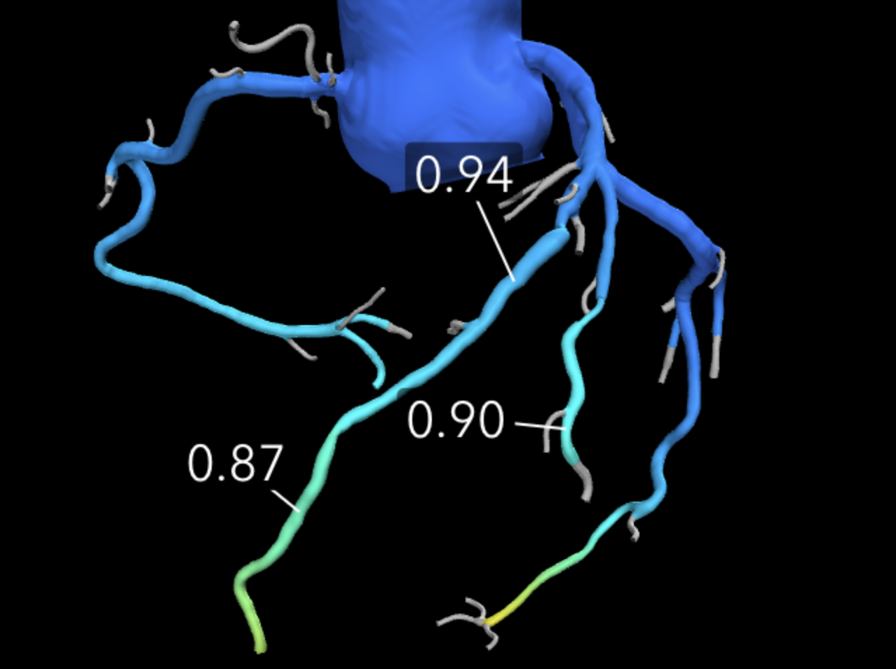
61-year-old cardiologist with hypertension and hyperlipidemia presents with chest discomfort
Moderate stenosis (50-69%) of mid LAD

Slide 34
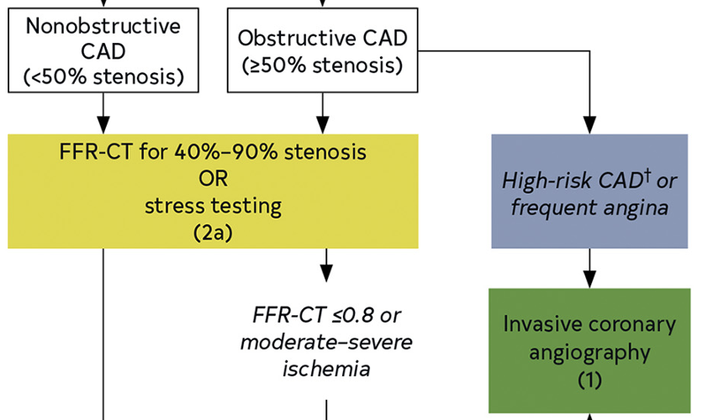
When is more testing needed after CCTA ?
Gulati et al. J Am Coll Cardiol 2021.

Slide 35
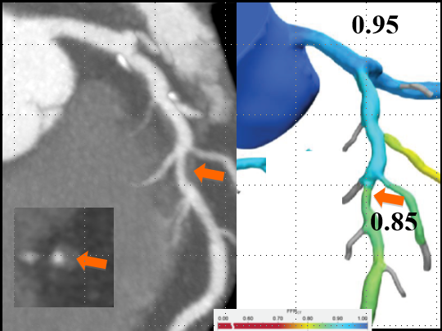
FFR_{CT} following CCTA
FFR CT
Reduced requirement for ICA;
Reduced proportion of ICA showing no obstructive CAD.
Higher rate of PCI from ICA.
No excess in clinical events, such as death or MI.
FFR_{CT}
LBCT Presented at AHA 2022

Slide 36
PRECISE
Trial
Design
Douglas et al. JAMA Cardiol. 2023;8(10):904-914.
LBCT Presented at AHA 2022

Slide 37
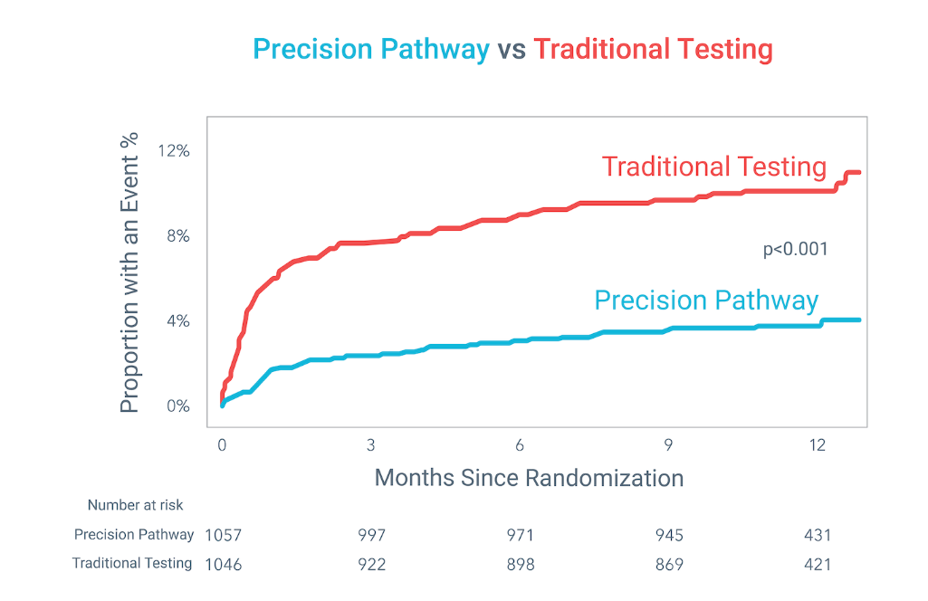
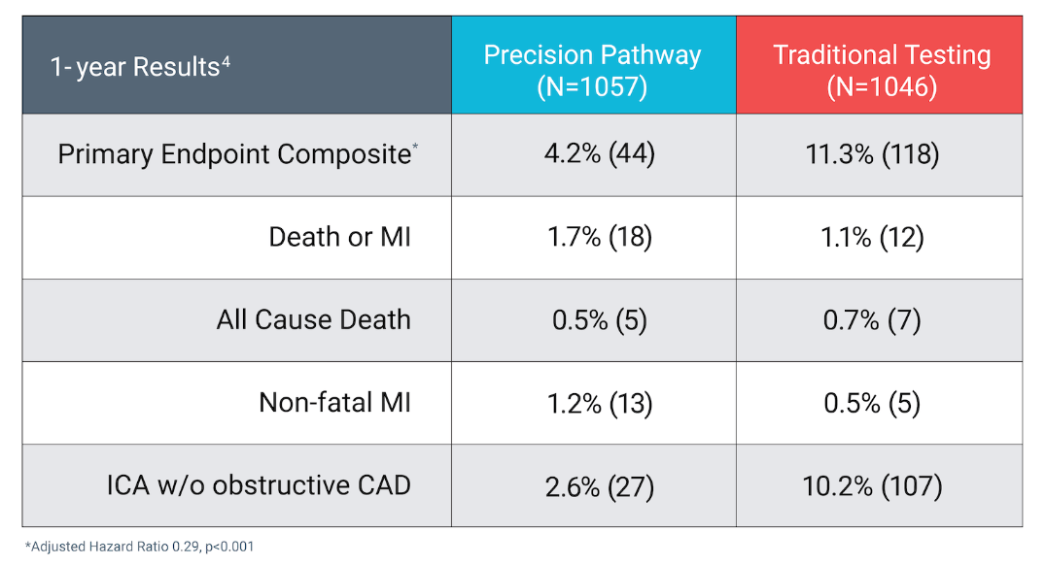
PRECISE trial
Douglas et al. JAMA Cardiol. 2023;8(10):904-914.
LBCT Presented at AHA 2022

Slide 38
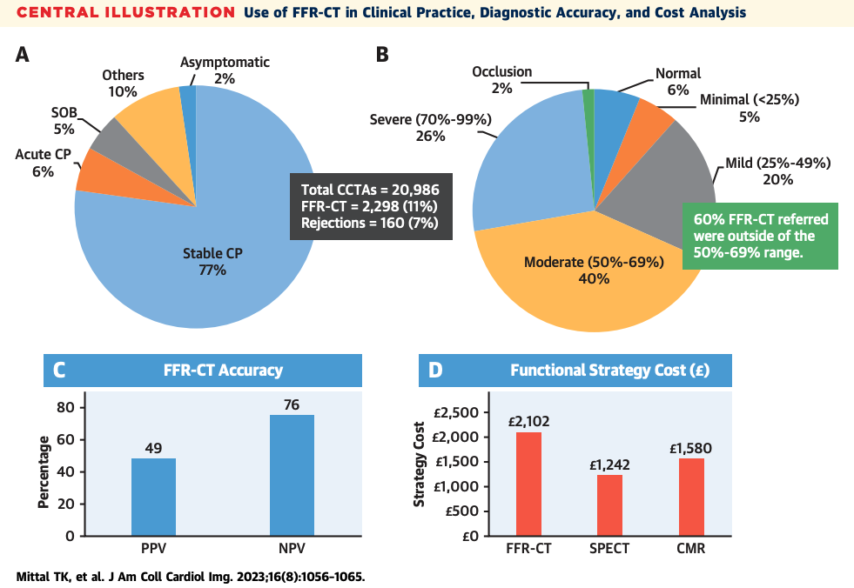
Notes:
(A) The clinical indications for FFR-CT. (B) Degree of stenosis on CCTA in patients referred for FFR-CT. (C) Diagnostic accuracy of FFR-CT for any CCTA stenosis in comparison with invasive FFR. (D) Cost of FFR-CT strategy and different stress imaging pathways as per Supplemental Figure 1 and Supplemental Table 4. CCTA ¼ coronary computed tomographic angiography; CMR ¼ cardiac magnetic resonance; CP ¼ chest pain; FFR-CT ¼ fractional flow reserve–computed tomography; NPV ¼ negative predictive value; PPV ¼ positive predictive value; SOB ¼ shortness of breath; SPECT ¼ single photon emission computed tomography.

Slide 39
Outline and learning objectives
Recall guideline recommendations for CCTA vs. functional testing in stable chest pain.
Understand traditional (current) methods of assessing plaque burden.
Discuss the impact of plaque burden for ASCVD risk and prognosis.
Analyze plaque burden and apply to patient care.
Quantitative plaque assessment and challenges in clinical practice.
Notes:
Within the past year

Slide 40
How is plaque burden assessed?
SIS score – segment involvement score
CAC
Visual assessment
Notes:
Beyond presence vs. absence of plaque

Slide 41
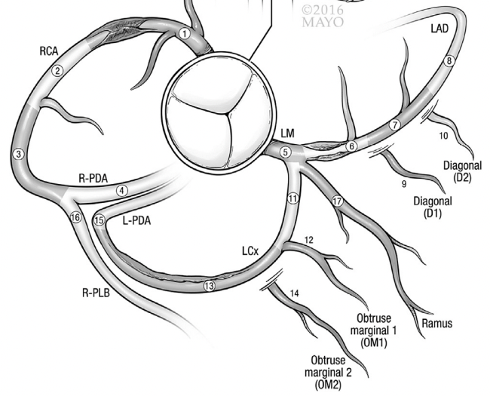
Segment involvement score
Ayoub et al. J Cardiovasc Comput Tomogr 2017;11:258-267.
Notes:
Beyond presence vs. absence of plaque

Slide 42
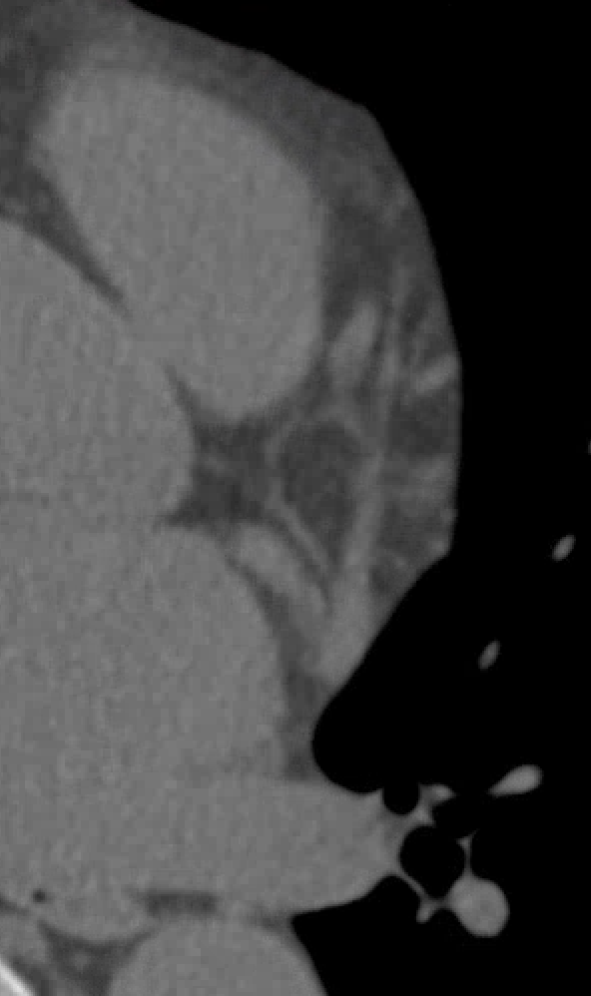
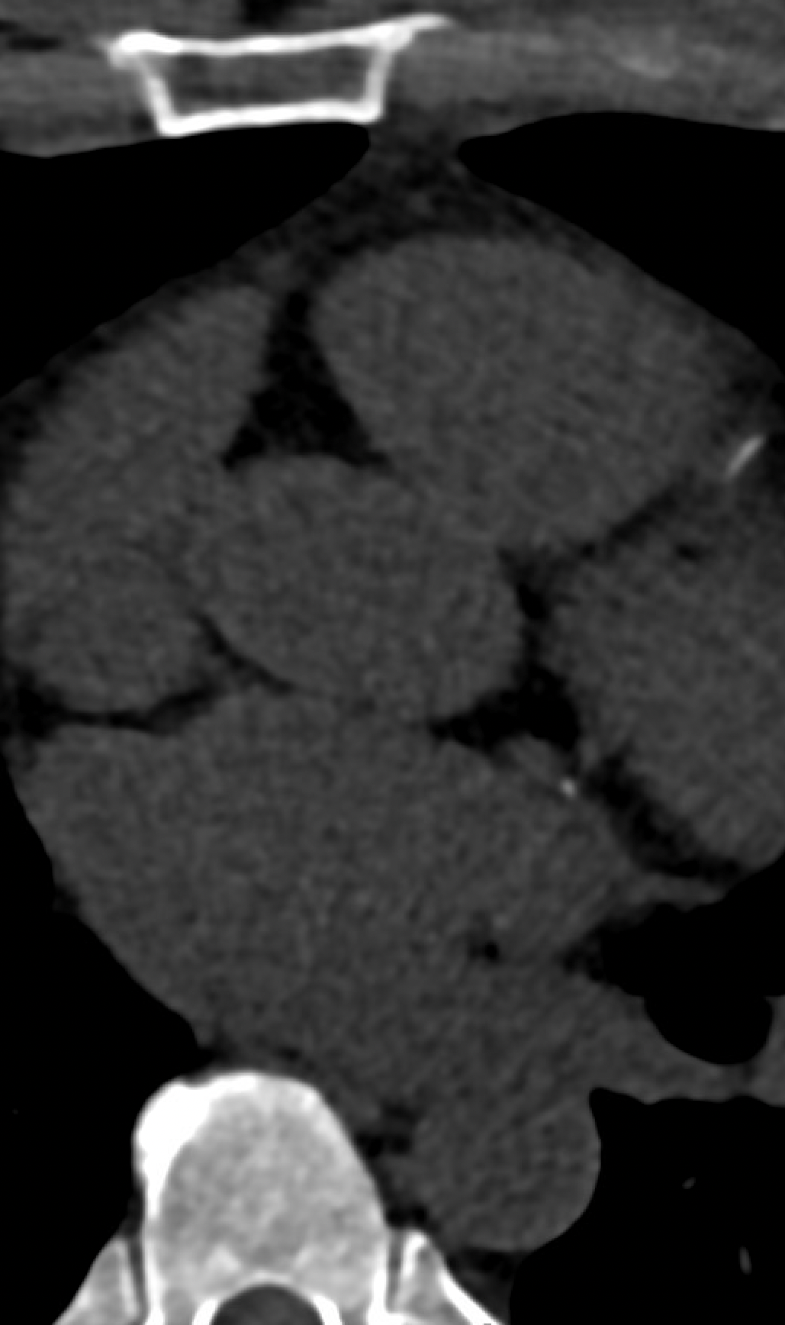
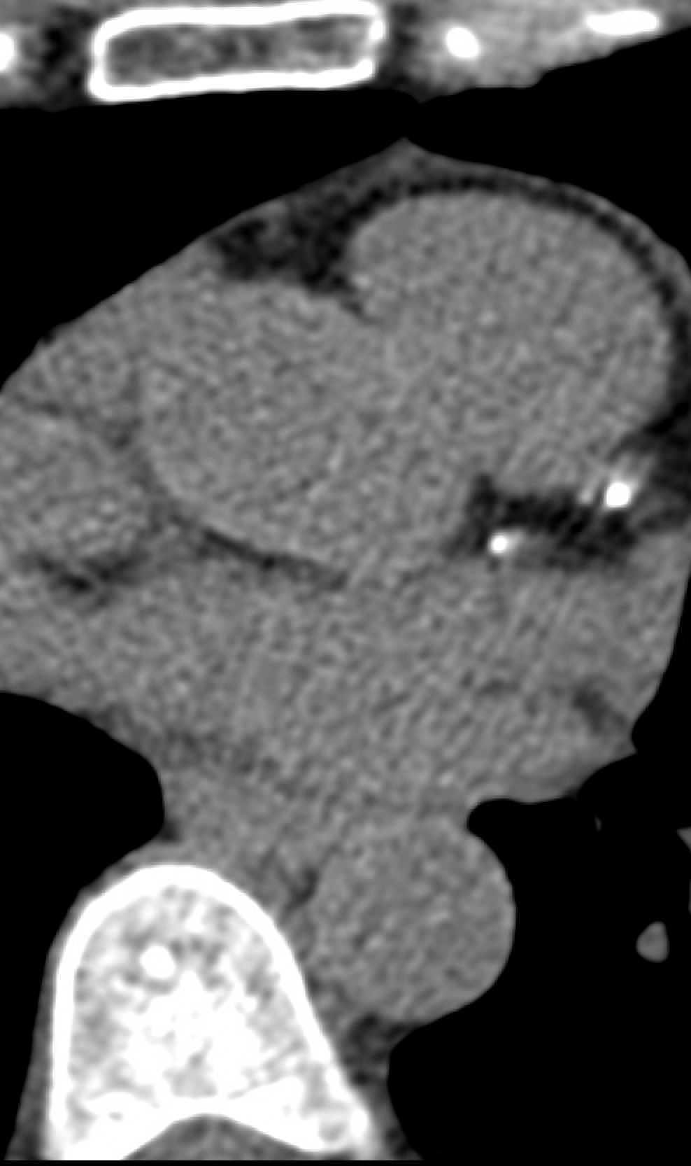
No CAC
Mild: 1-100 AU
Moderate: 101-300 AU

Slide 43
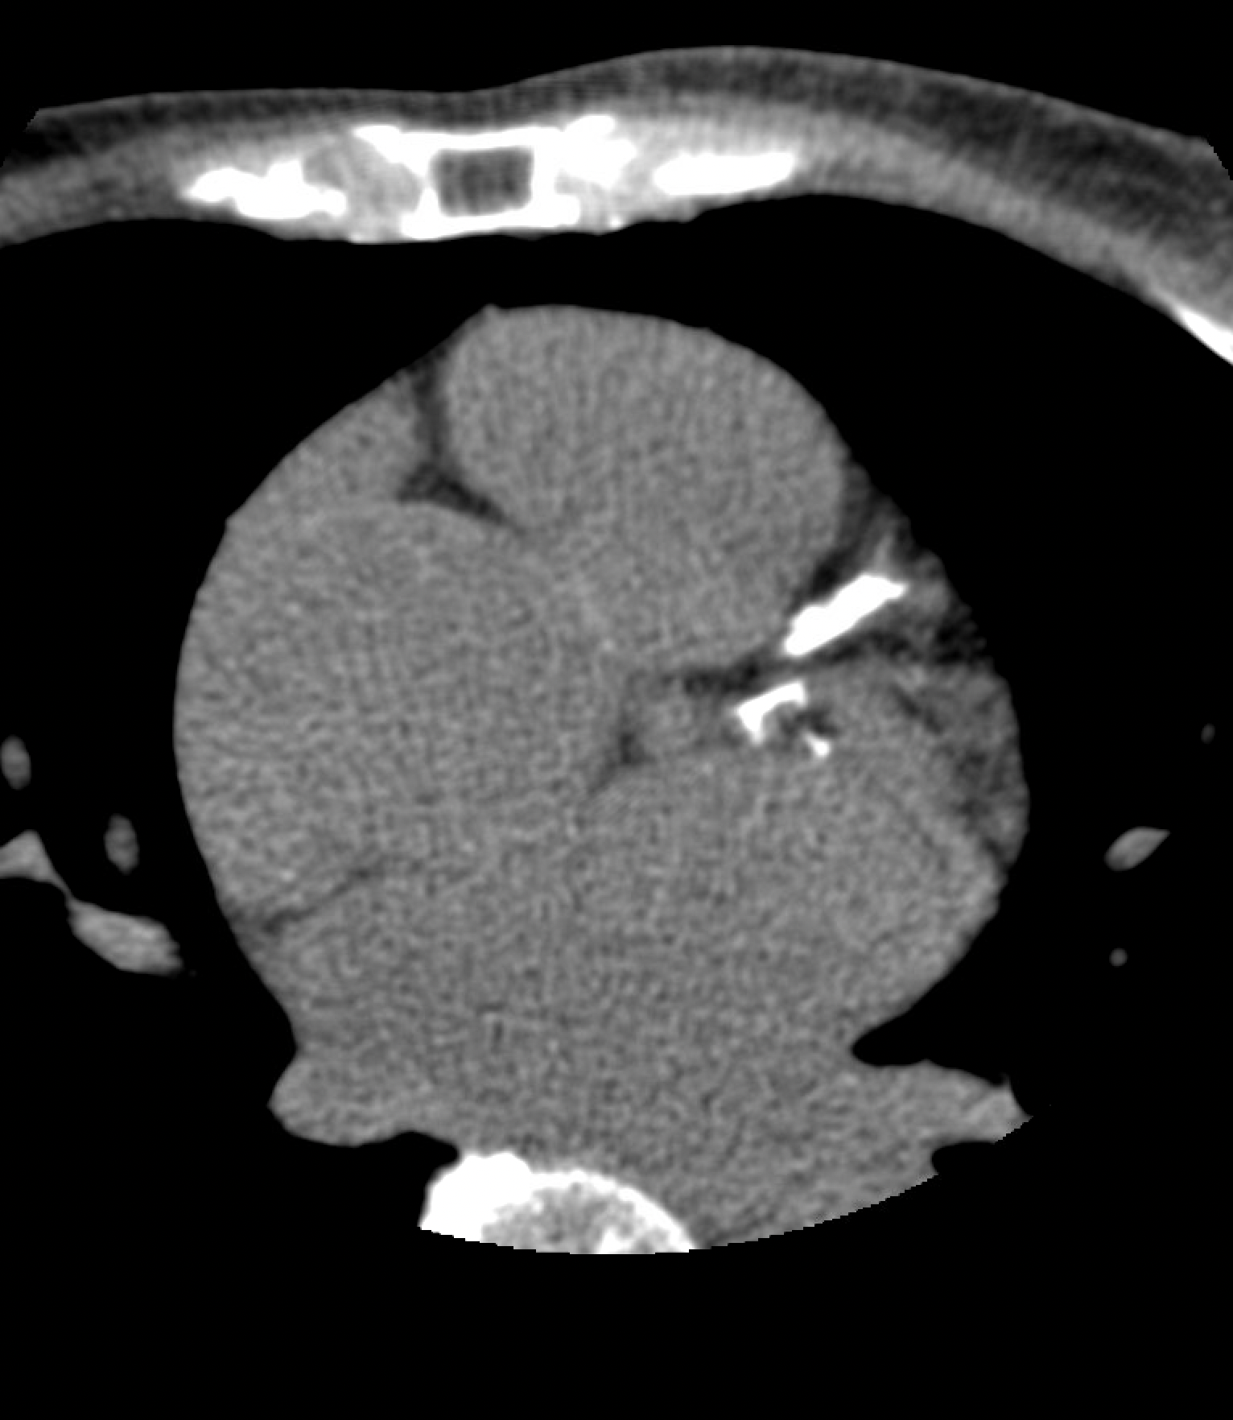
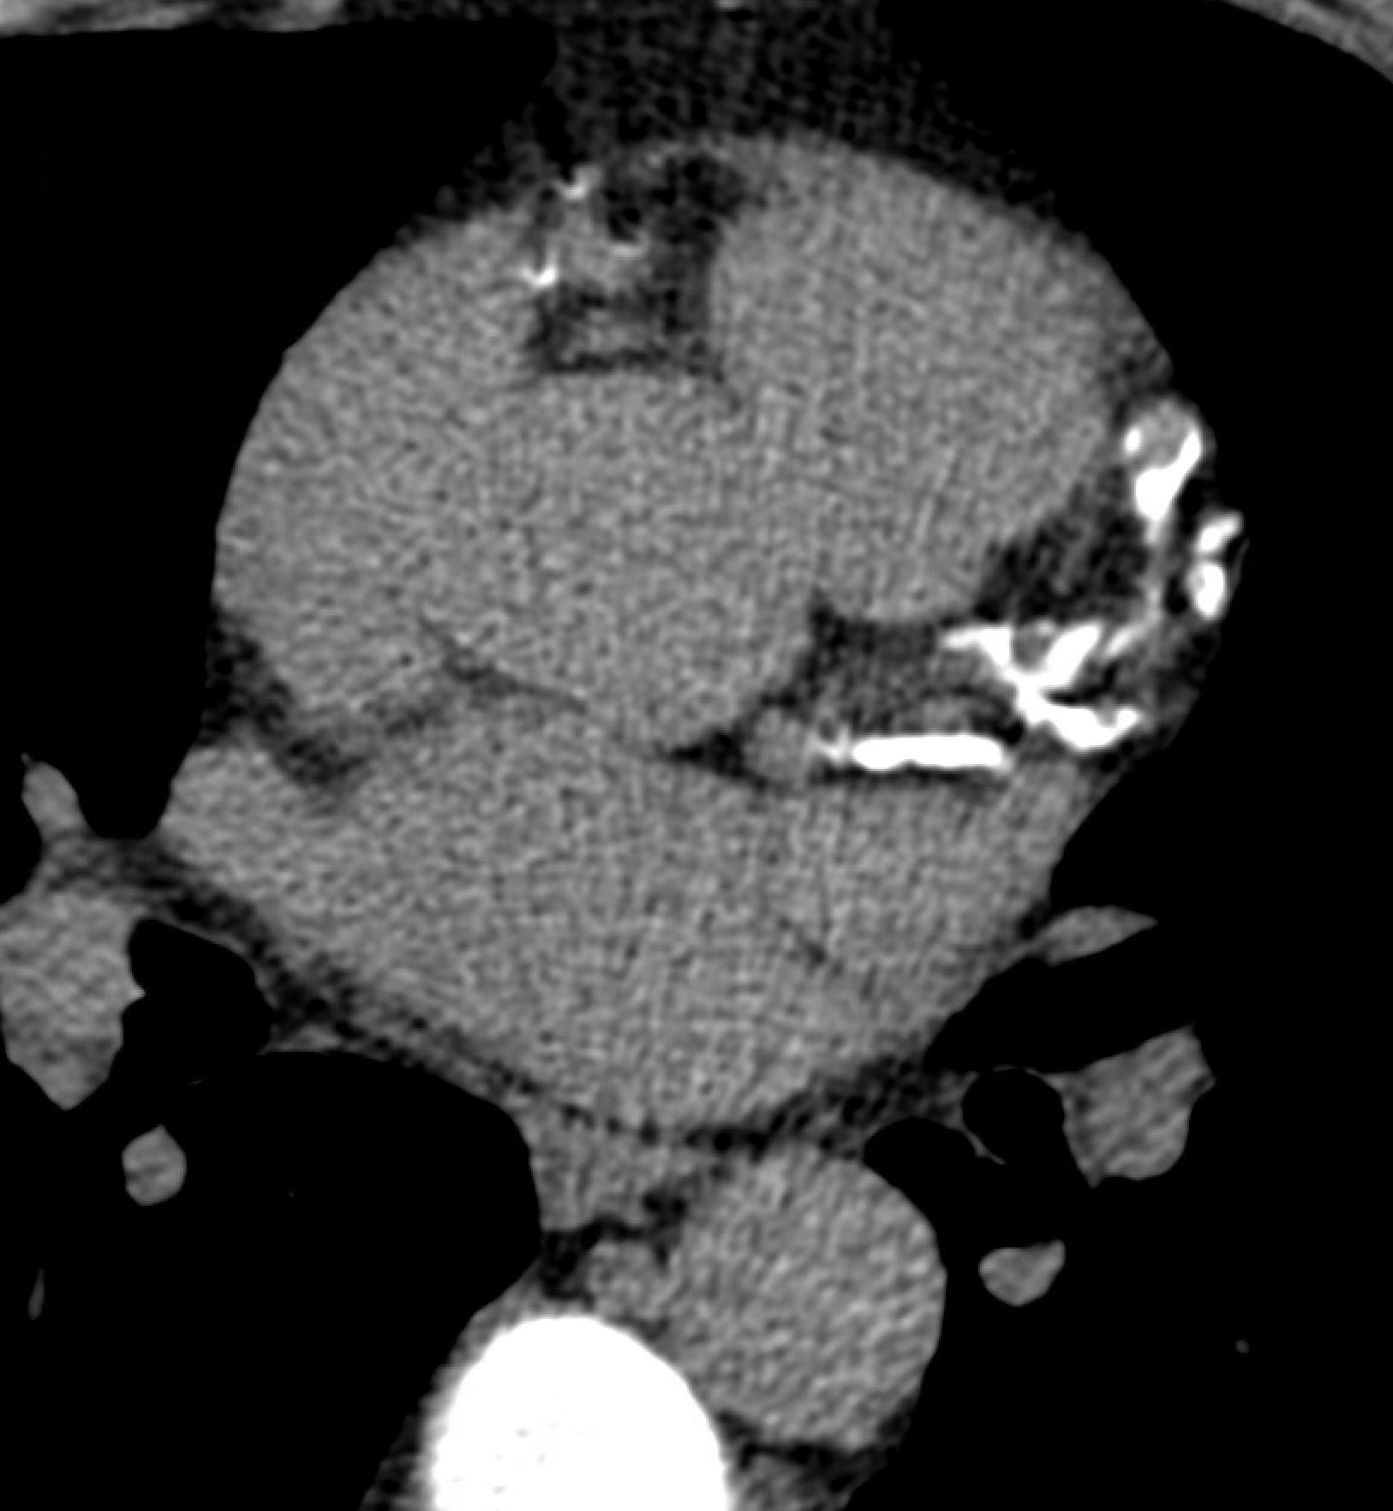
Severe: 301-999 AU
Extensive: > 1000 AU

Slide 44
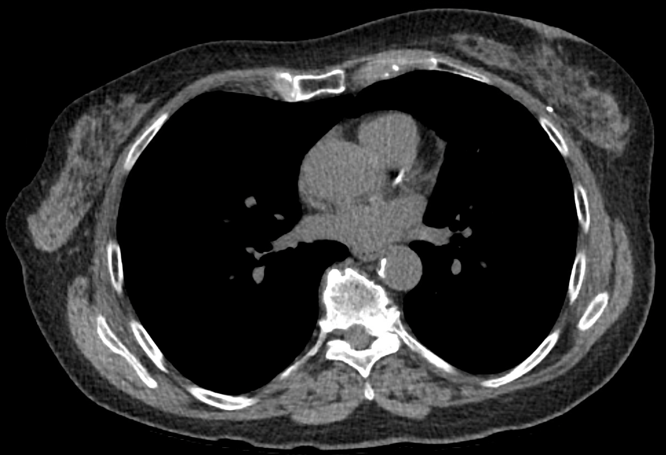
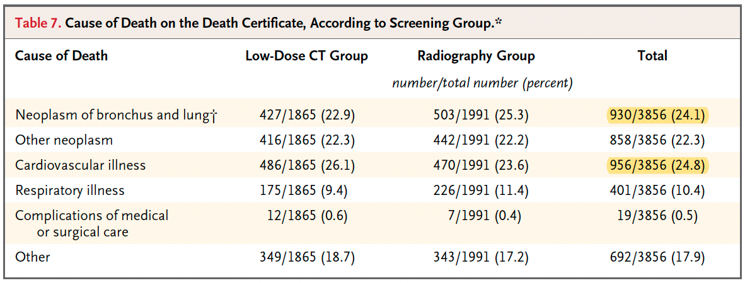
Remember to review chest CT for CAC
Arbele et al. N Engl J Med 2011;365:395-409.

Slide 45
Cury et al. J Cardiovasc Comput Tomogr 2022;16:536-557.
Notes:
Beyond presence vs. absence of plaque
CAC with CTA

Slide 46
Outline and learning objectives
Recall guideline recommendations for CCTA vs. functional testing in stable chest pain.
Understand traditional (current) methods of assessing plaque burden.
Discuss the impact of plaque burden for ASCVD risk and prognosis.
Analyze plaque burden and apply to patient care.
Quantitative plaque assessment and challenges in clinical practice.
Notes:
Within the past year

Slide 47
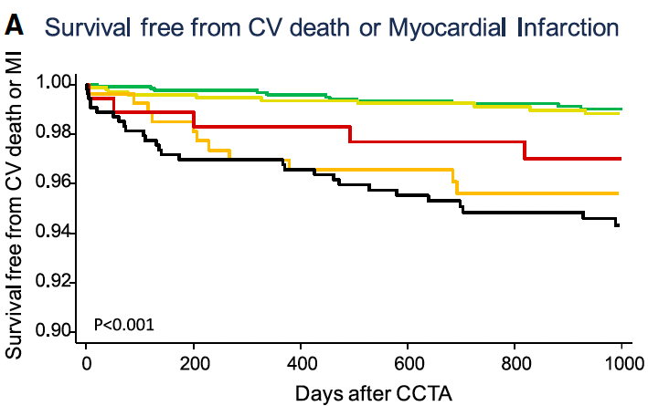
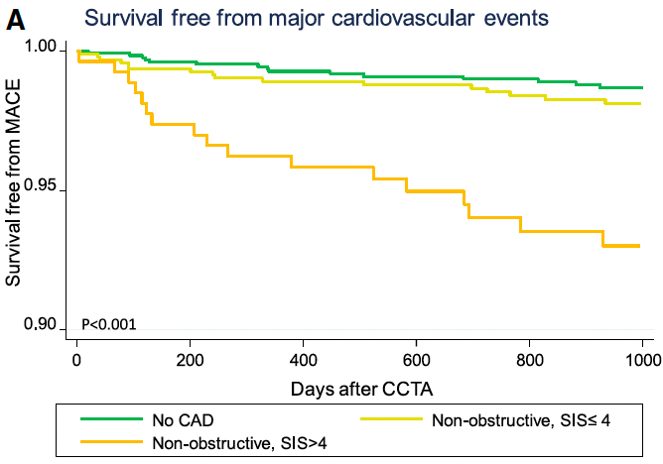
No CAD
Non-obstructive CAD, SIS ≤ 4
Obstructive CAD, SIS ≤ 4
Non-obstructive CAD, SIS >4
Obstructive CAD, SIS >4
Bittencourt et al. Circ Cardiovasc Imaging 2014;7:282-291
Notes:
The cohort included 3242 patients followed for the primary outcome of cardiovascular death or myocardial infarction for a median of 3.6 (2.1-5.0) years.

Slide 48

There is a similar risk of ASCVD between obstructive x nonobstructive disease, when accounting for CAC.
Notes:
23,759 symptomatic patients from the Western Denmark Heart Registry
Median follow-up 4.3 years

Slide 49

9533 asymptomatic individuals (Denmark)
≥ 40 years old, without known CAD
No CAD (54%)
Nonobstructive (36%)
Obstructive (10%)
Median follow-up of 3.5 years
193 deaths, 71 MI
Risk in asymptomatic with extensive CAD
Fuchs et al. Ann Intern Med 2023;176:433-442.
Notes:
specific causes of death during follow-up were not available.
The Copenhagen General Population Study (CGPS), initiated in 2003, is a cohort study of persons invited from the greater Copenhagen area, where coronary CTA was added to the research protocol in 2010 (20, 21). From February 2010 and onward, persons in the CGPS could opt for a research coronary CTA examination at Rigshospitalet in Denmark.
Analyses were adjusted for sex, age, arterial hypertension, hypercholesterolemia, current smoking, overweight or obesity, diabetes, aspirin, statin, education level, and income class.

Slide 50

Cardoso et al. SCCT 2024 (submitted)
Notes:
Within the past year

Slide 51
Outline and learning objectives
Recall guideline recommendations for CCTA vs. functional testing in stable chest pain.
Understand traditional (current) methods of assessing plaque burden.
Discuss the impact of plaque burden for ASCVD risk and prognosis.
Analyze plaque burden and apply to patient care.
Summarize quantitative plaque assessment and challenges in clinical practice.
Notes:
Within the past year

Slide 52
Disclaimer
Patients without clinical CAD selected based on amount of plaque: limited clinical trial data.
Plaque burden
Risk assessment
Medical therapy
Notes:
Within the past year

Slide 53
Trials in primary prevention
Clinical trial Therapy Enrollment criteria
ASPREE Aspirin Age ≥ 65 years (blacks and Hispanic) or ≥ 70 years
ASCEND Aspirin Diabetes
ARRIVE Aspirin Moderate risk (10-20% 10-year CHD risk)
CHARISMA Clopidogrel ≥ 45 years old, multiple atherothrombotic risk factors
CANVAS Canagliflozin Diabetes, ≥ 50 years old, ≥ 2 risk factors
HOPE-3 Rosuvastatin Age ≥ 55 (men) or ≥ 65 (women), ≥ 1 risk factor
REDUCE-IT Icosapent ethyl Diabetes, ≥ 50 years old, ≥ 1 additional risk factor
REWIND GLP1-RA Diabetes plus risk factors
SPRINT Anti-hypertensive Age ≥ 50, SBP 130-180 mmHg, FRS ≥ 15%
Notes:
Within the past year

Slide 54

Notes:
Inclusion criteria:
1. Age ≥ 50 (men), ≥ 55 (women)
2. LDL-C ≥ 90 mg/dL
3. CAD, CVD, PAD or DM, without prior MI or stroke
4. ≥ 1 high-risk feature
TIMI group – CAC or CCTA

Slide 55
Aggressive Medical Therapy for CAD:
Expanding evidence based on plaque
Therapy | Trials / Data | CAC Criteria used in trial/study
ASA | MESA, DHS (observational data) | CAC>100 – if risk of bleeding low
PCSK9i | VESALIUS-CV. (ongoing) VICTORION-1 PREVENT (ongoing) | CAC>100 / Stenosis on CCTA
Bempedoic Acid | CLEAR-outcomes | CAC>400
Colchicine | LoDoCo | CAC>400
Aggressive BP ↓ | SPRINT | CAC>400
Lp(a) lowering | ACCLAIM Lp(a) (ongoing) | CAC>100 / Stenosis on CCTA
GLP1-RA* | SELECT | Established CVD → ongoing studies to establish risk-equivalent by amount of plaque
* CAC Not used in trial

Slide 56
Final report
CAD-RADS 1/P3: Consider non-atherosclerotic causes of symptoms. Aggressive risk factor modification and preventive pharmacotherapy.
Notes:
Within the past year

Slide 57
57-year-old woman with chest pain and no known CAD
BP 136/74 mmHg
BMI 31 Kg/m²
TC 210 mg/dL, HDL 54 mg/dL, LDL-C 132 mg/dL
Notes:
Within the past year

Slide 58
Treatment modifications
Consider aspirin
High-intensity statin therapy
Better blood pressure control
Check lipoprotein(a)
Notes:
Within the past year

Slide 59

In SCOT-HEART, CCTA was associated with a reduced event rate compared with standard care
Initiation of preventive therapies during follow-up:
19.4% x 14.7% (OR 1.4; 95% CI 1.19-1.65)
Within 6 weeks of visit after testing:
Treatment was altered in 5% of standard care group
Treatment was altered in 23% of CCTA group
0.2% in CCTA: normal
45% in CCTA: nonobstructive
45% in CCTA: obstructive
CHD death or MI: 2.3% vs. 3.9% (HR 0.59, 95% CI 0.41-0.84)
Adamson et al. J Am Coll Cardiol 2019;74:2058-2070
Newby et al. N Engl J Med 2018; 379:924-933
Notes:
23% in both groups at 5 years (invasive coronary angiography)

Slide 60

Targeted medical therapy

Slide 61

Evidence of coronary plaque by CT modifies patient behavior
Gupta A, Blankstein R, et al. J Am Coll Cardiol Img 2017;10:833–42
Notes:
6 studies (11,256 participants, mean follow-up time: 1.6 to
6.0 years) were included.

Slide 62

Identification of plaque → Intensify prevention
Colchicine
Image courtesy of Ana Vitoria Rocha
Cardoso, Blankstein Chapter on Use of Cardiac CT in Prevention

Slide 63


A CAC of > 300 is equivalent to risk in secondary prevention
Budoff et al. JACC Cardiovasc Imaging 2023;16:1181-1189.
Notes:
CONFIRM registry , multinational
4511 individuals without known CAD, 438 individuals with established ASCVD
Mean follow-up of 4 years.
Only 16% had diabetes
Curve for MACE, but was identical for MI, ACM

Slide 64

In patients at low risk of bleeding, CAC ≥ 100 identifies a net benefit for aspirin in primary prevention
Ajufo et al. JAMA Cardiol 2021;179-187.
Notes:
CONFIRM registry , multinational
4511 individuals without known CAD, 438 individuals with established ASCVD
Mean follow-up of 4 years.
Only 16% had diabetes
Curve for MACE, but was identical for MI, ACM

Slide 65
EKSTROM trial
84 patients with stable CAD
Colchicine 0.5 mg vs. placebo
Colchicine reduced total plaque volume at 12 months
No difference in low attenuation plaque volume
Budoff et al. EKSTROM trial.
Notes:
CONFIRM registry , multinational
4511 individuals without known CAD, 438 individuals with established ASCVD
Mean follow-up of 4 years.
Only 16% had diabetes
Curve for MACE, but was identical for MI, ACM

Slide 66
Outline and learning objectives
Recall guideline recommendations for CCTA vs. functional testing in stable chest pain.
Understand traditional (current) methods of assessing plaque burden.
Discuss the impact of plaque burden for ASCVD risk and prognosis.
Analyze plaque burden and apply to patient care.
Summarize quantitative plaque assessment and challenges in clinical practice.
Notes:
Within the past year

Slide 67


Williams et al. J Cardiovasc Comput Tomogr 2022;16:124-137.
Notes:
Cleerly, HeartFlow, Elucid
Direct to consumer - analysis

Slide 68
The case for quantitative plaque analysis
More objective assessment of plaque burden
Better phenotyping of plaque (attenuation-based)
May improve inter-scan and inter-observer variability
Validated against IVUS/OCT
Predictive of clinical outcomes
Clinical trials: enrollment criteria and/or outcome
Notes:
Within the past year

Slide 69
Challenges in quantitative plaque analysis
Different vendors
Lack of standardization
Influence of scan parameters (kV)
Additional time
Small plaques
Incremental value
Notes:
Within the past year
Conceptually makes sense – efficacy x clinical trials

Slide 70

Cardoso R, Blankstein R, et al. J Cardiovasc Comput Tomogr 2022 (submitted for publication)

Slide 71
Challenges in quantitative plaque analysis
Different vendors
Lack of standardization
Influence of scan parameters (kV)
Additional time
Small plaques
Incremental value
Notes:
Within the past year

Slide 72

Challenges in quantitative plaque analysis
Different vendors
Lack of standardization
Influence of scan parameters (kV)
Additional time
Small plaques
Incremental value
Min et al. J Cardiovasc Comput Tomogr 2022;16:415–422.
Notes:
Within the past year

Slide 73

Nurmohamed A, et al. J Am Coll Cardiol 2024;17:269-280.
Notes:
539 patients referred for suspected stable CAD who underwent CCTA imaging between 2008 and 2014.
The primary MACE outcome was a composite of nonfatal myocardial infarction, nonfatal stroke, coronary revascularization and all-cause mortality.

Slide 74
Photon-Counting CT (PCCT)
Notes:
And this is where is Photon counting CT comes into the picture

Slide 75



What is Photon-Counting CT?
Conventional CT scanner
(Energy Integrating)
Photon-Counting
 | Conventional CT | Photon-Counting
Material | Scintillator | Semiconductor
Energy signal | Aggregated (data lost) | Retained
Conversion | X-rays → Light → Current | X-rays → Current
Siemens Naeotom Alpha User Documentation
Notes:
The photon detectors were initially developed for use in CERN’s Large Hadron Collider, and now have found their way into medicine
Shown here are schematics for a conventional CT scanner and photon counting CT scanner. And to put it in the simplest way, the conventional scanners detect the xrays, aggregate them and then convert them in to light, a 2 step process where data is lost, whereas photon counting detectors can directly measure the energy each individual photon and converts it into an image.
Another way to think about is taking a continuous variable and breaking it down into deciles for current scanners vs. photon counting which continues to treat it as individual data-points.

Slide 76

Conventional CT vs. Photon-Counting CT
 | Conventional CT | PCCT – Standard | PCCT – UHR
Slice thickness
Spatial resolution | Good | High | Highest
Radiation | ~2-3 mSv | ~2-3 mSv | ~3-5 mSv
Contrast | ~ 70 cc | ~ 70 cc | ~ 100 cc
0.6 mm
0.4 mm
0.2 mm
Notes:
Shown here is a comparison of conventional ct and photon counting Ct and its 2 main modes of use – the standard mode and an ultra-high resolution mode.
And in general the photon counting CT gives us significantly higher spatial resolution compared to conventional CT for similar radiation and contrast use, except for the ultra high resolution mode, which gives us the highest resolution with a slice thickess of 0.2 mm.

Slide 77


Decreased blooming provides improved lumen assessment
Conventional CT scanner
Photon-Counting
Notes:
Let me share with you some examples. On the left here is an image of calcfied plaque in the LAD obtained using conventional and on the right, the same lesion was evaluation using photon counting CT. And I hope you can notice the much higher spatial resolution and the reduction in blooming artifact which enables better assessment of the vessel lumen.

Slide 78

Enables visualization of lumen within stents
Notes:
In similar fashion we can evaluate stents. Show here is a curved reformat of an LAD showing a stent extending from the left main to LAD, and right at the ostium of the LAD these is a large amount of non-calcified plaque leading to in-stent restenosis

Slide 79

BWH example– Severe stenosis to mild stenosis with PCCT
Conventional CT scanner
Photon-Counting
Notes:
And here is one of our cases, where this patient had undergone coronary CT in 2021 and this lesion which was previously reported as severe, was now classified as mild using the photon counting CT scanner.

Slide 80

LCX
Proximal LCX stent
Widely patent
Well apposed
Well expanded
Notes:
Here is a curved reformat of his circumflex showing his proximal circumflex stent.

Slide 81
Pericoronary Fat Attenuation Index
Notes:
And this is where is Photon counting CT comes into the picture

Slide 82

Eur Heart J Cardiovasc Imaging, Volume 23, Issue 12, December 2022, Pages e526–e536, https://doi.org/10.1093/ehjci/jeac174
Notes:
How It Works:
Rationale: Inflammation from coronary artery disease (CAD) alters the composition of pericoronary adipose tissue, making it more hydrophilic (less lipid-dense), which increases CT attenuation (measured in Hounsfield units, HU).
Measurement: The FAI quantifies these changes by assessing the CT attenuation of fat surrounding the coronary arteries, particularly the proximal segments of major coronary arteries (e.g., LAD, RCA, LCx).
Clinical Significance:
Predicts Future Cardiac Events: Higher FAI values are associated with increased risk of major adverse cardiovascular events (MACE), including myocardial infarction and death.
Identifies "Inflamed" Coronary Plaques: Even in the absence of significant stenosis, elevated FAI can indicate active coronary inflammation, helping to detect vulnerable plaques.

Slide 83

Chan et al. Lancet 2024;403:2606.
Notes:
This multicentre, longitudinal cohort study included 40 091 consecutive patients undergoing clinically indicated CCTA in eight UK hospitals, who were followed up for MACE (ie, myocardial infarction, new onset heart failure, or cardiac death) for a median of 2·7 years (IQR 1·4–5·3). The prognostic value of FAI Score in the presence and absence of obstructive CAD was evaluated in 3393 consecutive patients from the two hospitals with the longest follow-up (7·7 years [6·4–9·1]).
. Increased FAI Score in all the three coronary arteries had an additive impact on the risk for cardiac mortality (hazard ratio [HR] 29·8 [95% CI 13·9–63·9], p<0·001) or MACE (12·6 [8·5–18·6], p<0·001) comparing three vessels with an FAI Score in the top versus bottom quartile for each artery. FAI Score in any coronary artery predicted cardiac mortality and MACE independently from cardiovascular risk factors and the presence or extent of CAD.

Slide 84
Conclusions
CCTA has a class I indication for assessment of patients with chronic chest pain and no known CAD.
Plaque burden (P1-P4) is an essential component of the CCTA report.
Patients with severe or extensive plaque burden have a high event rate, regardless of stenosis.
Tailor the intensity of preventive therapies to the total burden of plaque.
Quantitative assessment of coronary plaque is available for research and clinical use.
Notes:
Research: enrichment of trial populations for higher-risk patients, outcome for preventive therapy.
Clinical: additional benefit over CAC score and semi-quantitative method. Clinical use yet to be determined.

Slide 85




Why is plaque identification by CCTA important?
Key facts:
1. Most stress tests are normal
2. Most events occur in patients with normal functional study
3. Plaque burden predicts risk, better than stenosis
4. Improved outcomes!
Frequency of Abnormal and Ischemic MPI
5%
(Rozanski et al, 2013)
Newby et al, NEJM 2018
(Budoff et al Circulation 2017)
Mortensen et al, JACC 2021

Slide 86


Slide 87
Thank you
Rhanderson Cardoso, MD, MHS

