Slide 1

Peripheral Arterial Disease –
Prognosis as Bad as Some Cancers
Anvar Babaev, MD, PhD
Director, Endovascular Interventions, Cardiac Cath Lab, NYU Langone Medical Center

Slide 2
Disclosures
Consultant/Speaker:
  Medtronic, Abbott, Shockwave, BSCI
  Research Grant - Medtronic

Slide 3
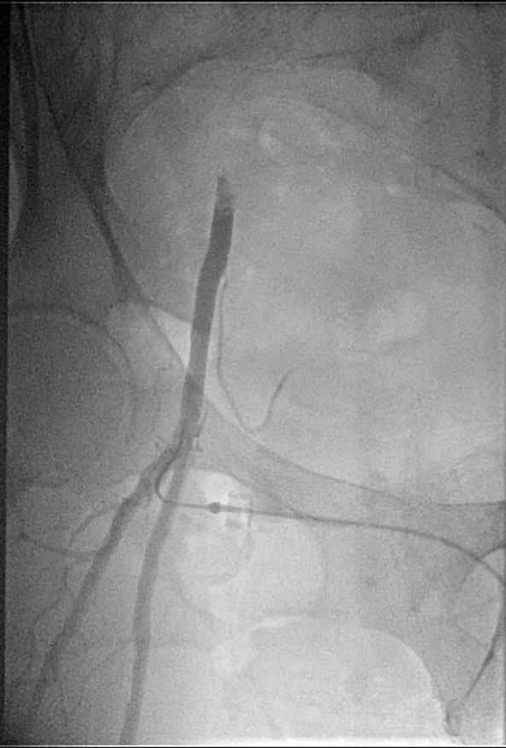
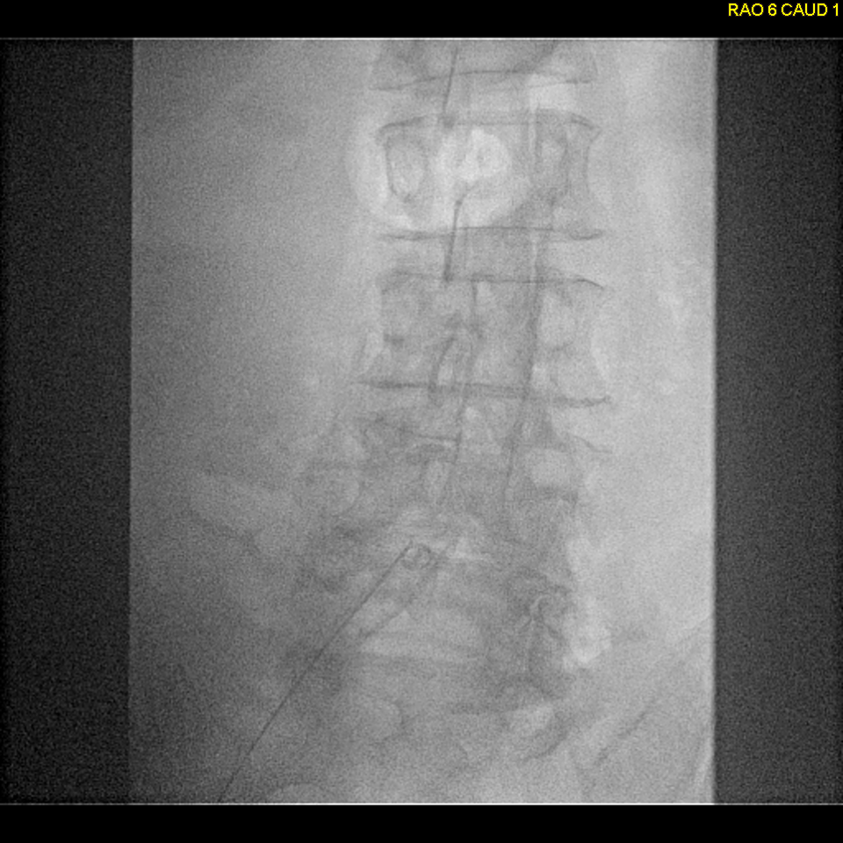
Case 1: 74F w CAD RF referred for cardiac cath due to abnl stress. She was scheduled for right knee replacement surgery due to right leg pain on walking

Slide 4
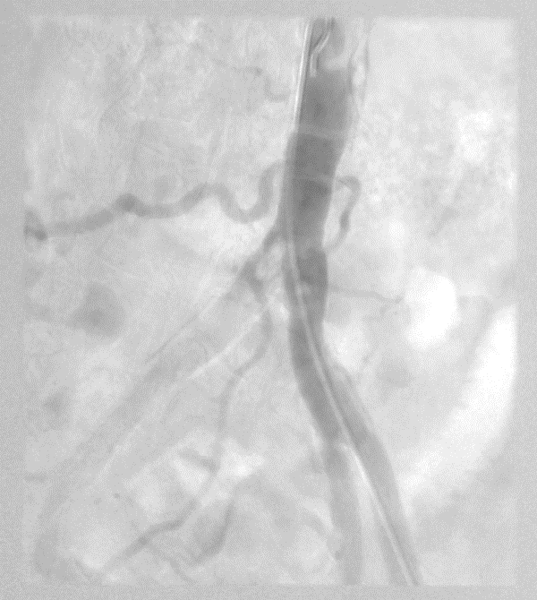
Contralateral access was obtained and angiogram performed
Right iliac is occluded at the ostium
Coronary angiogram revealed severe LAD stenosis – successfully stented

Slide 5
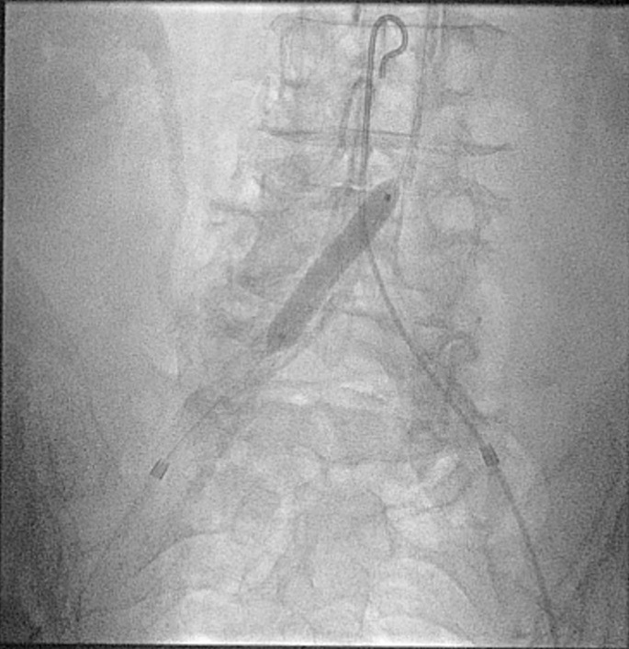
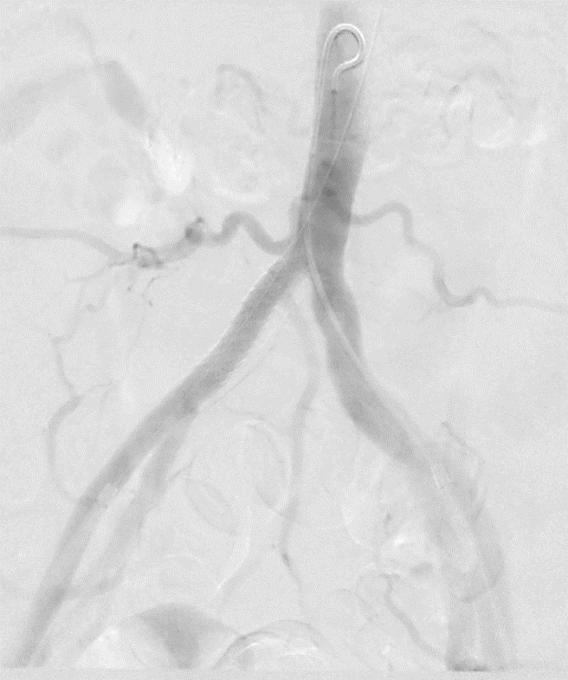
Returns for Right Iliac Revascularization
Lithotripsy angioplasty and Stent
Final Result

Slide 6
When Did She Have Right Knee Surgery after this Procedure?
NEVER

Slide 7


Slide 8
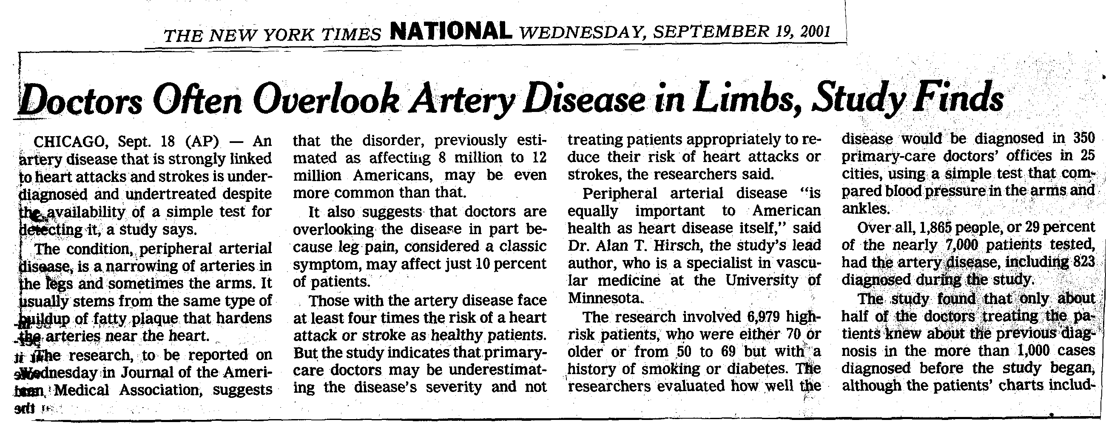
PAD is an underdiagnosed disease

Slide 9

Attempts to Increase Public Awareness - Not Very Successful

Slide 10

Population-Based Care of PAD
Fraction of Population
4-8%
30-50%
40-50%
Revascularization
Risk reduction
Severe
Dz
Exercise Training
Pharmacotherapy
Risk reduction
Revascularization
Mild-moderate
Claudication
Risk Reduction
Exercise
Asymptomatic PAD
(ABI < 0.9)
(Hirsch, 2000)
Notes:
We are seeing only a fraction of the PAD population. Only about 35-40% of patients at most have classic IC or critical limb ischemia. But all of these other patients need diagnosis and treatment. If we are vascular physicians, we have a responsibility to all of these patients, not just those who need an intervention. We need to get comfortable with the different tools for treatment and use them in everyday practice.

Slide 11
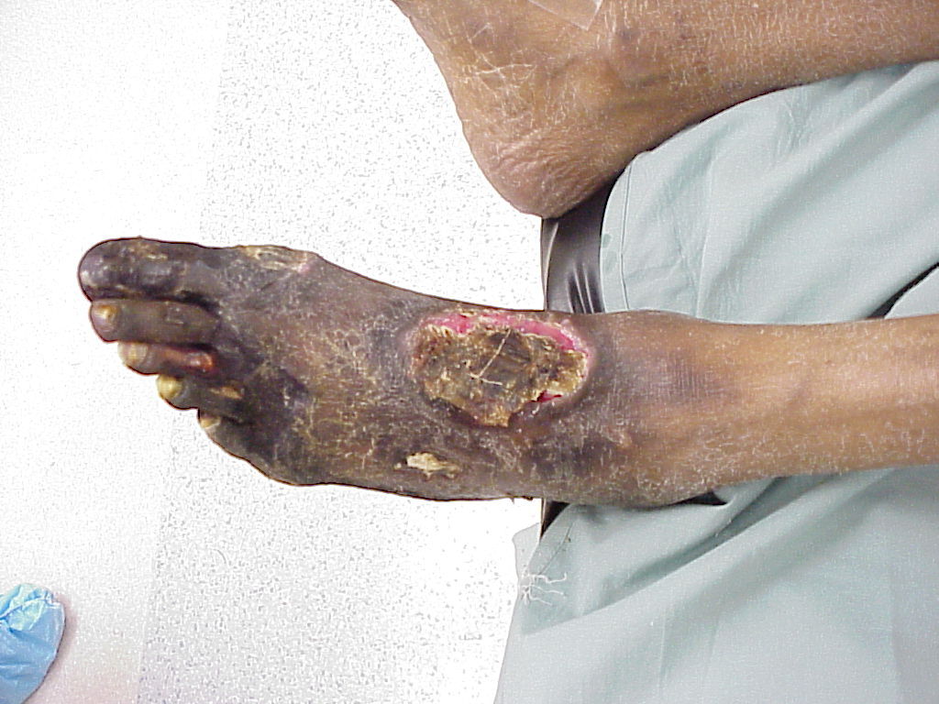
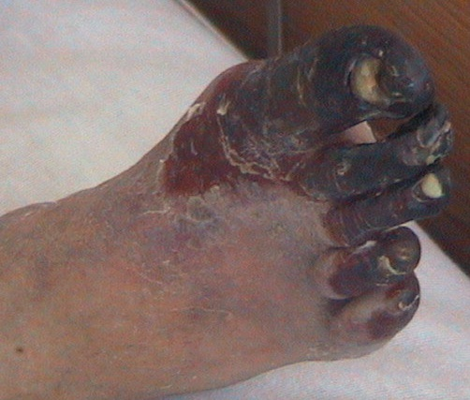
And we still see these pts presenting for the first time in the office!!!

Slide 12
5-Year Natural History of Intermittent Claudication
Population
>55 years of age
Intermittent claudication
5%
5-year peripheral
vascular outcomes
Other cardiovascular
outcomes
Stable
claudication
∼50%
Worsening
claudication
∼16%
Surgery or
tissue loss
≥25%
Major
amputation
< 4%
5-year nonfatal
CV events
(MI, stroke, etc)
20%
5-year
mortality
30%
Cardiovascular
cause
75%
Adapted from Weitz JI, et al. Circulation. 1996;94:3026-3049.
Notes:
5-Year Natural History of Intermittent Claudication
The progression of PAD of the lower extremities leads to a range of
symptoms, from intermittent claudication to discomfort at rest. Inter-mittent claudication is characterized by discomfort that develops in the affected limb with exercise and is relieved at rest. Up to 5% of men and 2.5% of women 60 or older have symptoms of intermittent claudication.
The 5-year outcomes in these patients are shown in the diagram. In
approximately half, the symptoms of claudication will remain stable.
Approximately 16% will experience worsening symptoms, and 25%
will require lower-extremity bypass surgery or experience tissue loss.
A small minority, fewer than 4%, will require major amputation.
In spite of a prognosis that does not appear on first sight to be
immediately drastic, intermittent claudication has a high degree of
association with other cardiovascular outcomes. About 20% of
patients will experience nonfatal cardiovascular events such as MI or
stroke, and the overall 5-year mortality in this population is 30%.
Three quarters of those deaths will be attributed to a CV cause.
These data emphasize the potentially severe consequences of
unrecognized or undertreated PAD.
Weitz JI, Byrne J, Clagett GP, et al. Diagnosis and treatment of chronic arterial insufficiency of the lower extremities: a critical review. Circulation. 1996;94:3026-3049.

Slide 13
PAD and All-Cause Mortality*
1.00
Normal Subjects
0.75
Survival
0.50
Asymptomatic LV-PAD†
Symptomatic LV-PAD†
0.25
Severe Symptomatic LV-PAD†
0.00
0
2
4
6
8
10
12
Year
* Kaplan-Meier survival curves based on mortality from all causes.
† Large-vessel PAD.
Adapted from Criqui MH et al. N Engl J Med. 1992;326:381-386.
Notes:
These 10-year Kaplan-Meier survival curves for patients with symptomatic or asymptomatic PAD were based on all-cause mortality for large-vessel PAD patients and normal subjects. Subjects were defined as normal (no evidence of PAD); asymptomatic (without symptoms of claudication); symptomatic (with symptoms of claudication or possible claudication); and severely symptomatic (with symptoms of claudication and abnormal diagnostic tests).¹
In another study, McKenna and colleagues evaluated the medical records of 744 patients who underwent ABI testing to determine if the ABI is an independent predicator of mortality. The authors defined PAD as an ABI reading of less than 0.85. They found that patients without PAD were more likely to be alive at 10 years than those with PAD (p<0.001) The authors found that patients were at a 136% increase risk of mortality if their ABI reading was less than 0.85. The authors also evaluated the risk of death associated with the severity of arterial disease and found a definite and powerful relationship between survival and the severity of arterial obstruction. Patients with an ABI of less than 0.4 had a 5 year actuarial survival of only 44% compared with 90%for those patients with an ABI greater than 0.85. This trend remained significant (p<0.001) even after adjustment for baseline variables such as diabetes, smoking history, age and hypertension. They concluded that PAD, as measured by the ankle/brachial index, is an independent predictor of mortality. A low ABI has a particularly strong, linear, and inverse relationship with the risk of death from myocardial infarction. ²
^{KEY TAKE AWAY for Reps:}
Most patients with PAD don’t die from PAD itself.
Patients with PAD have an increased risk for cardiovascular morbidity and mortality.
The increased risk is seen in both symptomatic and asymptomatic disease.
The mortality rate is more than 50% in patients with symptomatic disease in 10 years (ie. 1 out of every 2 PAD patients will likely die within 10 years).
A diagnosis of PAD is an independent predictor of both all cause and cardiovascular mortality.
1. Criqui MH, Langer RD, Fronek A, et al. Mortality over a period of 10 years in patients with peripheral arterial disease. N Engl J Med. 1992;326:381-3.
2. McKenna M, Wolfson S, Kuller L. The ratio of ankle and arm arterial pressure as an independent predictor of mortality. Atherosclerosis. 1991;87:119-128.
3. Dawson DL, et al: Peripheral Arterial Disease: Medical care and prevention of complications. Prev Cardiol 2002;5:119-130.

Slide 14
Critical Limb Ischemia
Risk Factors & Fate
Risk factors for CLI:
● Age >65 years ● Lipid abnormalities ● ABI <0.7 ● Smoker ● Diabetes
Critical Limb Ischemia
1-3%
Alive with two limbs 45%
Alive Amputated 30%
Dead 25%
PAD population (age ≥50 years) Initial Clinical Presentation
Continuing CLI 20%
1-Year Outcomes
CLI Resolved 25%
Norgren et al. J Vasc Surg. 2007;45:S5A-S67A.
Abu Dabrh AM, et al. J Vasc Surg. 2015;62(6):1642-51.e3.
Notes:
Risk factors for progression of PAD to CLI include being over age 65, having lipid abnormalities, an ABI of less than 0.7, and being a smoker or having diabetes.
Of the patients who present with critical limb ischemia, 45% are alive at one year post-diagnosis with both limbs; 30% are alive with an amputation; and 25% are deceased.
Sources:
https://pubmed.ncbi.nlm.nih.gov/17223489/
Norgren L, Hiatt WR, Dormandy JA, Nehler MR, Harris KA, Fowkes FG; TASC II Working Group. Inter-Society Consensus for the Management of Peripheral Arterial Disease (TASC II). J Vasc Surg. 2007 Jan;45 Suppl S:S5-67. doi: 10.1016/j.jvs.2006.12.037. PMID: 17223489.
https://pubmed.ncbi.nlm.nih.gov/26391460/
Abu Dabrh AM, Steffen MW, Undavalli C, Asi N, Wang Z, Elamin MB, Conte MS, Murad MH. The natural history of untreated severe or critical limb ischemia. J Vasc Surg. 2015 Dec;62(6):1642-51.e3. doi: 10.1016/j.jvs.2015.07.065. Epub 2015 Sep 26. PMID: 26391460.

Slide 15
Five Year Mortality Rates
PVD Versus Cancer
*Criqui M. Presentation: Vascular Medicine of the Lower Extremities at the American Diabetes Association’s Scientific Sessions June 1999

Slide 16
Survival and Amputation Risk
Mortality and major amputation risk increase with worse initial presentation
4-year Survival by Initial Presentation
4-year Freedom from Major Amputation by Initial Presentation
Rest Pain
Ulceration
Gangrene
Rest Pain
Ulceration
Gangrene
Hazard ratio (95% confidence interval)
Mustapha JA, et al. J Am Heart Assoc. 2018;7(16):e009724.
Notes:
Data show that mortality and amputation risk increase with worse disease at initial presentation
For example, patients presenting with ulceration and/or gangrene have lower survival than those presenting with rest pain; those presenting with gangrene have lower chances of freedom from amputation than those presenting with rest pain or ulceration
Sources:
https://pubmed.ncbi.nlm.nih.gov/30369325/
Mustapha JA, Katzen BT, Neville RF, Lookstein RA, Zeller T, Miller LE, Jaff MR. Determinants of Long-Term Outcomes and Costs in the Management of Critical Limb Ischemia: A Population-Based Cohort Study. J Am Heart Assoc. 2018 Aug 21;7(16):e009724. doi: 10.1161/JAHA.118.009724. PubMed PMID: 30369325; PubMed Central PMCID: PMC6201392.
Figure 1. Patient survival over 4 years following diagnosis of critical limb ischemia by clinical presentation in entire sample. *P<0.001 vs ulcer; †P<0.001 vs gangrene; ‡P<0.001 vs rest pain.
Figure 2. Freedom from major amputation over 4 years following diagnosis of critical limb ischemia by clinical presentation in entire sample. *P<0.001 vs ulcer; †P<0.001 vs gangrene; ‡P<0.001 vs rest pain.

Slide 17
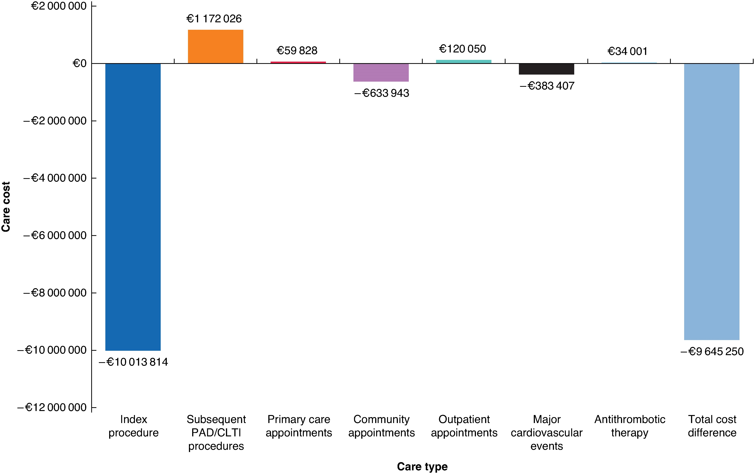
Major Amputation is Expensive
Avoiding amputation has potential for substantial cost savings
Annual Incremental Changes in Cost in the Hypothetical Scenario
Economic impact of limb-salvage strategies in chronic limb-threatening ischaemia: modelling and budget impact study based on national registry data
Study Design | Budget impact analysis for primary surgical procedures for CLTI Modelled scenario reduced major amputation rates in favor of other limb-salvaging revascularization types
Setting | England & Wales National Health Service (NHS)
Time horizon | 12 Months
Amputation procedures were the main cost driver
Decreased hypothetical amputation rate for CLTI associated with savings of more than €9 million for NHS in a year
Saratzis A, et al. BJS Open. 2024;8(5):zrae099.
Notes:
A recent budget impact analysis quantified healthcare costs associated with major amputations and demonstrated procedure costs were the main cost driver. They showed potential for substantial savings in a scenario where amputations were avoided.
Notes
In the analysis by Saratzis et al, the modelled scenario shifted national rates of major amputation from 10% to 3% in favor of angioplasty, open bypass, or arterial endarterectomy. Hypothetical scenario: Use lowest amputation rate with the difference re-distributed across other limb-salvaging revascularization types, weighted proportionately.
Savings for index procedures, community care and major CV events offset increased costs for use of primary care, outpatient appointments and subsequent surgery, for substantial overall savings. Compared with the procedure savings, differences in costs associated with other care pathway elements were relatively small.
Reference
Saratzis A, Zayed H, Buylova A, Rawlinson W, Veliu G, Siebert M. Economic impact of limb-salvage strategies in chronic limb-threatening ischaemia: modelling and budget impact study based on national registry data. BJS Open. 2024;8(5):zrae099. doi:10.1093/bjsopen/zrae099
https://pubmed.ncbi.nlm.nih.gov/39291605/

Slide 18
ACC/AHA Guidelines
Individuals at risk for LE PAD should be screened
Age <50yrs with DM and one other ather-s risk factor (smoking, dyslipidemia, HTN, or hyperhomocysteinemia)
Age 50-69 yrs and h/o smoking or DM
Age 65 yrs and older
Leg symptoms with exertion or ischemic rest pain
Abnormal lower extremity pulse examination
Known atherosclerotic coronary, carotid, or renal arterial disease
ACC/AHA PAD Guidelines, 2011

Slide 19
ACC/AHA Guideline for the Management of PAD:
Treatment of Claudication
Confirmed PAD Diagnosis
No significant functional disability
Lifestyle-limiting symptoms
Lifestyle-limiting symptoms with evidence of inflow disease
Pharmacological therapy:
Cilostazol
No claudication treatment required.
Follow-up visits at least annually to monitor for development of leg, coronary, or cerebrovascular ischemic symptoms.
Supervised
exercise program
Further anatomic definition by more extensive noninvasive or angiographic diagnostic techniques
Three-month trial
Three-month trial
Preprogram and postprogram exercise testing for efficacy
Endovascular
therapy or surgical bypass per anatomy
Clinical improvement:
Follow-up visits
at least annually
Significant disability despite medical therapy and/or inflow endovascular therapy, with documentation of outflow PAD, with favorable procedural anatomy and procedural risk-benefit ratio
Evaluation for additional endovascular or surgical revascularization
Hirsch AT, et al. J Am Coll Cdiol. 2006;47:e1-e192.

Slide 20
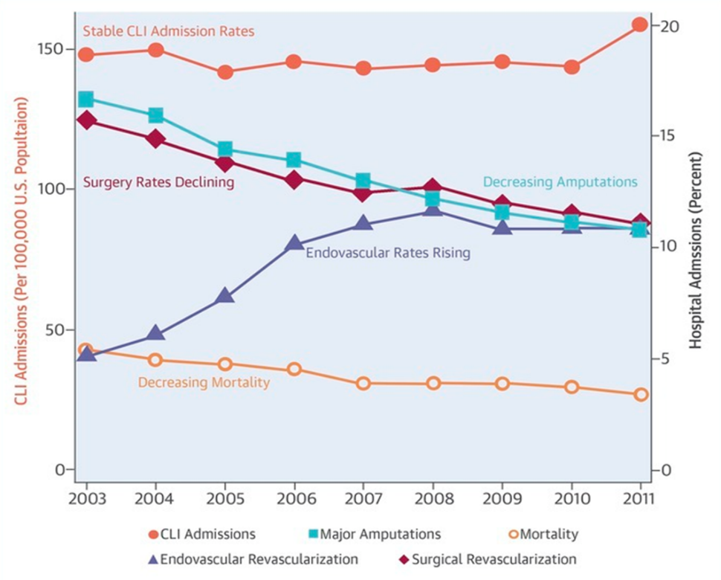
Trends in CLI Hospital Admissions and Outcomes
United States
Analysis included 642,433 CLI admissions from 2003 to 2011
Constant annual CLI admission rate (∼150 per 100,000 people in the US)
Significant reduction in the proportion of patients undergoing surgical revascularization
Increased rate of endovascular revascularization
Reduced incidence of in-hospital mortality and major amputation
Agarwal S, et al. J Am Coll Cardiol. 2016 Apr 26;67(16):1901-13
Notes:
While CLI-related admissions have remained stable, there is a significant reduction in the percentage of patients undergoing surgical intervention and an increasing percentage of endovascular revascularization
Parallel to this, there has been a reduction in the incidence of both in-hospital mortality and major amputation
Sources:
https://pubmed.ncbi.nlm.nih.gov/27012780/
Agarwal S, Sud K, Shishehbor MH. Nationwide Trends of Hospital Admission and Outcomes Among Critical Limb Ischemia Patients: From 2003-2011. J Am Coll Cardiol. 2016 Apr 26;67(16):1901-13. doi: 0.1016/j.jacc.2016.02.040. PubMed PMID: 27012780.

Slide 21

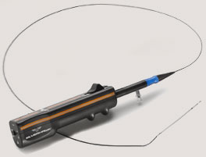


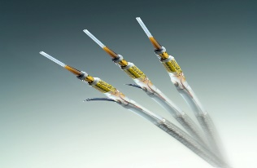
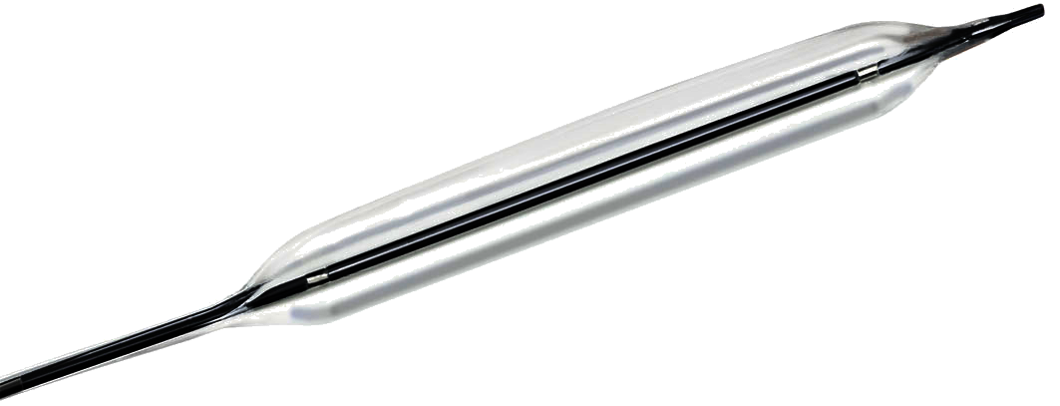

Endovascular Toolbox
Balloons: cutting, cryo, DEB
Stents: Fracture Resistant (Drug Eluting)
Atherectomy:
  Directional, Orbital, Rotational
  Laser
“Specialized” re-entry Devices for Subintimal CTO Crossing
“Specialized” CTO crossing devices
Pedal Access Devices

Slide 22
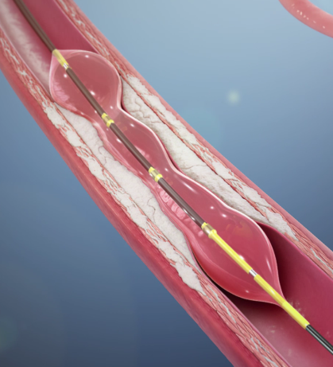
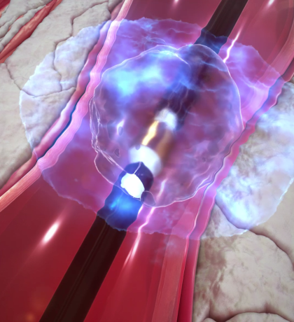
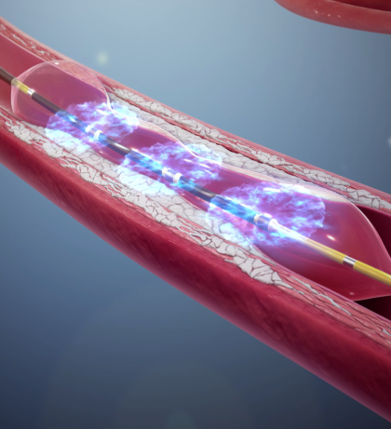
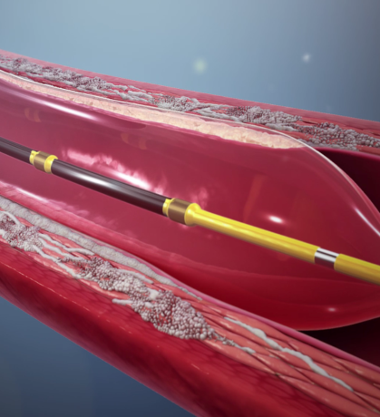
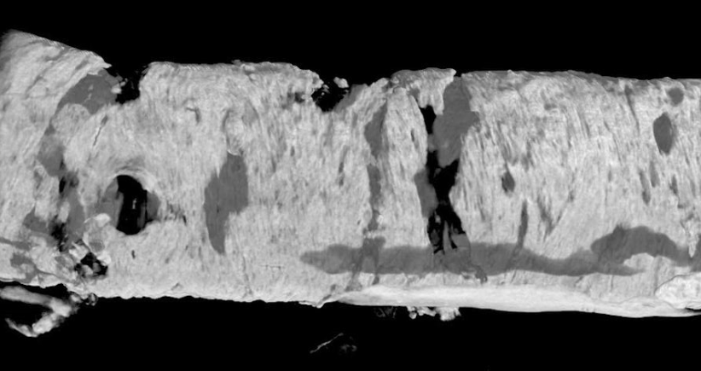
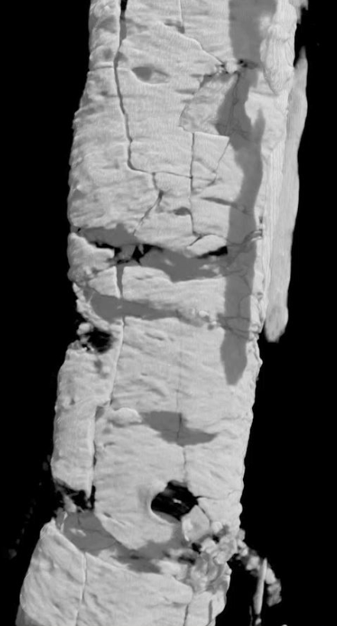

Intravascular Lithotripsy
IVL
Delivers 1 pulse/sec at effective pressure of ~50 atm
Balloon maintained at a low inflation pressure
Deliver catheter and inflate to low pressure
Generate sonic
pressure waves using lithotripsy
Crack
calcium
Safely expand
the vessel
Fractures both superficial and deep calcium
Pre-IVL Treatment*
Post-IVL Treatment*
*Micro-CT scan analysis: R. Virmani, CV Path Institute

Slide 23

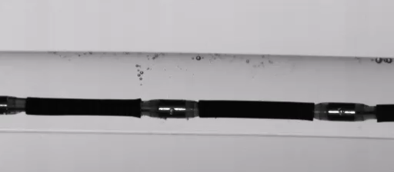
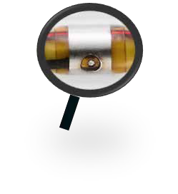


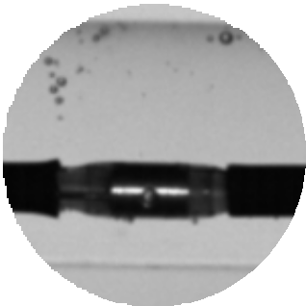


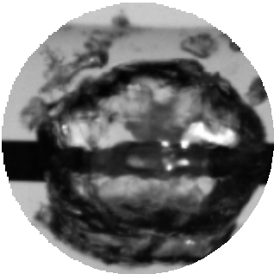
IVL’s Unique Mechanism of Action
High Speed Sonic Pressure Wave Created Safely Inside Integrated Balloon
1
Unfocused lithotripsy energy is created at the emitters which are contained in a fluid filled coupler.
2
Electrical energy is delivered to the emitter, initiating the vapour bubble, which expands
& collapses – creating sonic pressure waves.
Fluid filled Balloon
Video: Actuation of Single Pulse (20µs/frame)

Slide 24
Case2: 86F with CAD, s/p AVR, Afib, HTN developed large and deep ulcer of the right anterior surface of the ankle and dorsum of the foot
Admitted initially to OH where Fem-pop bypass was done with no effect on ulcer healing or improvement in rest pain
Amputation was then recommended
Patient left hospital AMA and presented to our clinic for second opinion.
On exam deep ulcer, size 8x17 cm

Slide 25
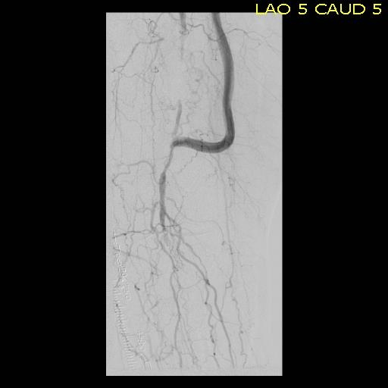
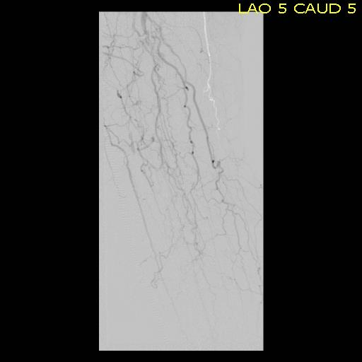
Distal Angiogram Explains why Fem-Pop Bypass Did Not Work

Slide 26
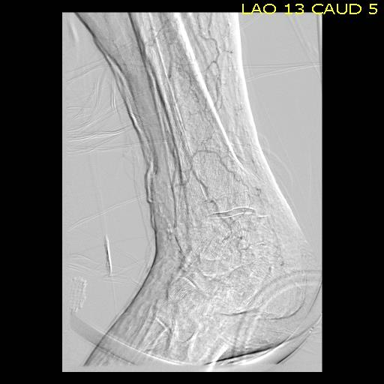
Foot angio difficult to perform, pt was moving due to rest pain despite sedatives and analgesics

Slide 27
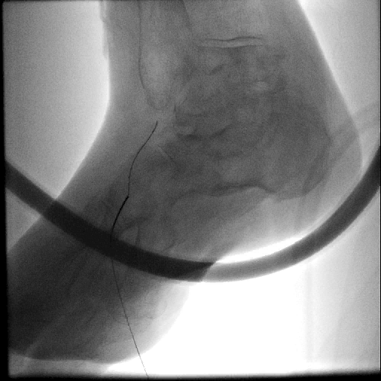
Using US and angio DP access was obtained

Slide 28
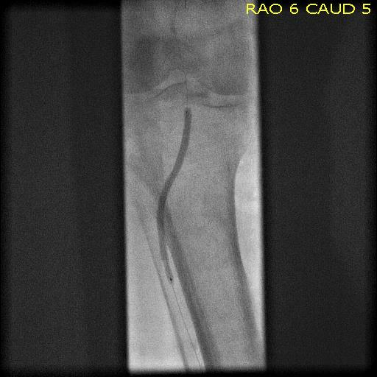
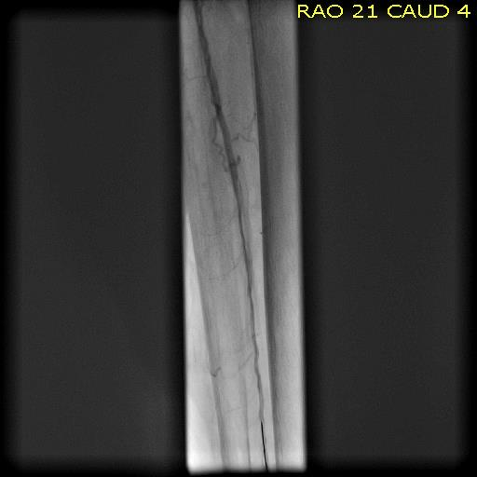
Wire crossed CTO retrograde and was externalized, PTA/stenting performed with restoration of the antegrade flow

Slide 29
Outcome
After procedure rest pain completely resolved
ABI index 1.12
Ulcer completely healed with skin graft used

Slide 30
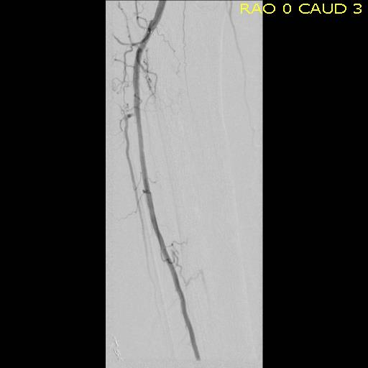
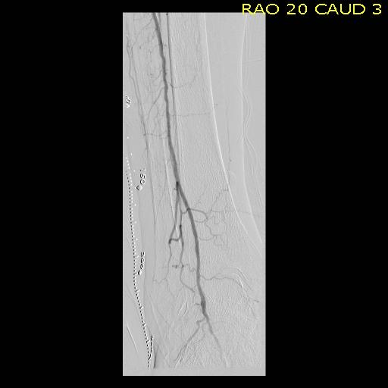
5 years later

Slide 31
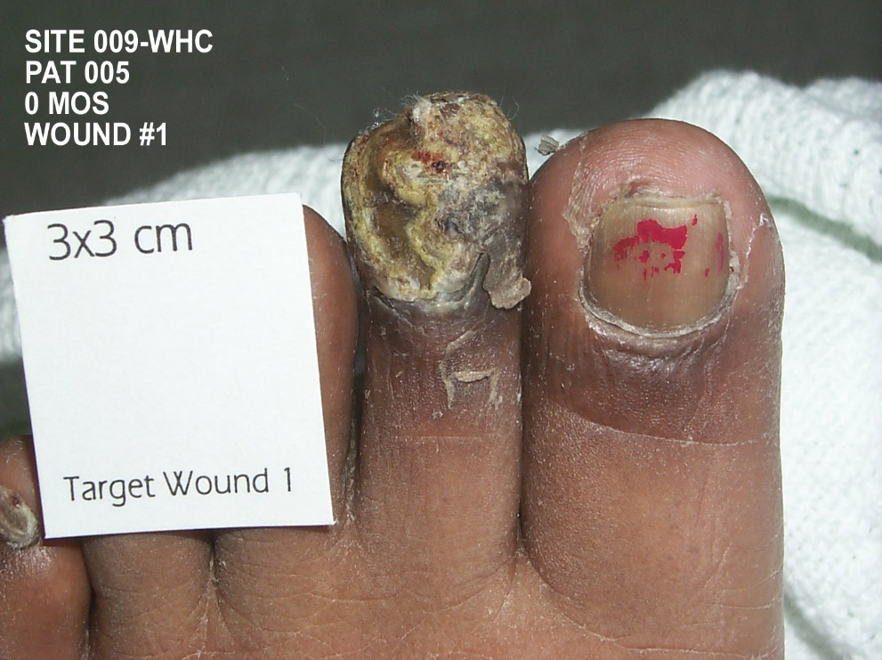
Case 3:
45 year old female
Diabetes mellitus, morbid obesity
Distal popliteal occlusion, tibial disease
Painful, ischemic 2nd toe

Slide 32
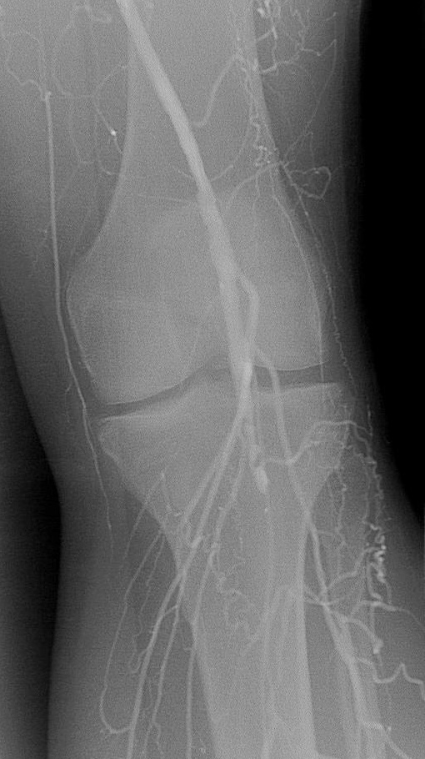
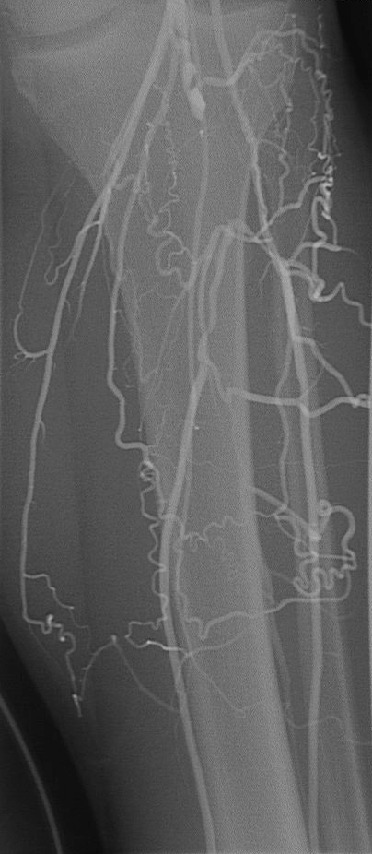
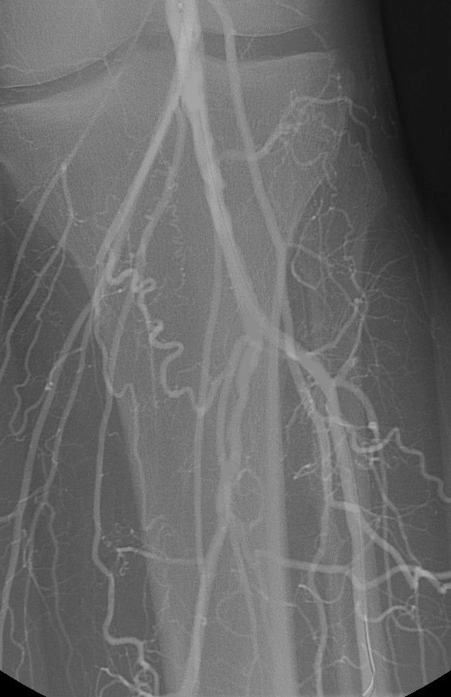

Slide 33
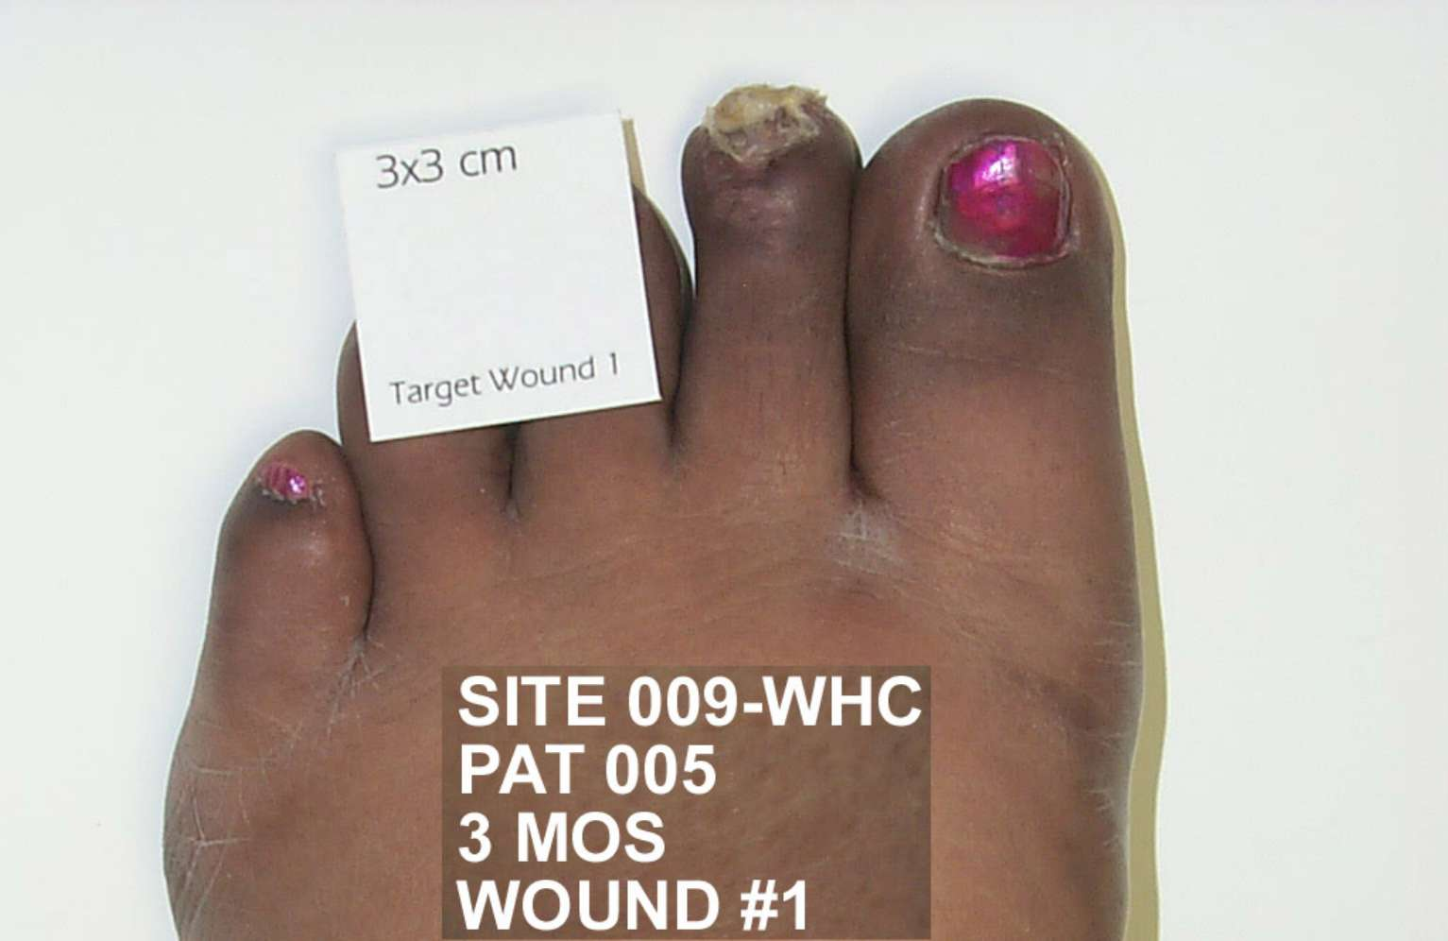
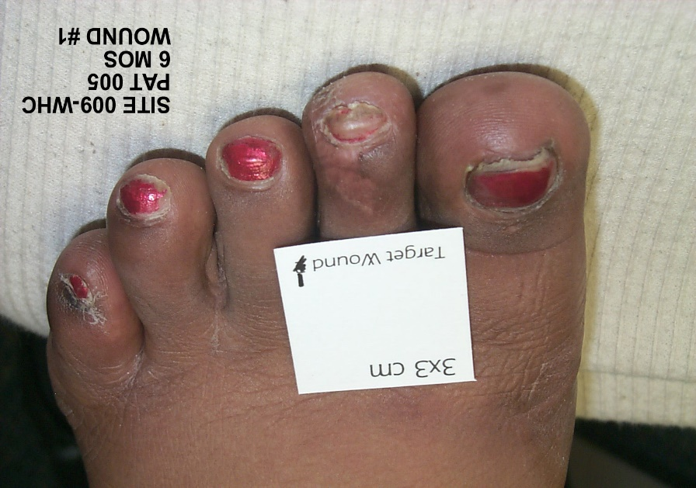
3-month Follow-Up
6-month Follow-Up

Slide 34

“Peripheral Arterial Disease is Equally Important to American Health as Heart Disease Itself”
Alan Hirsh, MD., NY Times

Slide 35

Thank you
Anvar Babaev, MD, PHD

