Slide 1
Cardiogenic Shock
Dana C. Aiello, M.D., MSc.
St. Joseph's Hospital Health Center

Slide 2
Disclosures
No relevant financial disclosures

Slide 3
Outline
Introduction
Pathophysiology
Etiology/Risk Factors
Clinical Presentation and Diagnosis
Management and Treatment
Prognosis and Prevention
Conclusion and Q&A

Slide 4
Introduction
Definition of cardiogenic shock
Complex syndrome characterized by low cardiac output resulting in tissue hypoperfusion
Importance in critical care and cardiology
Often results in serious injury, multisystem organ failure, and death
Brief Overview of incidence and Mortality
5-10% of cases of acute MI
Leading cause of death after MI
Acute MI accounts for 81% of patients in CS
Mortality widely cited as ~50% !!
408 in 100k hospitalizations
Notes:
2-3 min

Slide 5
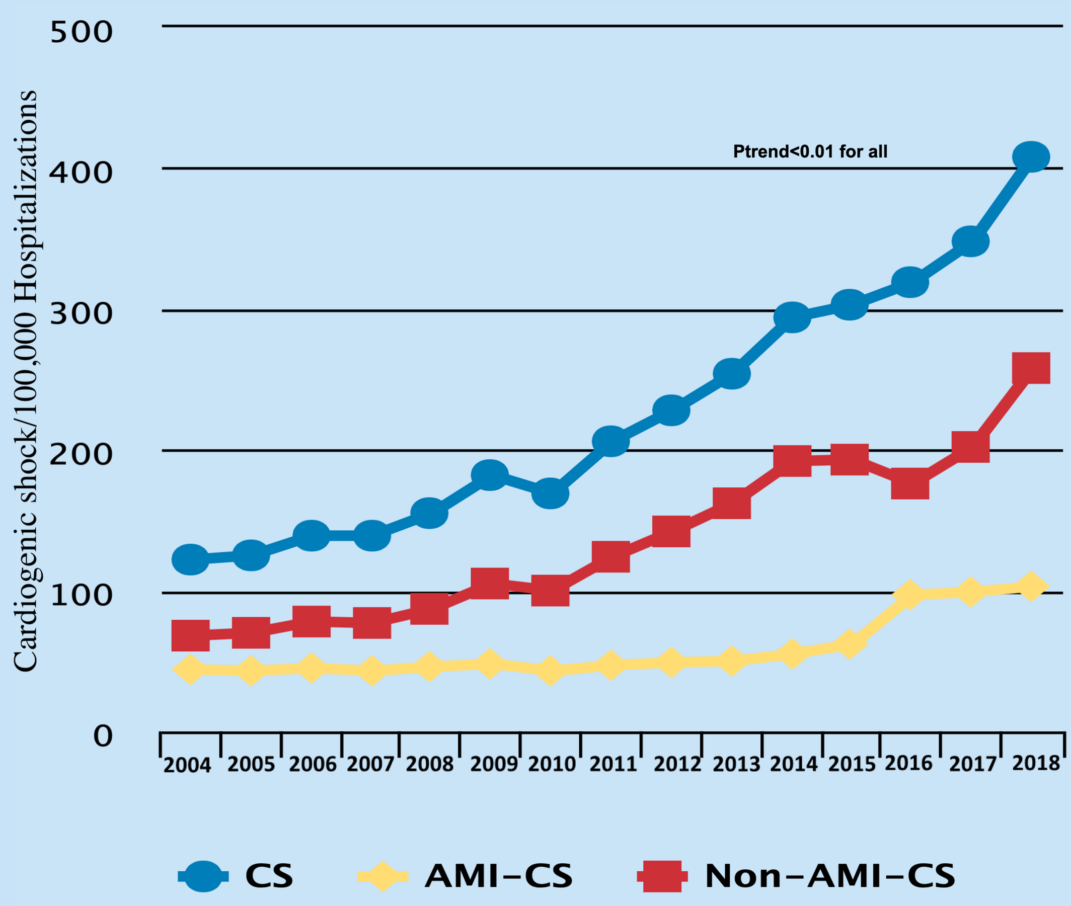
Notes:
https://www.ahajournals.org/doi/10.1161/JAHA.121.021061

Slide 6
Pathophysiology
Primary mechanisms: pump failure, decreased CO, inadequate tissue perfusion
Compensatory responses (sympathetic activation, RAAS)
Hemodynamic parameters ( CO, SVR, PCWP)
Notes:
4-5 min

Slide 7
Shock physiology
Tissue Perfusion
SBP
CO
SVR
BP = CO x SVR
CO = HR x SV
SV determined by
Preload
Afterload
Contractility
SVR
Vessel length
Blood viscosity
Vessel tone (diameter)

Slide 8
Etiology and Risk Factors
Common causes
Acute MI (most common)
Arrhythmias
Valvular disease
Myocarditis
Cardiomyopathies
Predisposing conditions
CAD
Prior MI
Heart failure
Notes:
3-4 min

Slide 9
Clinical Presentation and Diagnosis
Signs and symptoms
Hypotension
Cold/clammy skin
Altered mental status
Oliguria/anuria
Key diagnostic criteria
SBP <90mmHg
CI <2.2 L/min/m²
PCWP >15mmHg
Diagnostic tools
ECG
Echocardiography
Hemodynamic monitoring (PA catheter)
Biomarkers (troponin, BNP)
Notes:
4-5 min

Slide 10
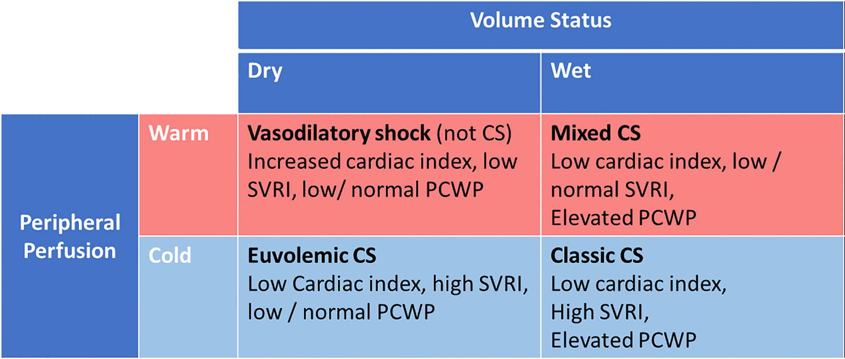
Notes:
https://doi.org/10.1002/ccd.28329

Slide 11
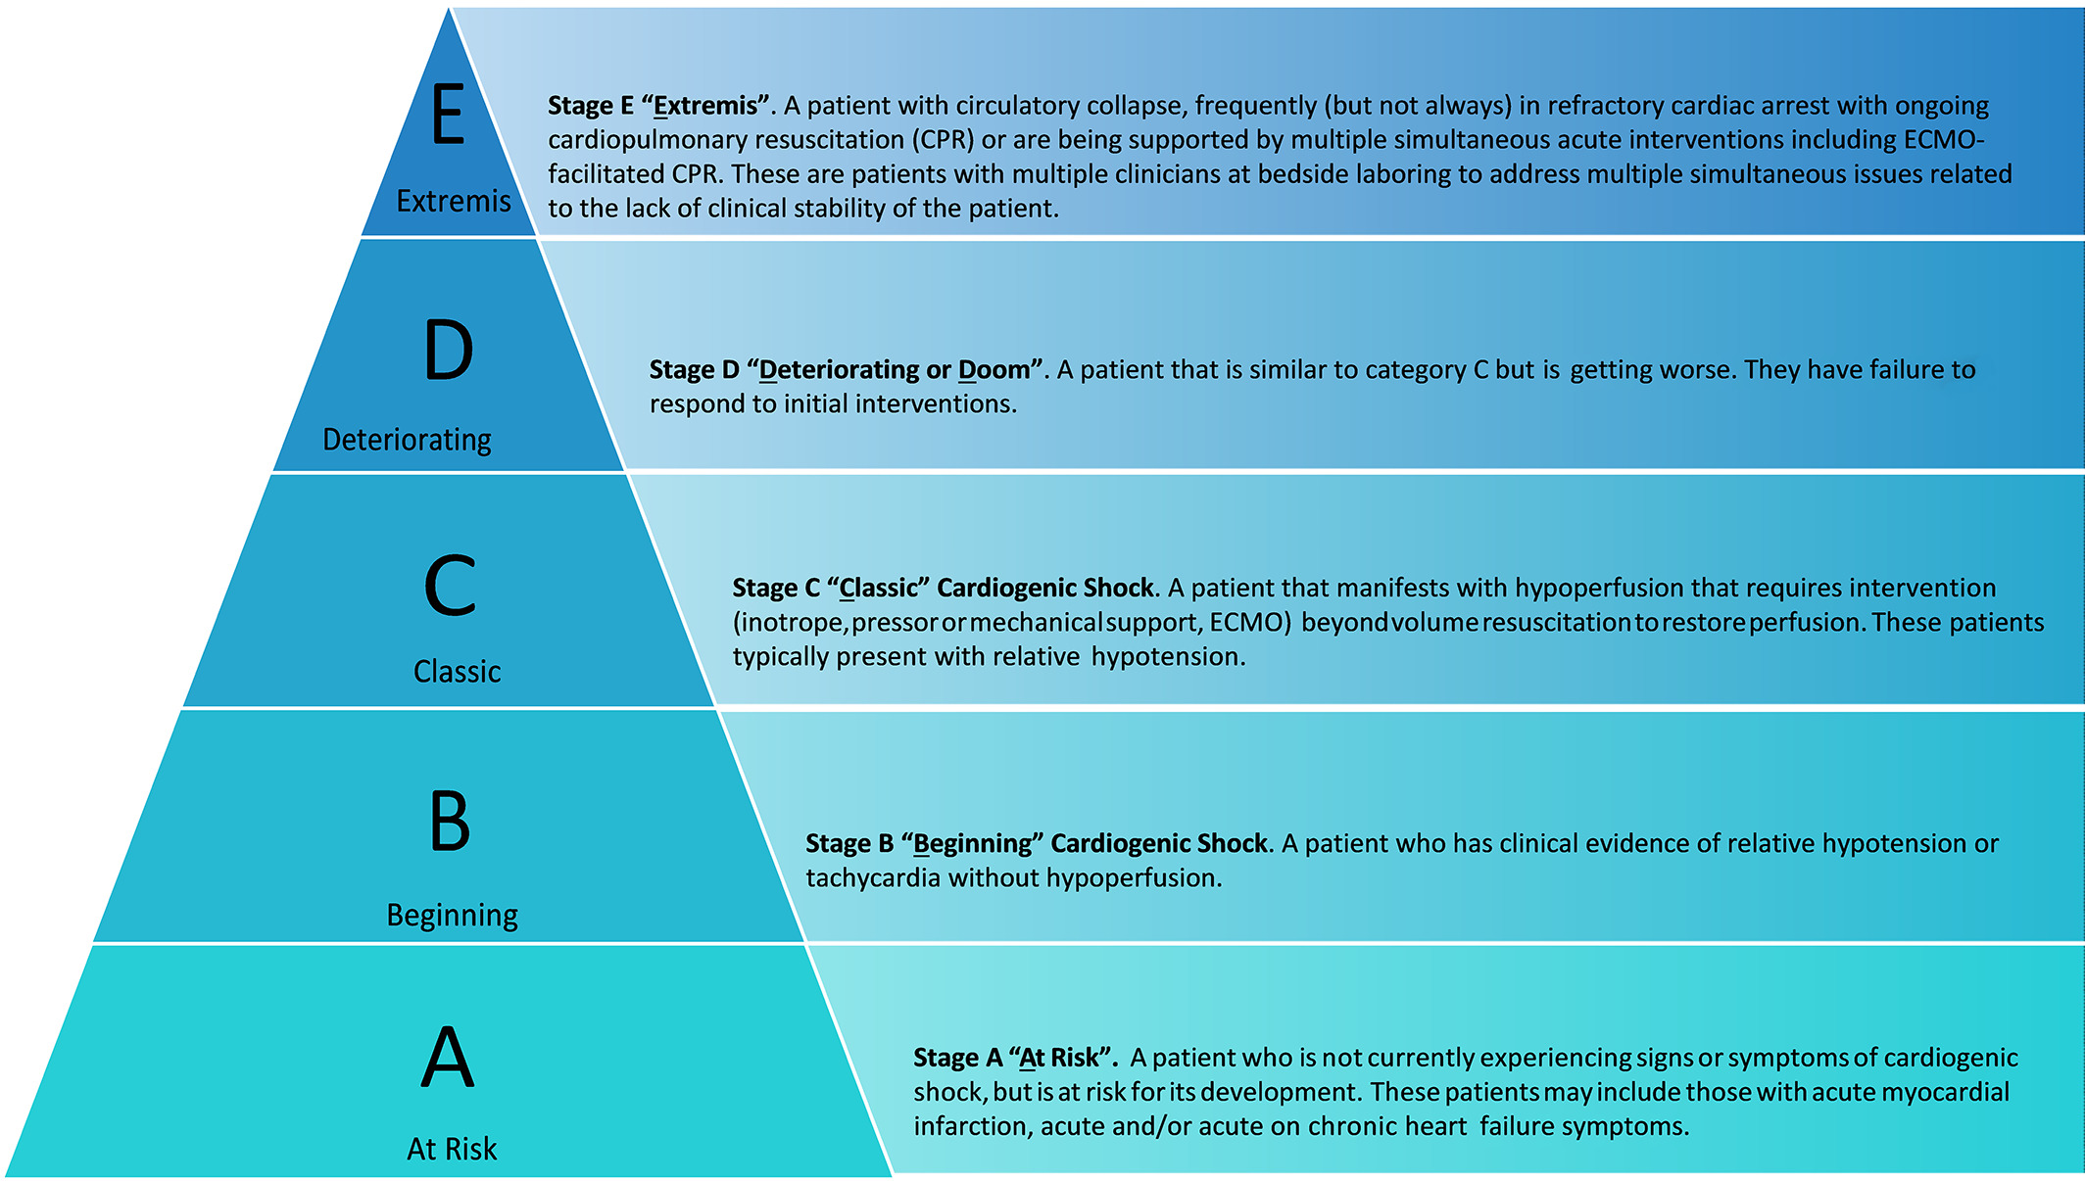
Classification of Cardiogenic Shock
No previous classification
SCAI developed in 2019

Slide 12
Management and Treatment
General Principles:
Pharmacologic support
Inotropes (dobutamine, milrinone)
Vasopressors (norepinephrine, dopamine)
Diuretics (if pulmonary congestion)
Mechanical support
IABP
Microaxial pump (Impella)
ECMO
Definitive interventions
Revascularization (PCI, CABG)
Valve replacement/repair
Advanced HF therapies (LVAD, transplant)
hemodynamic stabilization
ABCs
Notes:
5-6 min

Slide 13
Prognosis and Prevention
Mortality rates and factors affecting outcomes
Strategies for early recognition and intervention
Prevention of cardiogenic shock in high-risk patients
Notes:
2-3 min

Slide 14
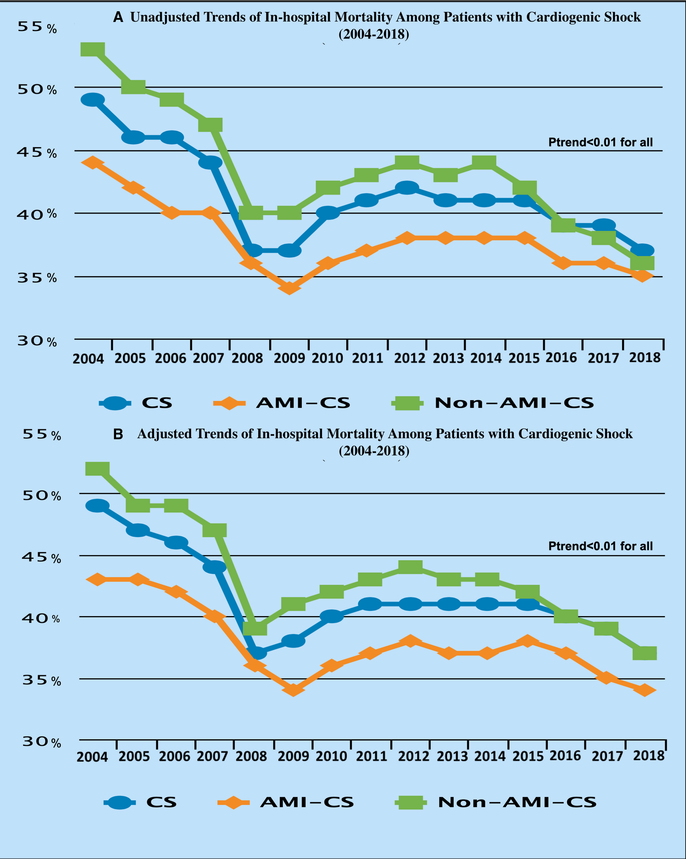
Notes:
https://www.ahajournals.org/doi/10.1161/JAHA.121.021061

Slide 15
Factors Effecting Outcomes
>90% of CS patients are on at least 1 vasoactive agent
Notes:
https://doi.org/10.1161/JAHA.123.029787

Slide 16
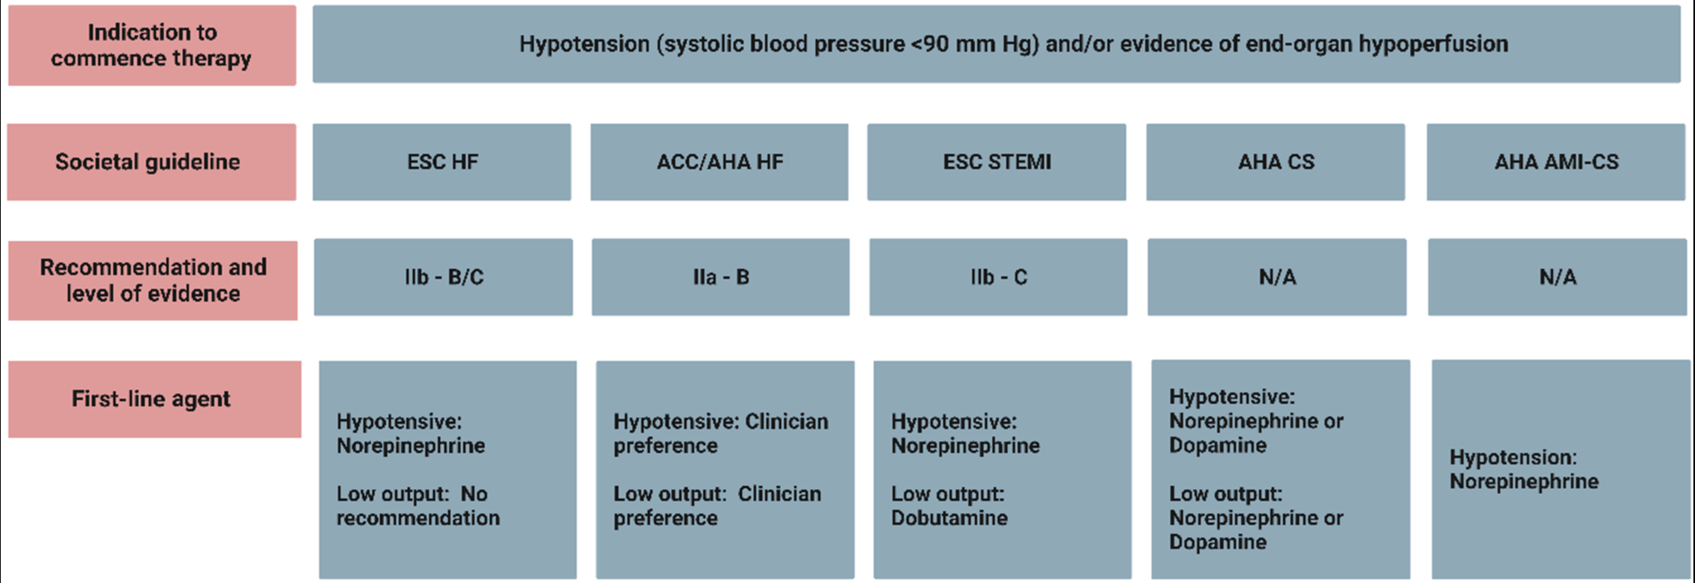

Slide 17
Other factors affecting mortality
Shock team
Independently associated with lower CICU mortality (23% vs 29%; adjusted OR: 0.72; 95% CI: 0.55-0.94; P = 0.016).¹
PA Catheters
In a large multicenter registry representing real-world patients with CS in the contemporary MCS era, use of complete PAC-derived hemodynamic data prior to MCS initiation was associated with improved survival from CS²
Notes:
Papolos AI, Kenigsberg BB, Berg DD, Alviar CL, Bohula E, Burke JA, Carnicelli AP, Chaudhry SP, Drakos S, Gerber DA, Guo J, Horowitz JM, Katz JN, Keeley EC, Metkus TS, Nativi-Nicolau J, Snell JR, Sinha SS, Tymchak WJ, Van Diepen S, Morrow DA, Barnett CF, Critical Care Cardiology Trials Network Investigators J Am Coll Cardiol. 2021;78(13):1309.
2. Garan AR, Kanwar M, Thayer KL, Whitehead E, Zweck E, Hernandez-Montfort J, Mahr C, Haywood JL, Harwani NM, Wencker D, Sinha SS, Vorovich E, Abraham J, O'Neill W, Burkhoff D, Kapur NK JACC Heart Fail. 2020;8(11):903.

Slide 18
Mechanical Circulatory Support
DanGer-Shock: Microaxial flow pump (Impella CP)
Lower all-cause mortality at 180d
Higher device related events (severe bleeding, limb ischemia, hemolysis, device failure, AI) and need for RRT
ECLS-Shock
Mortality rates similar (49 v 48%)
ECLS relative risk 2.8 for ischemic events
1 year mortality also unchanged
IABP-Shock II
Mortality rates similar (40 v 41%)
No difference in secondary endpoints (ICU LOS, kidney fxn, bleeding, limb ischemia, sepsis, CVA)

Slide 19
Early Recognition and Intervention
Suspicion based on risk factors
History of CHF/current CHF
Current myocardial infarction
History of valvular heart disease
History of CAD
Clinical exam is important (even before hypotension)
Cool extremities
Low urine output
AMS
Distended neck veins
Labs
Elevated lactate
BNP / NT-proBNP
LFTs
Renal function

Slide 20
Prevention Strategies
Recognize risk factors (SCAI stage A) and treat appropriately
Reperfusion therapy
PCI
Thrombolytics
Surgical revascularization
Early referrals for CS risk factors
Valvular disease. TAVR has changed the game a lot
CAD

Slide 21
Conclusion and Q&A
Key takeaways
Emphasis on early diagnosis and aggressive management
Open for questions
Notes:
2-3 min

