Slide 1
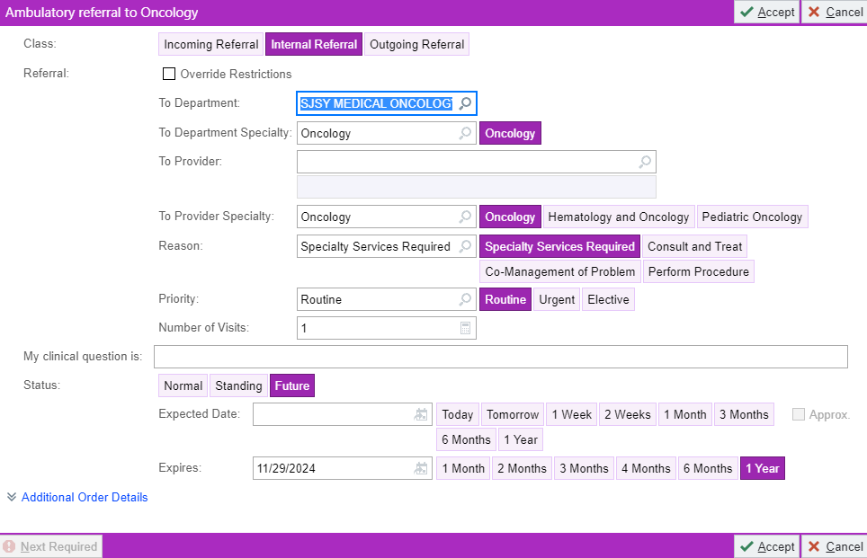
St. Joseph’s Health Cancer Care
A Roswell Park Cancer Care Site
Referrals are entered into epic: sjsy medical oncology
To Dept: Must be filled for it to go to the work que
St. Joseph’s Health Cancer Care & Infusion Center 301 Prospect Avenue Syracuse, NY 13203 (P) 315.448.6188 |
(F) 315.703.2403

