Slide 1
Event reporting education
Midas RDE Purpose and Use
Event Reporting Education July 2023

Slide 2
Why Event reporting matters
Event reporting education July 2023

Slide 3
Why we report:
Reporting events that cause harm or could have caused harm identifies organizational weaknesses.
When we identify our areas of risk, we can develop action plans to mitigate further risk
Reporting supports a physically and emotionally safer workplace.
Reporting allows us to identify situations such as unsafe practices, environmental concerns, equipment malfunctions, processes with gaps, the causes of human error and latent safety problems
Reporting leads to improved care standards and facilitates learning
Event reporting education July 2023

Slide 4
What does the organization do with the reports?
The Risk Management team reviews every Midas (aka Event Report) that is entered.
How Midas entries are processed
Risk Management runs a report of the previous day’s Midas entries every morning Monday through Friday. The entire team reviews the entries, conducts chart reviews when needed, discusses, debates and determines what needs to be escalated based on actual or potential harm and other factors.
All Midas entries are referred to the location of origin and reviewed at the unit level. Some are referred to involved units. Unit Event Managers are responsible for completing documentation related to the findings and follow up on every Midas that is entered.
Midas entries that meet specific criteria are reported to NYS, sent for Peer Review, unit level Clinical Case Review or Track and Trend, or may be escalated to System Office via an SBAR.
Event reporting education July 2023

Slide 5
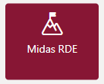
Important facts about entering a Midas (aka Event Report)
Midas RDE is found on the SJHEN homepage and in ZENworks
Midas entries can be placed ANONYMOUSLY. The reporter is protected from any form of retaliation, intimidation or retribution.
Midas entries should be placed immediately upon discovery of an event or a near miss (or as soon as possible after an event/near miss, keeping in mind that the care of the patient, staff or visitor always comes first).
People who are directly involved in an event or who witness an event should complete the Midas entry. All staff members are encouraged to report events via Midas.
The description of the event should be clear and concise, only stating the facts. A chart review will be conducted and someone from Risk Management will reach out as needed to obtain more information.
Events that involve a patient (directly or indirectly) should always be entered under the patient’s name and correct encounter date.
Utilize the “Witness” and “Attribution” tabs to identify staff members. Do not enter staff names in the description of the event.
Event reporting education July 2023

Slide 6
How to enter a Midas
Tools and tips
Event reporting education July 2023

Slide 7
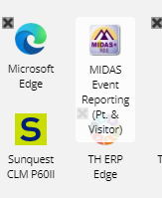
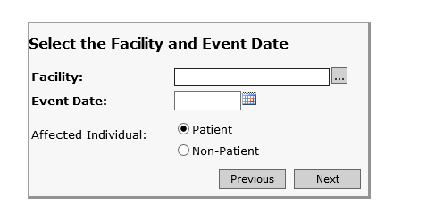
Midas RDE is found on the SJHEN homepage and in the ZENworks app.
Click either app to get to the Event Report-Remote Data Entry page where you will choose the event type. Click the event type that best describes the event that occurred.
Enter jnpl then click Tab. The Facility will auto-fill with NY-St Josephs Health
Enter the Event Date and choose Patient (whether a patient is directly or indirectly involved) or Non-Patient,
Click Next
Event reporting education July 2023

Slide 8
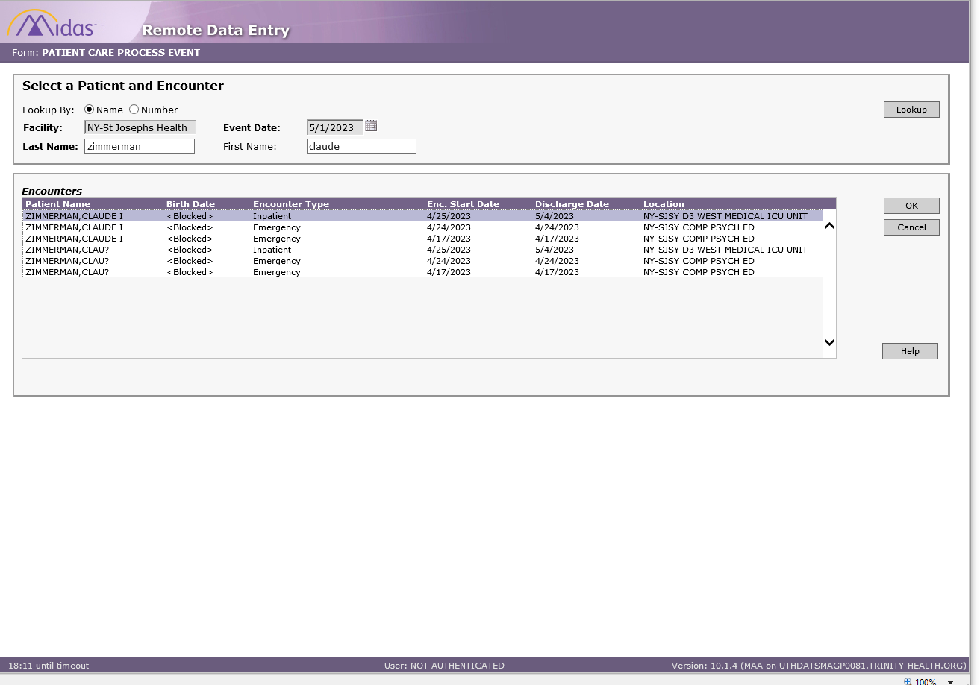
Select a Patient and Encounter
Enter the patient’s Last name and First name then click Lookup. It may take a few seconds to load.
Click the appropriate Encounter
Click OK

Slide 9
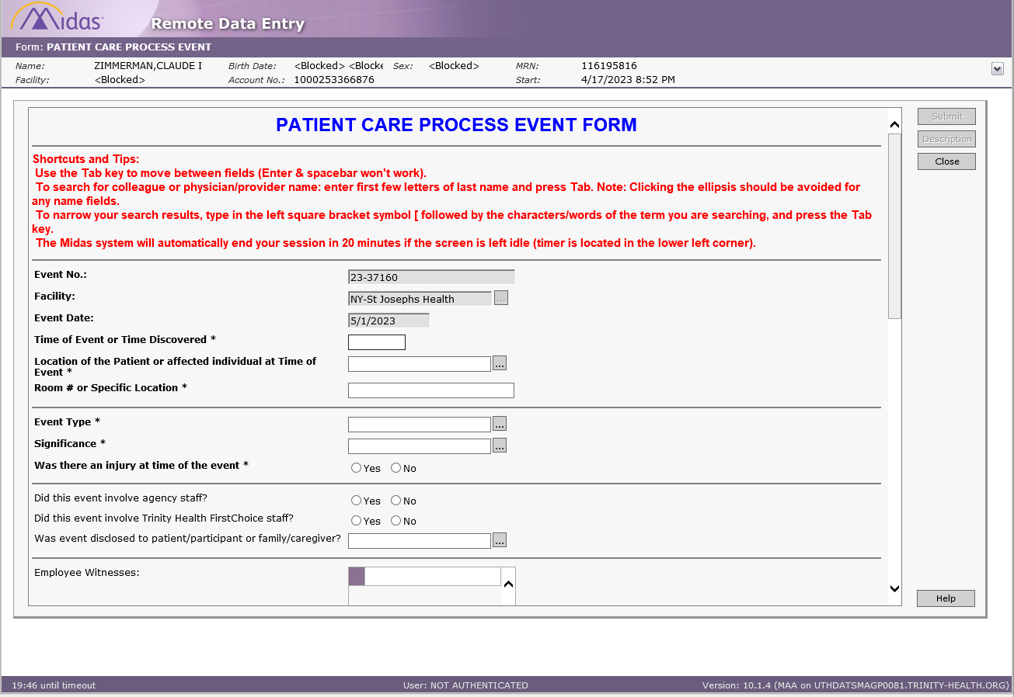
Complete the required fields
The BOLD fields are required.
You have 20 minutes to complete the Midas entry before it times out, the timer is at the bottom left.

Slide 10
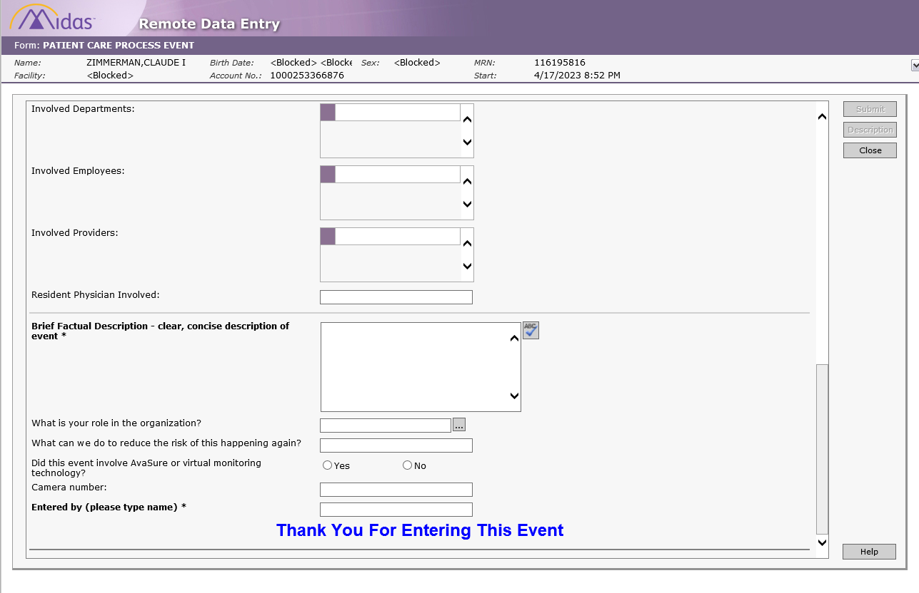
Your description of the event should be clear and concise.
Examples of clear and concise descriptions:
Return to the OR, concern for injury caused by the Trochar
Provider notification not received on critical CMP lab results
Order was placed for STAT antibiotics to be initiated due to sepsis. There was a 4 hours delay in administering the abx.
Consult placed to [xx] service. No communication to Attending related to delay in assessing the patient
In reviewing the hospital course, I am concerned about the lack of communication and follow up related to the complication experienced during surgery.
Once the BOLD fields are completed the Submit button will highlight, click Submit to complete your Midas entry.
You CAN enter ANONYMOUS

Slide 11
For more information about why reporting safety events matters the linked article from the Agency for Healthcare Research and Quality titled “Reporting Patient Safety Events” is a quick read.
https://psnet.ahrq.gov/primer/reporting-patient-safety-events
If you need assistance or have further questions, please contact someone on the Risk Management team.
In house extensions 83588, 86282, 85786
Event reporting Education July 2023

